Slide 1


Similarities: C Corp. Vs. Individual
  Gross Income of a corporation and individual are very similar
    Includes compensation for services, income from trade or business, gains from property, interest, dividends, etc
    Fewer exclusions for corporation
    Nontaxable exchange treatment is similar
  Business deductions of a corporation and individual also are very similar:
    interest (subject to the certain limitation) taxes, losses (including casualty and theft losses), bad debts, cost recovery, charitable contributions, net operating losses, research and experimental expenditures, and some other less common deductions.
    Corporations ➔ no distinction between business and nonbusiness bad debts.
    Like individuals, corporations are not allowed an interest expense deduction if tax-exempt securities are purchased with borrowed funds.
    No expense
      for entertainment expense contrary to public policy
      Related parties
      lobbying expenses
    Some of the tax credits available to individuals, such as the foreign tax credit, can also be claimed by corporations.
Visit: farhatlectures.com for complete course: Lectures, MCQs, TF, & Notes

Slide 2
Dissimilarities: C Corp. Vs. Individual
Different tax rates apply (progressive)
Corporate is flat (used to be progressive)
In general, all expenses of corporation are business deductions
    Corporation does not calculate AGI
    No allowed a standard deduction or itemized deductions;
    the deduction for qualified business income* does not apply to corporations (duh!)
    In addition, the TCJA of 2017 adds a limitation on the excess business losses of individuals (which does not apply to corporations)
Not available to corporations credits of personal nature such as:
  the child and dependent tax credits, the credit for elderly or disabled taxpayers, and the earned income credit
Visit: farhatlectures.com for complete course: Lectures, MCQs, TF, & Notes

Slide 3
Side by Side Comparison
Individual
Corporations
Income (broadly defined)
(Exclusion)
= gross Income
(Deductions for AGI)
= AGI
(greater of itemize or standard deduction)
(QBI deduction)
=Taxable income
(Tax credits)
=tax due (or refund)
Income (broadly defined)
(Exclusion)
= gross Income
-Deductions (except NOL and DRD)
=taxable income before NOL and DRD
(NOL)
(DRD)
=taxable income
(Tax credits)
=Tax due (or refund
AGI = Adjusted gross income
NOL = Net Operating Loss
DRD = Dividend Received Deduction
QBI= Qualified Business Income
Visit: farhatlectures.com for complete course: Lectures, MCQs, TF, & Notes

Slide 4
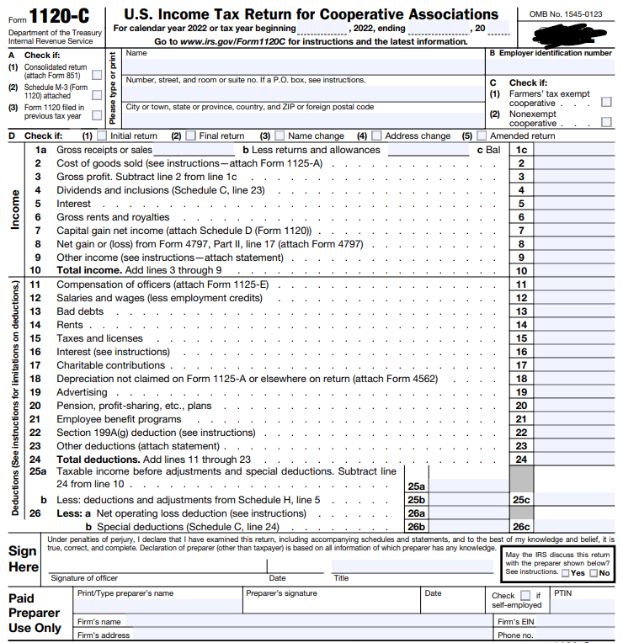
Visit: farhatlectures.com for complete course: Lectures, MCQs, TF, & Notes

Slide 5
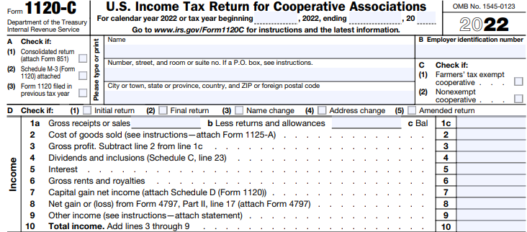

Visit: farhatlectures.com for complete course: Lectures, MCQs, TF, & Notes

Slide 6
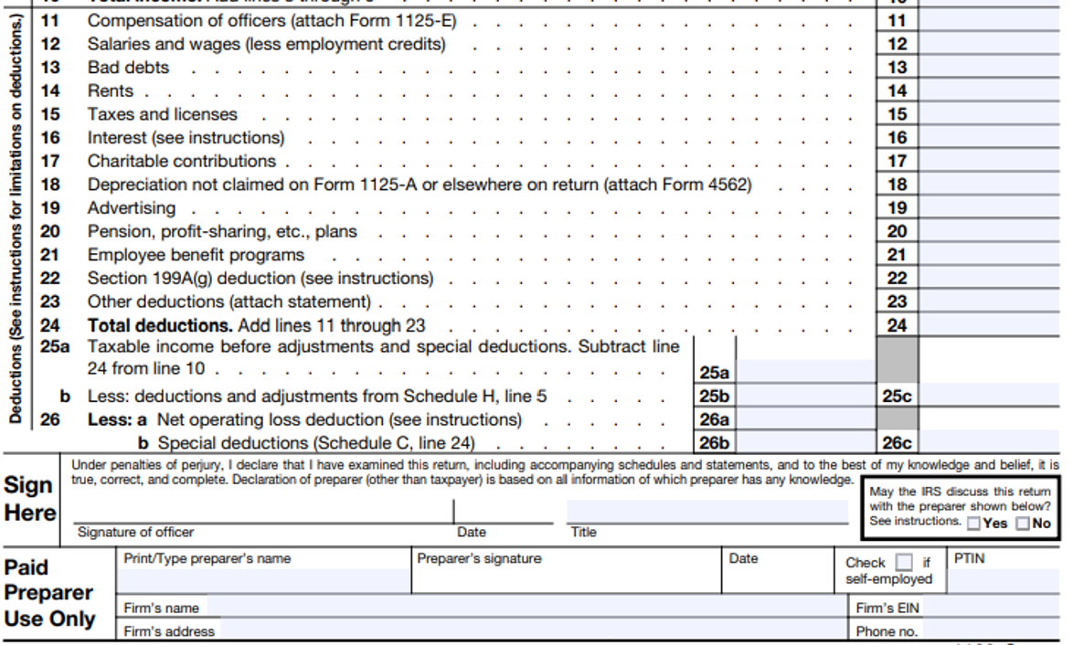
Visit: farhatlectures.com for complete course: Lectures, MCQs, TF, & Notes

Slide 7

Key Differences
In comparing the income taxation of individuals and corporations, the following key differences exist:
  Accounting period and accounting methods
  Capital gains and losses
  Recapture of depreciation
  Business interest expense limitation
  Passive activity losses
  Charitable contributions
  Executive compensation
  Net operating losses
  Special deductions available only to corporations
Visit: farhatlectures.com for complete course: Lectures, MCQs, TF, & Notes

Slide 8

Accounting periods
Accounting periods
  C corporations can use calendar year or fiscal year ending on last day of a calendar month (or 52-53 week year)
  S corporations and Personal Service Corporations (PSC) are limited* in available year ends
A Personal Service Corporation (PSC) is a type of corporation that:
  Is established to offer "personal services" in areas such as health, law, engineering, architecture, accounting, actuarial science, performing arts, or consulting;
  Has the majority of services significantly performed by shareholder-employees;
  Features over 10% of its stock (in value) owned by shareholder-employees.
Visit: farhatlectures.com for complete course: Lectures, MCQs, TF, & Notes

Slide 9
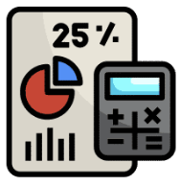
Accounting methods
In general, the cash accounting method is not accessible to corporations, with a few exceptions such as:
  Corporations with an average of $29 million or less in annual gross receipts over the latest three-year period
Typically, businesses that hold inventory for customer sales must use the accrual accounting method to calculate sales and cost of goods sold.
  However, businesses with average annual gross receipts of $29 million or less over the past three years are permitted to use the cash accounting method for inventory management.
The TCJA of 2017 also modifies the rules regarding the timing of gross income by accrual basis taxpayers
    Generally, must recognize gross income no later than the tax year in which such income is included in income for financial statement purposes
Visit: farhatlectures.com for complete course: Lectures, MCQs, TF, & Notes

Slide 10
Key Differences
In comparing the income taxation of individuals and corporations, the following key differences exist:
  Accounting period and accounting methods
  Capital gains and losses
  Recapture of depreciation
  Business interest expense limitation
  Passive activity losses
  Charitable contributions
  Executive compensation
  Net operating losses
  Special deductions available only to corporations
Visit: farhatlectures.com for complete course: Lectures, MCQs, TF, & Notes

