Slide 1
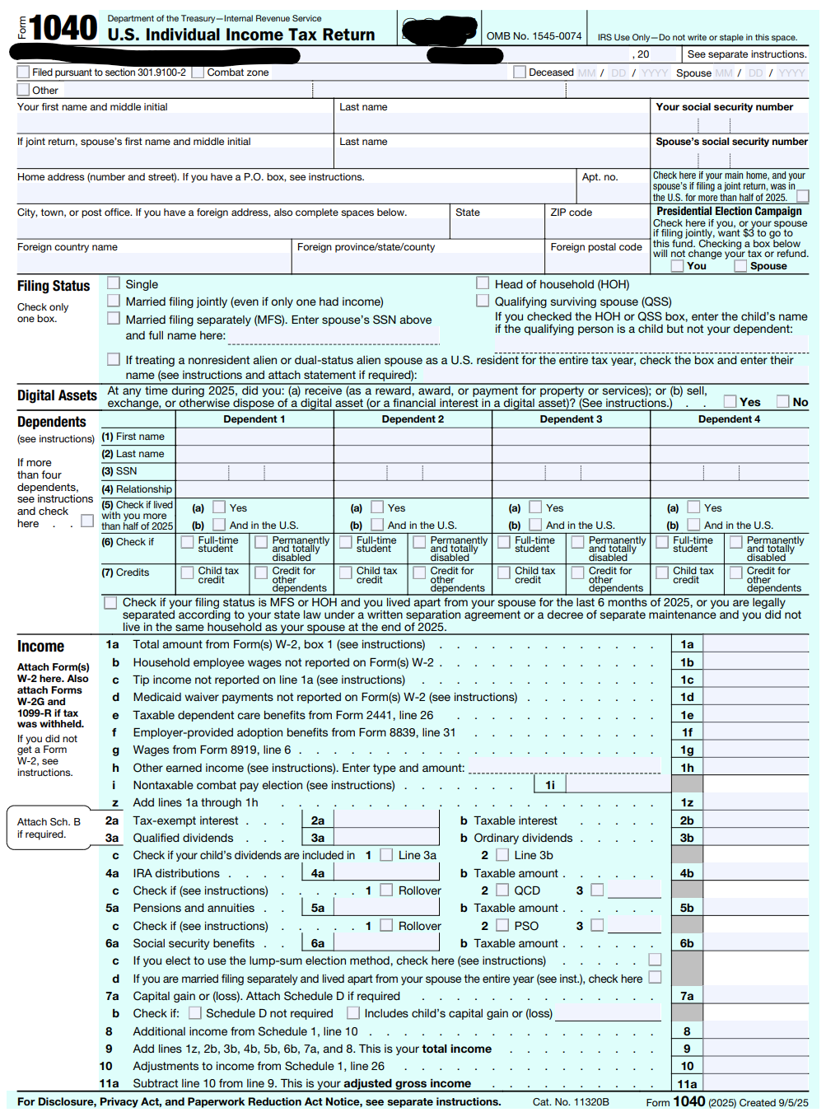

📹 Videos AICPA MCQs & Sims 🤖 Farhat AI Assistant🎙 Podcast Lessons 📊 CPA, CMA, EA Exam 💼Accounting & Finance Courses 🙌 Support by Farhat Team
🌐 farhatlectures.com | ⭐ Start Your Free Trial

Slide 2
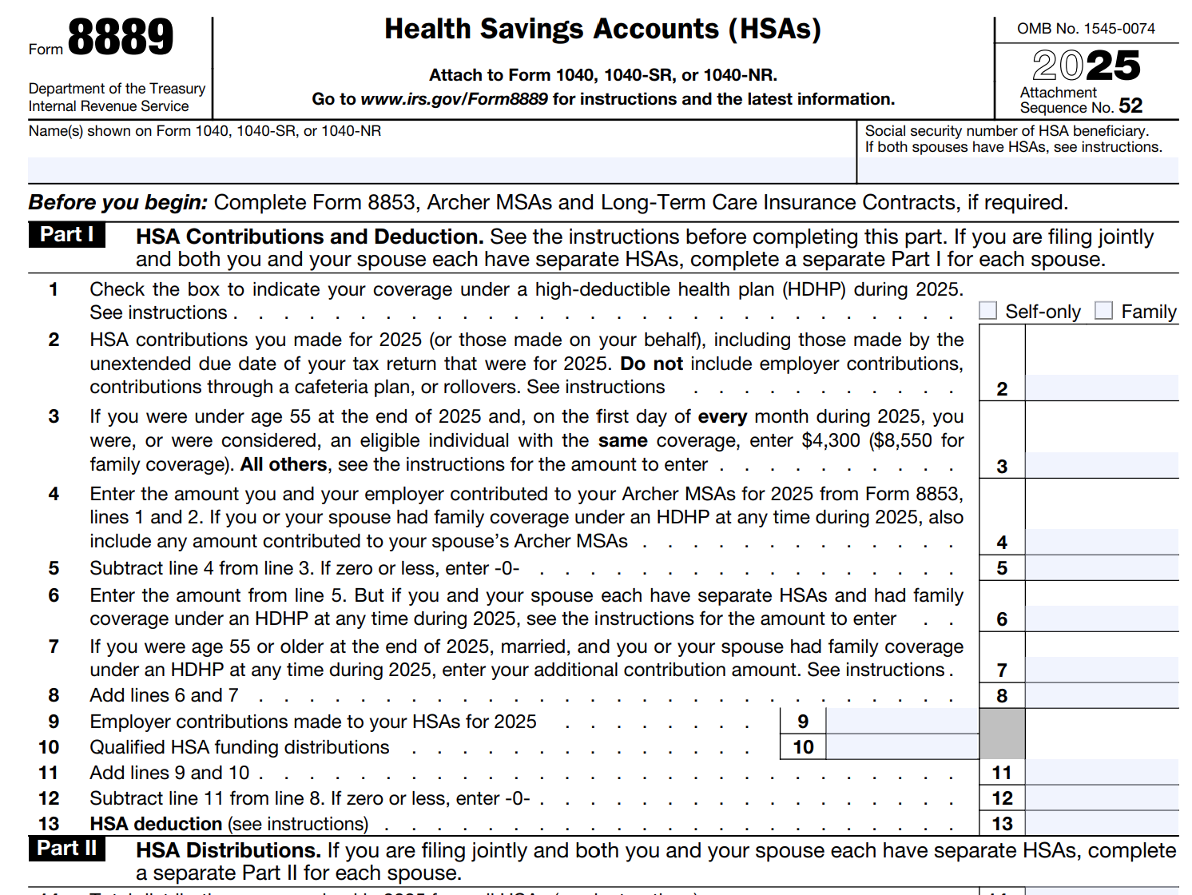
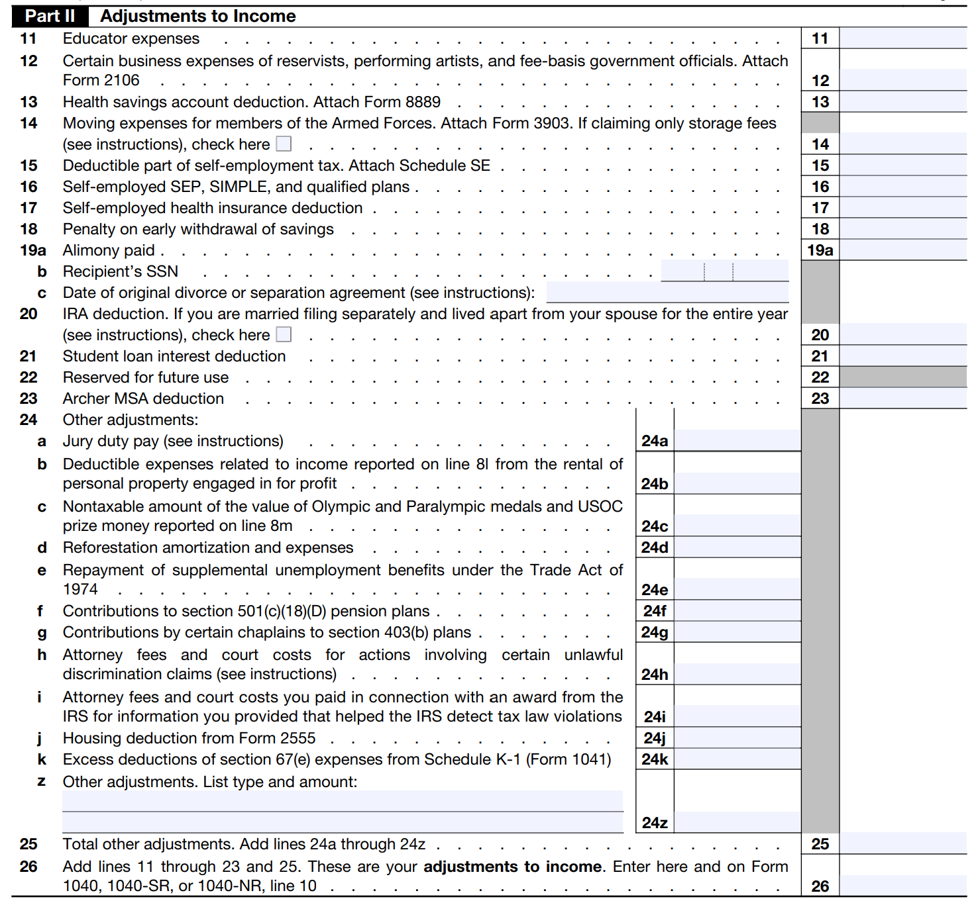
📹 Videos AICPA MCQs & Sims 🤖 Farhat AI Assistant🎙 Podcast Lessons 📊 CPA, CMA, EA Exam 💼Accounting & Finance Courses 🙌 Support by Farhat Team
🌐 farhatlectures.com | ⭐ Start Your Free Trial

Slide 3

Health Savings Account (HSA)
Health Savings Account (HSA) is a personal savings account designed to help you pay for medical costs using money that is never taxed.
Think of it as a "health IRA"—a place to grow money for healthcare needs today or even 30 years from now.
📹 Videos AICPA MCQs & Sims 🤖 Farhat AI Assistant🎙 Podcast Lessons 📊 CPA, CMA, EA Exam 💼Accounting & Finance Courses 🙌 Support by Farhat Team
🌐 farhatlectures.com | ⭐ Start Your Free Trial

Slide 4

High-Deductible
Health Plan (HDHP).
To use an HSA, you must be enrolled in a High-Deductible Health Plan (HDHP).
Employer can set-up when they have HDHP Plan
The Trade-off: These plans usually have lower monthly premiums (you pay less each month for insurance) but a higher deductible (you pay more out of pocket before insurance kicks in).
The Bridge: The HSA acts as a bridge to cover those higher out-of-pocket costs using your tax-free savings.
Ownership: Unlike a Flexible Spending Account (FSA), the money in your HSA is yours to keep forever.
  It rolls over every year and stays with you even if you change jobs or retire.
It is often called a "catastrophic" plan because it protects you from huge, unexpected medical bills while requiring you to pay for smaller, routine costs yourself until you hit a certain spending limit.
📹 Videos AICPA MCQs & Sims 🤖 Farhat AI Assistant🎙 Podcast Lessons 📊 CPA, CMA, EA Exam 💼Accounting & Finance Courses 🙌 Support by Farhat Team
🌐 farhatlectures.com | ⭐ Start Your Free Trial

Slide 5
High-Deductible Health Plan (HDHP)
100% Free Preventive Care: By law, even if you haven't met your deductible, an HDHP must cover "preventive care" (like annual checkups, flu shots, and certain screenings) at no cost to you.
Feature | Self-Only Coverage | Family Coverage
Minimum Deductible | $1,700 | $3,400
Max Out-of-Pocket Cap | $8,500 | $17,000
📹 Videos AICPA MCQs & Sims 🤖 Farhat AI Assistant🎙 Podcast Lessons 📊 CPA, CMA, EA Exam 💼Accounting & Finance Courses 🙌 Support by Farhat Team
🌐 farhatlectures.com | ⭐ Start Your Free Trial

Slide 6

The Core Purpose:
The "Triple Tax Advantage"
The main reason people use an HSA is for its unique tax benefits, often called the Triple Tax Advantage:
Tax-Free In: Money you put into the account lowers your taxable income for the year.
Tax-Free Growth: Any interest or investment earnings in the account grow without being taxed.
Tax-Free Out: You pay no taxes when you withdraw money to pay for qualified medical expenses.
📹 Videos AICPA MCQs & Sims 🤖 Farhat AI Assistant🎙 Podcast Lessons 📊 CPA, CMA, EA Exam 💼Accounting & Finance Courses 🙌 Support by Farhat Team
🌐 farhatlectures.com | ⭐ Start Your Free Trial

Slide 7

The Secret Weapon: The HSA
The biggest reason people choose an HDHP is that it is the only type of plan that allows you to open a Health Savings Account (HSA).
Tax Savings: You put money into the HSA tax-free to help pay that higher deductible.
Employer Help: Many employers will actually put money into your HSA for you as an incentive to choose the HDHP option.
Long-Term Wealth: Unlike other health accounts, HSA money never expires.
  If you don't spend it this year, it stays in the account, grows with interest, and follows you even if you change jobs.
📹 Videos AICPA MCQs & Sims 🤖 Farhat AI Assistant🎙 Podcast Lessons 📊 CPA, CMA, EA Exam 💼Accounting & Finance Courses 🙌 Support by Farhat Team
🌐 farhatlectures.com | ⭐ Start Your Free Trial

Slide 8

HAS Contribution 2025
For 2025, the basic HSA contribution limit for self‑only HDHP coverage is 4,300.​
  MFJ 8,550
If a taxpayer is age 55 or older by the end of 2025, they may make an additional 1,000 “catch‑up” contribution, assuming only one spouse has an HSA.​
If both spouses each have their own eligible self‑only HDHP coverage and separate HSAs, each spouse may contribute up to 4,300 to their own HSA in 2025, plus a possible 1,000 catch‑up each if each spouse is at least 55.​
📹 Videos AICPA MCQs & Sims 🤖 Farhat AI Assistant🎙 Podcast Lessons 📊 CPA, CMA, EA Exam 💼Accounting & Finance Courses 🙌 Support by Farhat Team
🌐 farhatlectures.com | ⭐ Start Your Free Trial

Slide 9
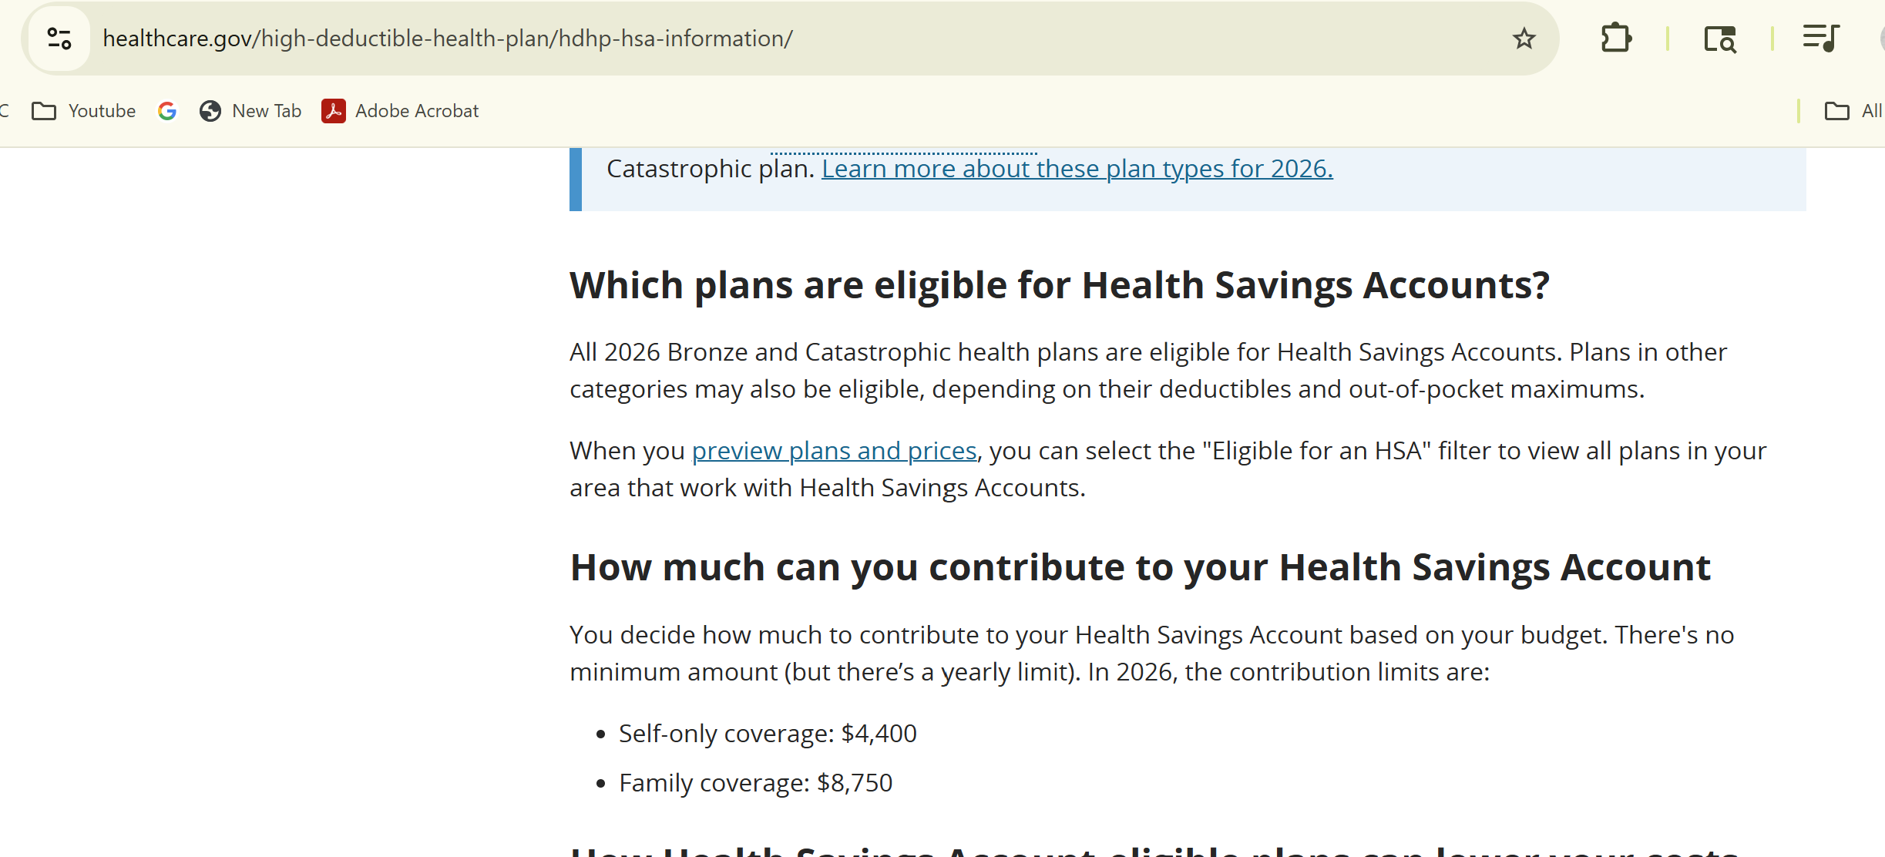
📹 Videos AICPA MCQs & Sims 🤖 Farhat AI Assistant🎙 Podcast Lessons 📊 CPA, CMA, EA Exam 💼Accounting & Finance Courses 🙌 Support by Farhat Team
🌐 farhatlectures.com | ⭐ Start Your Free Trial

Slide 10

One‑time IRA‑to‑HSA transfer
Individuals are allowed a one‑time transfer from an IRA to an HSA (a “qualified HSA funding distribution”).​
The transfer must be a direct trustee‑to‑trustee transfer; the taxpayer cannot receive the IRA funds and then redeposit them.​
The amount transferred is not included in income to the extent it would otherwise be taxable, and it is not subject to the 20% additional tax on early distributions that normally applies to certain IRA withdrawals.​
The IRA‑to‑HSA transfer counts against that year’s HSA contribution limit; it is not in addition to the regular limit.​
📹 Videos AICPA MCQs & Sims 🤖 Farhat AI Assistant🎙 Podcast Lessons 📊 CPA, CMA, EA Exam 💼Accounting & Finance Courses 🙌 Support by Farhat Team
🌐 farhatlectures.com | ⭐ Start Your Free Trial

Slide 11

last‑month Rule
Mid‑year HDHP coverage (“last‑month rule”)
If an individual becomes covered by an HDHP during the year and is HSA‑eligible on December 1, they may use the “last‑month rule” and contribute as though they were eligible for the entire year.​
However, they must remain an eligible individual (HSA‑eligible with HDHP coverage and no disqualifying coverage) for the testing period (generally through December 31 of the following year), or the extra amount becomes taxable and subject to a 10% additional tax.
📹 Videos AICPA MCQs & Sims 🤖 Farhat AI Assistant🎙 Podcast Lessons 📊 CPA, CMA, EA Exam 💼Accounting & Finance Courses 🙌 Support by Farhat Team
🌐 farhatlectures.com | ⭐ Start Your Free Trial

Slide 12

Contribution Deadline & Ownership
Contributions for a tax year (including catch‑up and IRA‑to‑HSA amounts) must be made by the due date of the tax return, not including extensions (typically April 15 of the following year).​
HSAs are individually owned accounts rather than employer-owned benefit arrangements; an employee is effectively fully vested in amounts contributed to their HSA and can keep the account and its funds when changing jobs or retiring.
📹 Videos AICPA MCQs & Sims 🤖 Farhat AI Assistant🎙 Podcast Lessons 📊 CPA, CMA, EA Exam 💼Accounting & Finance Courses 🙌 Support by Farhat Team
🌐 farhatlectures.com | ⭐ Start Your Free Trial

Slide 13
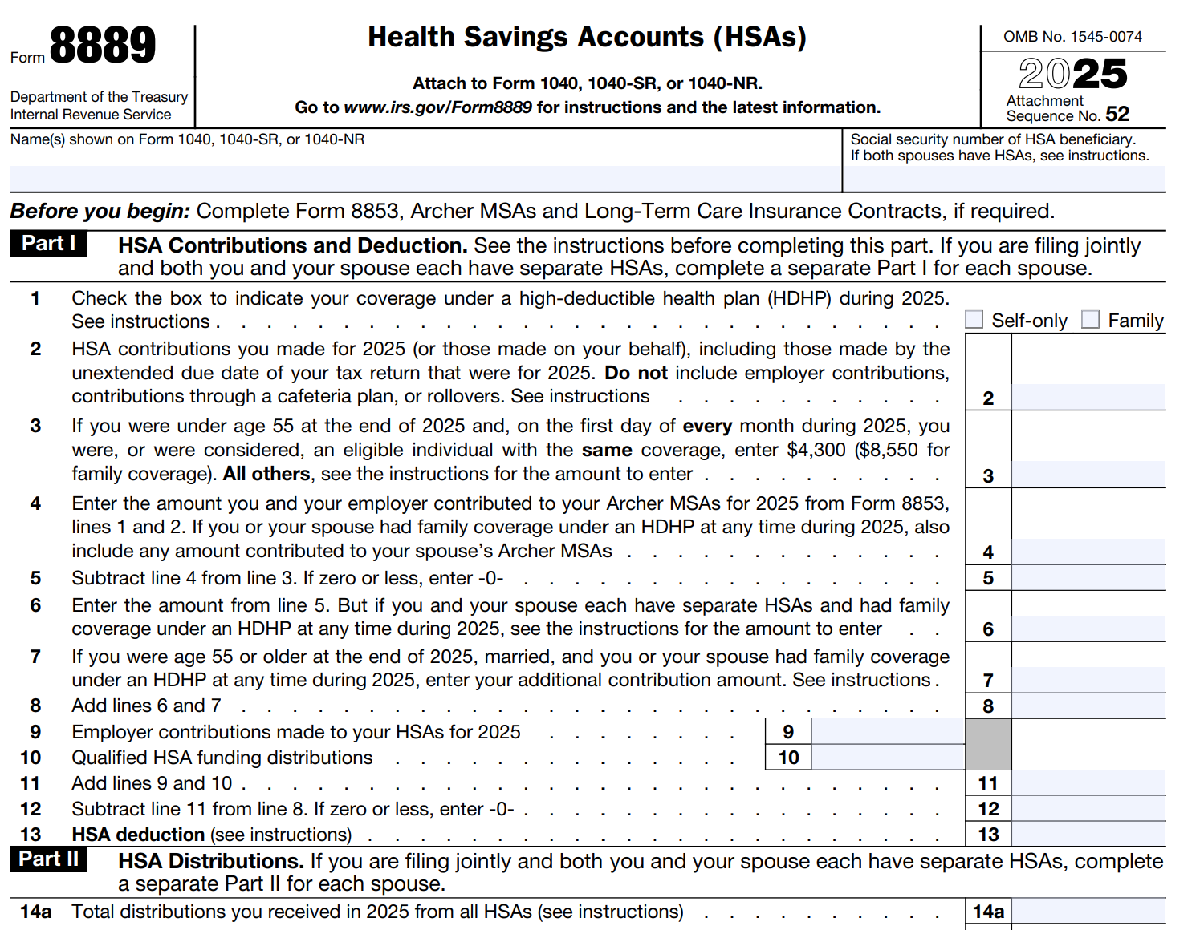
Part I – Contributions and Deduction
📹 Videos AICPA MCQs & Sims 🤖 Farhat AI Assistant🎙 Podcast Lessons 📊 CPA, CMA, EA Exam 💼Accounting & Finance Courses 🙌 Support by Farhat Team
🌐 farhatlectures.com | ⭐ Start Your Free Trial
Notes:
5. Part I — HSA Contributions and Deduction
Line 1: HDHP Coverage Type
The taxpayer must indicate coverage type:
Self-only
Family
For 2025, HDHPs must meet specific minimum deductible and maximum out-of-pocket thresholds.
John Doe has self-only coverage.
Line 2: HSA Contributions
Enter personal contributions made during the year, including payroll deductions.
John contributed $4,300 ($358.33 per month)
Employer contributions are not included here
Contribution amounts may be verified later using Form 5498-SA, an informational return issued after the filing deadline.
Line 3: Contribution Limit (Under Age 55)
For 2025:
Self-only coverage: $4,300
Family coverage: $8,600
These limits assume HDHP coverage existed for every month of the year.
Line 4: Archer MSA Contributions
Archer MSAs are predecessors to HSAs and are reported on Form 8853.
Contributions to Archer MSAs reduce the HSA contribution limit
John Doe has no Archer MSA contributions
Line 5: Adjusted Contribution Limit
Since Line 4 is zero, the contribution limit remains $4,300.
Line 6: Allocation Between Spouses (Family Coverage Only)
If spouses:
Have family HDHP coverage
Maintain separate HSAs
Then the $8,600 family limit must be shared, not duplicated.
Spouses may split the amount in any proportion, as long as the combined total does not exceed the limit.
Line 7: Additional Contribution (Age 55+)
Taxpayers age 55 or older may make a $1,000 catch-up contribution, prorated if coverage did not exist for the full year.
John Doe is not eligible, so the amount is zero.
Line 8: Total Allowed Contribution
This represents the maximum allowable contribution before considering employer funding or IRA rollovers.
Line 9: Employer Contributions
Any employer contributions reduce the taxpayer’s remaining contribution capacity.
John Doe received no employer contributions.
Line 10: Qualified HSA Funding Distribution
This is a one-time, lifetime transfer from:
A traditional IRA or
A Roth IRA
The transfer must be trustee-to-trustee and is limited to the annual HSA contribution cap.
Tax planning note:
Transfers from a traditional IRA are often more advantageous than Roth transfers.
John Doe made no funding distribution.
Line 11–13: HSA Deduction
Line 11: Total employer and funding distributions (zero)
Line 12: Maximum allowable contribution remains $4,300
Line 13: Deduction is the lesser of actual contributions or the limit
John Doe deducts $4,300, reported as an above-the-line adjustment on Schedule 1.

Slide 14
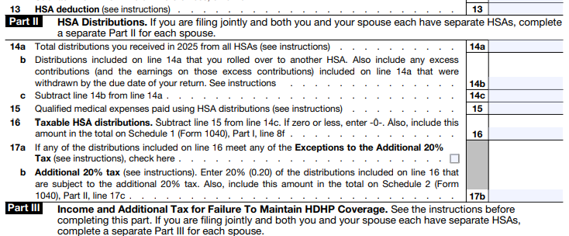
HSA Distribution
📹 Videos AICPA MCQs & Sims 🤖 Farhat AI Assistant🎙 Podcast Lessons 📊 CPA, CMA, EA Exam 💼Accounting & Finance Courses 🙌 Support by Farhat Team
🌐 farhatlectures.com | ⭐ Start Your Free Trial
Notes:
Part II — HSA Distributions
Line 14a: Total Distributions
John Doe withdrew $5,000 during the year.
Line 14b: Non-Taxable Rollovers or Returned Excess
Includes:
HSA-to-HSA rollovers
Timely return of excess contributions
John Doe has none.
Line 15: Qualified Medical Expenses
Qualified expenses generally include:
Schedule A medical deductions
Certain OTC medications
COVID-related items
Feminine hygiene products
Certain insurance premiums
John Doe incurred qualified expenses exceeding $5,000.
Line 16: Taxable Distributions
Since expenses exceed distributions, the taxable amount is zero.
Schedule 1 Impact
No additional income from distributions
$4,300 above-the-line deduction remains intact
Additional 20% Penalty (If Applicable)
If distributions exceed qualified expenses:
Excess is included in income
A 20% penalty applies unless an exception exists
Exceptions include:
Death
Disability
Age 65 or older
Example:
$6,000 withdrawn
$5,000 qualified expenses
$1,000 taxable income
$200 penalty (unless an exception applies)

Slide 15
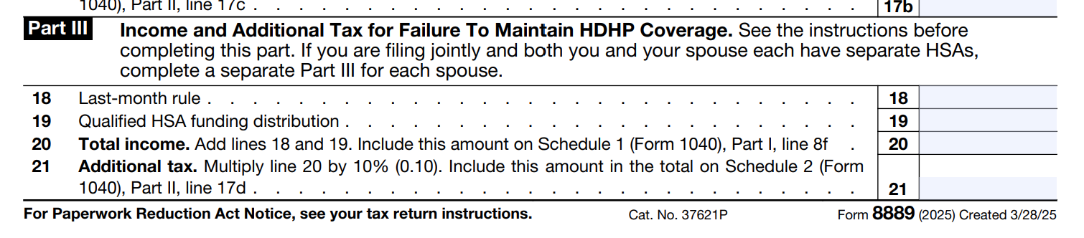
Why Auditors Use
Tests of Details?
📹 Videos AICPA MCQs & Sims 🤖 Farhat AI Assistant🎙 Podcast Lessons 📊 CPA, CMA, EA Exam 💼Accounting & Finance Courses 🙌 Support by Farhat Team
🌐 farhatlectures.com | ⭐ Start Your Free Trial
Notes:
Part III — Failure to Maintain HDHP Coverage
This section applies if the taxpayer did not maintain HDHP coverage for the required period.
The Last-Month Rule
If HDHP coverage exists on December 1, the taxpayer is treated as covered for the entire year.
If the rule is not met:
Contributions must be prorated
Additional income and a 10% penalty may apply
This penalty is separate from the 20% distribution penalty.
John Doe maintained coverage and completes no entries in this section.

Slide 16

MCQ from farhatlectures.com
In 2025, Alex is 52 years old and is covered for the entire year under a self-only High-Deductible Health Plan (HDHP) that qualifies for a Health Savings Account (HSA). Alex’s employer contributes $1,200 to Alex’s HSA during the year.
What is the maximum additional amount Alex may personally contribute to the HSA for 2025?
A. $3,100
B. $4,300
C. $5,300
D. $8,550
📹 Videos AICPA MCQs & Sims 🤖 Farhat AI Assistant🎙 Podcast Lessons 📊 CPA, CMA, EA Exam 💼Accounting & Finance Courses 🙌 Support by Farhat Team
🌐 farhatlectures.com | ⭐ Start Your Free Trial

