Slide 1
1) Households:
  Suppliers of capital.
  Purchase securities issued by firms
2) Firms:
  Demanders of capital.
  Raise capital now to pay for investments in plant and equipment.
  The income generated by those real assets provides the returns to investors who purchase the securities issued by the firm.
3) Governments:
  can be borrowers or lenders, depending on the relationship between tax revenue and government expenditures.
  Since World War II, the U.S. government typically has run budget deficits.
  Issued treasury bills, notes, and bonds is the major way that the government borrows funds from the public.
  Latter part of the 1990s (dot.com), the government enjoyed a budget surplus and was able to retire some outstanding debt.
3 Major Players!

Slide 2
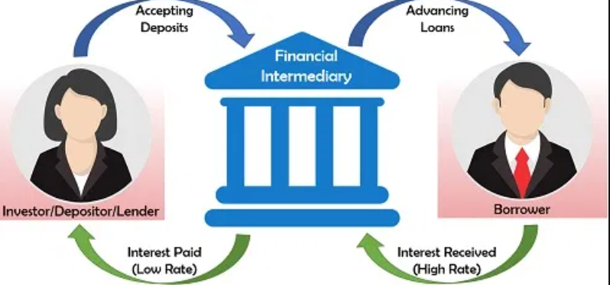
Households desire investments for their savings.
  Deposit money at the bank or financial institutions
  Household don’t solicit investments on their own.
  Time consuming, costly and needs expertise to assess credit and market risk
Corporations and governments do not sell all or even most of their securities directly to individuals.
  For example, about half of all stock is held by large financial institutions such as pension funds, mutual funds, insurance companies, and banks.
  These financial institutions stand between the security issuer (the firm) and the ultimate owner of the security (the individual investor)

Slide 3


A (commercial) bank raises funds by borrowing (taking deposits) and lending that money to other borrowers.
  The spread between the interest rates paid to depositors and the rates charged to borrowers is the source of the bank’s profit.
  In this way, lenders and borrowers do not need to contact each other directly.
  Matched by the bank
Financial intermediaries are distinguished from other businesses in that both their assets and their liabilities are overwhelmingly financial.

Slide 4

Other examples of financial intermediaries are investment companies, insurance companies, and credit unions.
  All these firms offer similar advantages in their intermediary role.
    First, by pooling the resources of many small investors, they are able to lend considerable sums to large borrowers.
    Second, by lending to many borrowers, intermediaries achieve significant diversification, so they can accept loans that individually might otherwise be too risky.
    Third, intermediaries build expertise through the volume of business they do and can use economies of scale and scope to assess and monitor risk.

Slide 5


Investment companies:
  Firms managing funds for investors.
  An investment company may manage several mutual funds.
  Mutual funds have the advantage of large-scale trading and portfolio management, while participating investors are assigned a prorated share of the total funds according to the size of their investment.
  This system gives small investors advantages they are willing to pay for via a management fee to the mutual fund operator.

Slide 6


Like mutual funds, hedge funds also pool and invest the money of many clients.
  open only to institutional investors such as pension funds, endowment funds, or wealthy individuals.
  They are more likely to pursue complex and higher-risk strategies.
  They typically keep a portion of trading profits as part of their fees, whereas mutual funds charge a fixed percentage of assets under management.

Slide 7


Economies of scale also explain the proliferation of analytic services available to investors
  Newsletters, databases, and brokerage house research services all engage in research to be sold to a large client base.
  Investors clearly want information, but with small portfolios to manage, they do not find it economical to personally gather all of it.
  Hence, a profit opportunity emerges: A firm can perform this service for many clients and charge for it

Slide 8



Investment Bankers (TBD later)
Firms specializing in the sale of new securities to the public, typically by underwriting the issue.
Advise an issuing corporation on the prices it can charge for the securities issued
Help set appropriate interest rates for bonds
Handles the marketing of the security in the primary market.
Primary market:
  A market in which new issues of securities are offered to the public (brand new!)
Secondary market:
  Markets in which previously issued securities are traded among investors.

Slide 9

Most venture capital (VC) funds are set up as limited partnerships.
A management company starts with its own money and raises additional capital from limited partners such as pension funds.
That capital may then be invested in a variety of start-up companies.
The management company usually:
  sits on the start-up company’s board of directors,
  helps recruit senior managers, and
  provides business advice.
It charges a fee to the VC fund for overseeing the investments. After some period of time, for example, 10 years, the fund is liquidated and proceeds are distributed to the investors.
Venture capital investors commonly take an active role in the management of a start-up firm.
Other active investors may engage in similar hands-on management but focus instead on firms that are in distress or firms that may be bought up, “improved,” and sold for a profit. Collectively, these investments in firms that do not trade on public stock exchanges are known as private equity investments.

