Slide 1
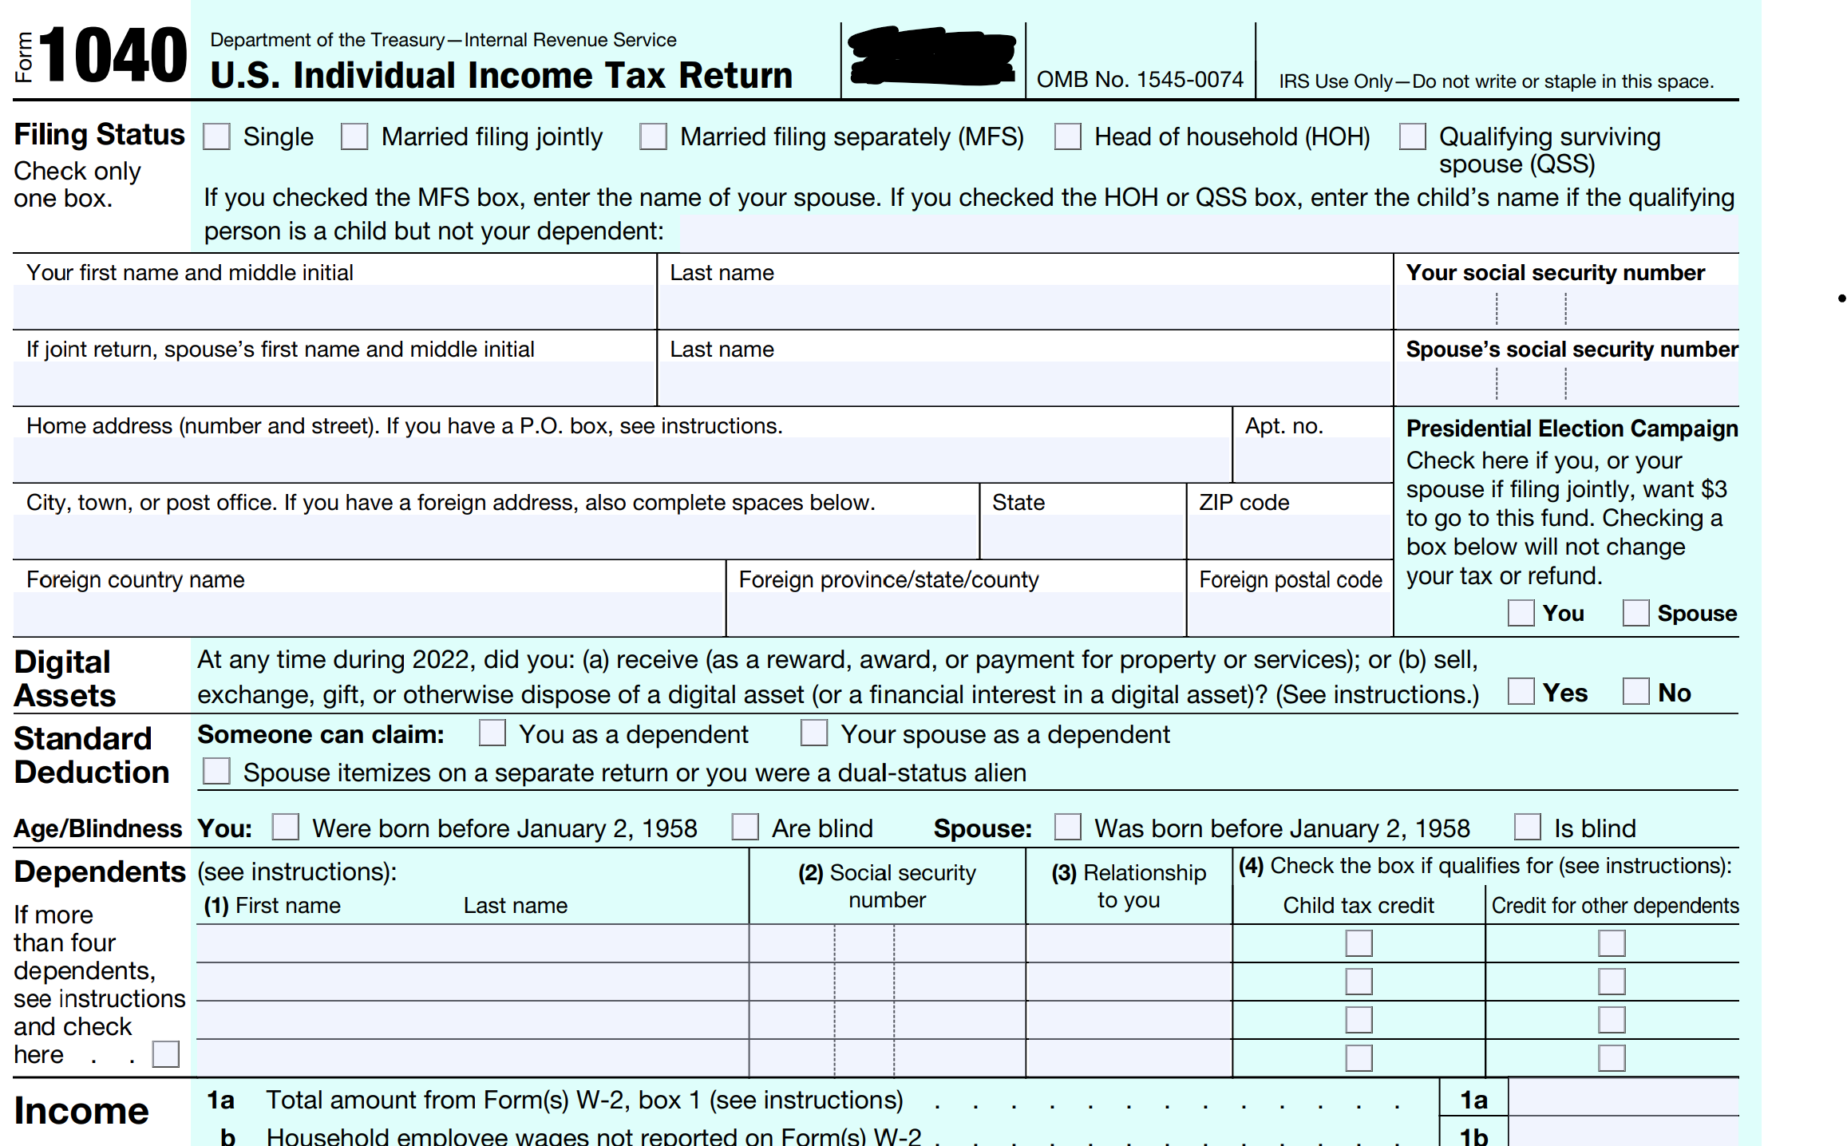
Tax Form
Student or CPA/EA Candidate?
www.farhatlectures.com

Slide 2
The 5 Filing Status
Single
Married Filing Jointly
Qualifying Widow(er) with Dependent Child
Married Filing Separately
Head of Household
Student or CPA/EA Candidate?
www.farhatlectures.com

Slide 3
Single
This status is for individuals who are
  unmarried
  divorced or
  legally separated
according to their state law as of December 31.
George Dee was divorced in January and is unmarried at the end of the year. Also, George does not claim any dependents. What is his filing status?
  Single because he was not married at the end of the tax year and did not claim any dependents.
Student or CPA/EA Candidate?
www.farhatlectures.com

Slide 4
Married Filing Jointly (MFJ)
Most Advantageous
Both spouses must be married to each other at the end of the tax year (December 31) and
Both must agree to file a joint tax return (must sign the same return).
  Both spouses will report their combined income and claim any credits and deductions on a single tax return.
Filing a joint tax return will result in a lower tax liability than filing separately
If the one spouse dies during the year ➔ considered married for that whole year
Student or CPA/EA Candidate?
www.farhatlectures.com

Slide 5
Qualifying Widow or Widower (Surviving Spouse)
Year of death MFJ. Year X1 (year of death)
The following two years (X2 and X3) if the surviving spouse:
  remain unmarried and
  have paid over half the cost of maintaining a household where a child who is his/her dependent lived for the entire (whole) year
    ➔ Qualifying widow(er)
Except for temporary absences: college or medical facilities
The dependent child must be a child or stepchild including an adopted child (not a foster child) of the taxpayer.
Student or CPA/EA Candidate?
www.farhatlectures.com

Slide 6
Example
Assuming that last year, the taxpayer's spouse passed away and Paulette did not remarry during the current year. Paulette maintained a household for Tony and Maria, who are her dependent children.
Under these circumstances, what is Paulette’s filing status for the current year?
Answer: Qualifying Surviving Spouse.
  Last year MFJ.
Assume that Paulette did not maintain a household for any dependent child and did not remarry?
  Current year Single
Student or CPA/EA Candidate?
www.farhatlectures.com

Slide 7
Married Filing Separately
Least Advantageous
Couples who choose to file separate tax returns.
Keep financing separate or for whatever reason!
If one spouse itemizes then the other will have to itemize
  One spouse has 40,000 of itemized deduction
  The other is $500 (must itemize)
Penalized:
  Cannot take interest deduction student loan
  Capital loss deduction is limited to 1,500
  No earned income credit, child and dependent care expense
Student or CPA/EA Candidate?
www.farhatlectures.com

Slide 8
Head of Household (HOH)
Considered unmarried on the last day of the tax year (abandoned spouse), and
Paid more than half the cost of maintaining a household for the tax year.
  A household is defined as a home that is maintained for the taxpayer and
  at least one qualifying person.
A qualifying person is typically a dependent, such as a child or other relative, who lived with the taxpayer for more than half the year.
  Qualifying Child (see separate recording)
  Qualifying Relative (see separate recording)
    Must meet the relationship test
    Free loading boyfriend or girlfriend will not qualify you!
    Irresponsible friends (do not qualify you as HOH)
    Parents (exception) don’t have to live with you
Head of household filing status generally results in a lower tax rate and a higher standard deduction than the single filing status.
Student or CPA/EA Candidate?
www.farhatlectures.com

Slide 9
Abandoned Spouse
An abandoned spouse is someone who has been separated from their spouse, either physically or financially, without their consent
To qualify as an abandoned spouse, a taxpayer must generally meet the following requirements:
  The taxpayer must have lived apart from their spouse for the last six months of the tax year.
  The taxpayer must have paid more than half the cost of maintaining a household for the tax year.
  The taxpayer must have a dependent child 9You can claim) who lived with them for more than half the year.
No MFJ (no one to sign with) MFS (disadvantageous)
If you qualify, file HOH
Student or CPA/EA Candidate?
www.farhatlectures.com

