Slide 1
Excess Business Loss Limitation (EBLL)
What is the idea?
Limits the amount of nonbusiness income (salary) that can be sheltered from tax as a result of business losses.
If a noncorporate taxpayer has an excess business loss for the year, it is not allowed
  Instead, it is carried forward and treated as part of the taxpayer’s NOL carryforward in subsequent years
  Simply put, the taxpayer is allowed to deduct a net business loss (Business deductions – Business income) of up to a threshold amount. This amount is revised each year to account for inflation.
For 2022, it amounted to $270,000 for single taxpayers and $540,000 for MFJ taxpayers.
EBLL is the final limitation (After Basis, At-Risk amount then Passive activity loss rule) that applies to the deduction of the taxpayer’s loss.
Student or CPA Candidate?
www.farhatlectures.com

Slide 2
Simple Example
In 2022, Adam, a single taxpayer, operates a business in which he materially participates. His business generates a gross income of $320,000 and deductions of $700,000, resulting in a loss of $280,000. This large loss resulted from the acquisition of an equipment which Adam immediately expensed.
Adam can only deduct $270,000 of the $280,000 against other income. The remaining $10,000 is carried as a future NOL.
If Adam was MFJ taxpayer then he can deduct the full amount $280,000 against other income as the limit for 2022 MFJ is $540,000.
Student or CPA Candidate?
www.farhatlectures.com

Slide 3
During the tax year 20X3, Alex earned the following income:
Interest Income: $10,000
Share of the X&Y partnership’s ordinary income (Alex has a 5% ownership interest in X&Y and does not materially participate in its activities): $5,200
Rental Real Estate income: $6,000
Wages: $82,200
Royalty income: $2,100
In addition, Alex was a 6 percent partner in the A&B partnership, which reported an ordinary business loss of $440,000, in 20X3.
Alex’s tax basis in the partnership A&B was $27,000, and his at-risk basis was $21,000.
What is the amount of loss that Alex may deduct in 20X3?
Solution: During 20X3, Alex had an active income of $82,200, a passive income of $11,200, and a portfolio income of $12,100.
In addition, Alex had a passive loss from the A&B partnership, of $440,000 x 0.06 = $26,400.
The deductible loss should clear the following four hurdles:
The tax basis limitation: Alex had a tax basis of $27,000, which exceeded the amount of loss. Thus, there is no loss suspension at the tax basis level.
The at-risk limitation: Alex had an at-risk basis of $21,000. Therefore, the deductible loss is limited to $21,000. The remaining $5,400 is carried forward to future periods.
The passive income limitation: Alex had a passive income of $11,200. Therefore, the deduction of the loss is further limited to $11,200. The remaining $9,800 is suspended and carried forward to offset future passive income.
The excess business loss limitation does not apply here as the remaining deductible loss of $11,200 is way below the threshold amount of $270,000 for single taxpayers.
Student or CPA Candidate?
www.farhatlectures.com

Slide 4
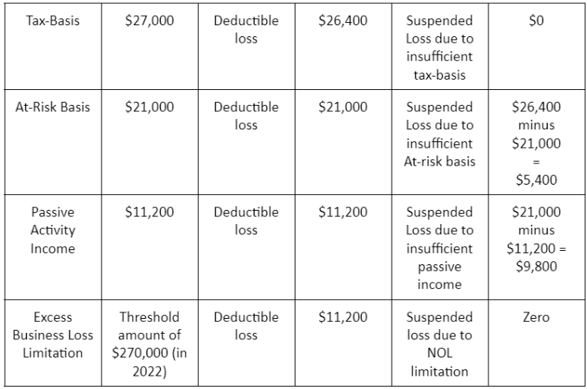
The limitations are summarized in the following table:
Student or CPA Candidate?
www.farhatlectures.com

Slide 5
Assume Alex sells his interest in A&B Partnership for a gain of $25,000.
How much of losses can be deducted?
  $5,400 at-risk suspended
  $9,800 of PAL
Student or CPA Candidate?
www.farhatlectures.com

Slide 6
Assume that Alex has a cumulative suspended passive activity loss of $400,000 for A&B Partnership when he sold the limited partnership.
Also assume that Alex has $30,000 of passive activity income from X&Y Partnership. Assume $300,000 in wages and $100,000 in gambling winnings from Atlantic City Casino (yeah right!).
How much can he deduct in the year of disposal?
  $400,000 - $30,000 = $370,000
  Can use another $270,000 against other income
  The remaining $100,000 (or $400,000 - $30,000 PI - $270,000 OI) is carried forward now as NOL.
Student or CPA Candidate?
www.farhatlectures.com

