Slide 1

Who is a Tax Return Preparer?
Any person who prepares for compensation ($), or
employs one or more persons to prepare for compensation, all or a substantial portion of any return of tax or claim for refund under the Internal Revenue Code (IRC).
Different than a tax Practitioners (license Required)
  CPA, EA and Attorney
    Unlimited Representation rights before the IRS
Tax Preparer:
  Preparer tax Identification Number (PTIN)
  Limited representation before IRS
For more lectures, visit:
www.farhatlectures.com

Slide 2
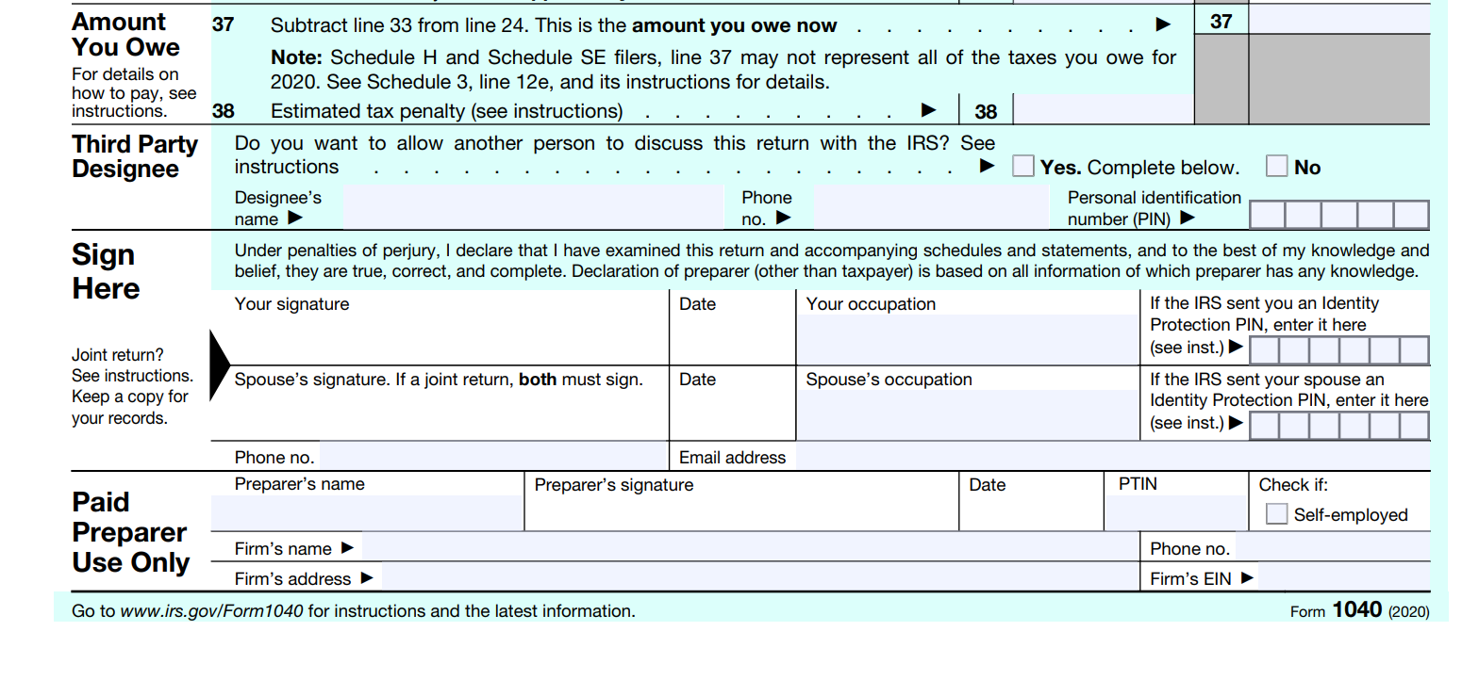
Non-Signing Preparer
Signing Preparer
No Primary Responsibility for the overall return or claim if refund
Assist (not just mechanical or clerical or intern)
Examples include preparers who provide advice that constitutes a substantial portion of the return
Attorney provide workpaper for total revenue.
Primary responsibility for the overall accuracy of return or claim of refund.
Sign their name!
Multiple parties could be engaged.
  Multi-state
  International
For more lectures, visit:
www.farhatlectures.com

Slide 3
Persons who are not tax return preparers include the following:
Employee preparing tax return in his/her regular duties for his/her employer
A fiduciary who prepares a return or refund claim for the trust
A person who prepares a refund claim in response to a notice of deficiency issued to another
A person who provides typing, reproducing, or other mechanical assistance, i.e., clerical (Intern)
Tax Planning: Making projection
For more lectures, visit:
www.farhatlectures.com

Slide 4
How should Tax Prepared Behave?
Due Diligence
Making factual inquiries to ensure clients’ accuracy and truthfulness and follow the tax law.
Rely on client information in good faith (you are not auditing them).
  Do not ignore (look the other way) conflicting, inaccurate or incomplete information
  Must make reasonable inquiries if the information appears inaccurate or incomplete.
  Make appropriate inquiries of the taxpayer about the existence of documentation for deductions.
    Ask if they have proof for cash charitable contrition etc.
When a tax return preparer discovers that a taxpayer has made an error in or omission from any document filed with the IRS, (s)he must notify the taxpayer of the error or omission immediately.
  The tax return preparer also must advise the taxpayer of the consequences of the error or omission.
For more lectures, visit:
www.farhatlectures.com

Slide 5

What happens in Case of Valuation?
Penalties are imposed
  Different and severe penalties for various violations.
  Supervisor given advice at the firm are also subject to penalties
For more lectures, visit:
www.farhatlectures.com

Slide 6
Substantial Authority
Determining whether an item is an income or allowed deduction. Part of your due Diligence
Primary Authorities:
  Provision of the Internal Revenue Code
  Final Regulations
  Revenue Rulings by U.S. Treasury Department
  Court Cases
Not Primary Authorities:
  Internal Revenue Bulletin
  Administrative pronouncement
  Press releases
For more lectures, visit:
www.farhatlectures.com

Slide 7
What is Frivolous submission
A return is considered frivolous when it
  Omits information necessary to determine the taxpayer’s tax liability
  Shows a substantially incorrect tax or willful understatement of tax liability
  Is based on the taxpayer’s desire to impede the collection of tax.
For more lectures, visit:
www.farhatlectures.com

Slide 8
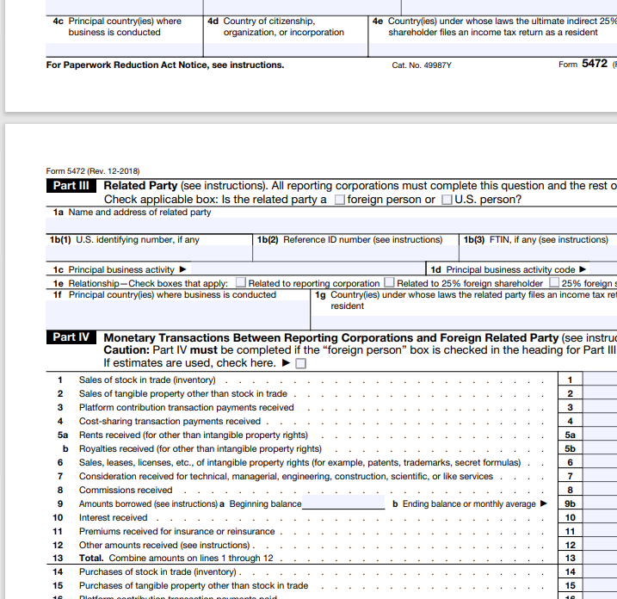
Reportable and Listed Transactions
A reportable transaction specifically identified by the secretary of the US Treasury Department as either
  Tax avoidance transaction (legal use to reduce tax liability)
  Tax Evasion (illegal use to reduce tax liability)
A listed transaction is a transaction one of the types of transactions the US Treasury has determined to be a
  tax avoidance transaction
For more lectures, visit:
www.farhatlectures.com

Slide 9
Terms (standards) & % to be familiar with
More likely than not > 50% chance succeeding in court (most stringent)
Substantial Authority > 40 % but < 50% chance succeeding in court
Reasonable basis with disclosure > 20% of your tax position is upheld
Arguable < 20% chance your tax position upheld.
For more lectures, visit:
www.farhatlectures.com

Slide 10
What is Unreasonable Position?
A position is “unreasonable position” unless it meets one of the three conditions
You have a substantial authority, disclosure is not an issue (40% to 50% winning)
If Disclose, you need to a meet reasonable basis >20% of success
Reportable transaction (tax shelter or listed transaction)> 50%chance more likely than not succeeding
For more lectures, visit:
www.farhatlectures.com

Slide 11
Penalty for Unreasonable Position
Fraud
  Negligence:
Not intentional
Failure (error)
Penalty: $1,000 or 50% of income
Negligence includes any failure to make a reasonable attempt to either comply with the provisions of the Internal Revenue laws or
exercise ordinary and reasonable care in the preparation of a return.
Fraud:
Purposeful
Misleading
Willfully
Recklessly
The penalty is higher
For more lectures, visit:
www.farhatlectures.com

Slide 12
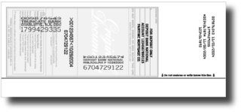
$635 for endorsing or otherwise negotiating any check issued to a taxpayer
Any tax return preparer who operates a check cashing agency that cashes, endorses, or negotiates tax refund checks for returns prepared also is subject to a penalty.
For more lectures, visit:
www.farhatlectures.com

Slide 13

Penalty Aiding or Abetting (Proof on IRS)
A $1000 penalty per return or document is imposed against person who aid in the preparation of returns or other documents they know or have reason to believe would result in an understatement of the tax liability of another person.
This penalty applies to those other than tax preparer of the actual tax return for example advisors, attorney corporate officers and executives.
  Clerical assistance in the return preparation does not incur the penalty
For more lectures, visit:
www.farhatlectures.com

Slide 14
Penalty For Unethical Behavior “$60 penalty”
Failure to provide a copy to taxpayer (unless reasonable cause exist)
  Penalty $60 (max 31,500 per year) Subject to change
Failure to sign return
  Penalty $60 (max 31,500 per year)
Failure to furnish identification number of preparer
  Penalty $60 (max 31,500 per year)
Failure to properly retain records
  3 years
    Copy of Return or
    Listing clients
  Penalty $60 (max 31,500 per year)
Failure to file correct information returns (employer HR Block)
  BY July 31 submit to IRS
    Name or Tax Preparer
    Tax identification number
    Place of work
For more lectures, visit:
www.farhatlectures.com

Slide 15
Procedural Requirements
  A return preparer is required to sign the return or claim for refund after completion but before it is presented to the taxpayer (provide taxpayer with complete return).
  Retain a completed copy of each return or claim prepared for 3 years after the close of the return period or
  keep a list that includes, for the returns and claims prepared, the following information:
      The taxpayers’ names
      Taxpayer identification numbers
      Their tax years
      Types of returns or claims prepared
    The return period is the 12-month period beginning on July 1 each year.
For more lectures, visit:
www.farhatlectures.com

Slide 16
Procedural Requirements
  A return preparer is required to sign the return or claim for refund after completion but before it is presented to the taxpayer (provide taxpayer with complete return).
  Retain a completed copy of each return or claim prepared for 3 years after the close of the return period or
  keep a list that includes, for the returns and claims prepared, the following information:
      The taxpayers’ names
      Taxpayer identification numbers
      Their tax years
      Types of returns or claims prepared
    The return period is the 12-month period beginning on July 1 each year.
For more lectures, visit:
www.farhatlectures.com

Slide 17
Disclosure of Taxpayer Information Penalty
  Owe Duty of confidentiality
  A penalty is imposed on any tax return preparer who
    discloses or
    uses any tax return information without the consent of the taxpayer.
  The penalty is not imposed if the disclosure was specifically for preparing, assisting in preparing, or providing services in connection with the preparation of any tax return of the taxpayer.
  The penalty is $250 per disclosure, with a maximum of $10,000 per year.
  If convicted of knowingly or recklessly disclosing the information, a preparer is guilty of a misdemeanor and subject to up to $1,000 in fines and up to a year in prison.
For more lectures, visit:
www.farhatlectures.com

Slide 18
Exceptions: NO penalty for Disclosure
Following court order or the Internal Revenue Code
Client consent (in writing and explicit/specific) to disclose
To tax return preparers within the same firm (partner)
For the purpose of a quality or peer review to the extent necessary to accomplish the review
For use in preparing, assisting in preparing, or providing services in connection with tax return preparation (K-1)
  State or local return
For more lectures, visit:
www.farhatlectures.com

