Slide 1

Dividend Received Deduction (DRD)
What is the big idea? Multiple taxation of dividend.
If corporation owns stock in another corporation and receives dividends, a portion of dividends may be deducted from income.
Company A
Revenue
-Expense
= Net income
Retained Earning
Dividend
Company B
Revenue
-Expense
= Net income
Retained Earning
Dividend
Company C
Revenue
-Expense
= Net income
Retained Earning
Dividend
% of Ownership | Deduction %
Less than 20% | 50%
20% to less than 80% | 65%
80% or more | 100%
DRD is limited to a % of taxable income (TI).
Limitation percentage is the same as the deduction percentage
Visit: farhatlectures.com for complete course: Lectures, MCQs, TF, & Notes

Slide 2

Limitation of DRD
The dividend received deduction is limited to a lesser of
  Percentage (50 or 65%) of dividend received deduction or
  Percentage (50 of 65%) of taxable income limitation corresponds to the deduction percentage
The taxable income limitation does not apply if DRD creates an an NOL for the current taxable year.
If NOL exists, then NOL rules takes priority over the limitation
  Any unused DRD is lost (use it or lose it)
For this purpose, taxable income is computed while ignoring:
    The NOL deduction
    The domestic production activities deduction
    The dividends received deduction
    Any capital loss carryback to the current tax year
Visit: farhatlectures.com for complete course: Lectures, MCQs, TF, & Notes

Slide 3
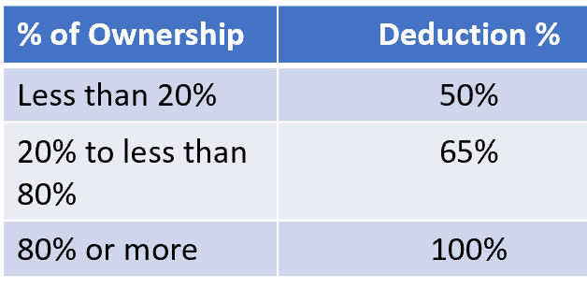
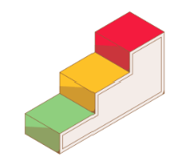
Steps in Computing DRD
1. Multiply dividends received by deduction percentage
2. Multiply taxable income by deduction percentage same as step 1
3. Subtract 1. from taxable income
  -If entity has income before DRD, but DRD creates (or increases) NOL, amount in 1. is DRD (the NOL rule)
  -If DRD does not create (or increase) NOL, deduction is limited to lesser of 1. or 2.
Visit: farhatlectures.com for complete course: Lectures, MCQs, TF, & Notes

Slide 4

45 Days Holding Period
To prevent tax loopholes related to short-term stock holdings, a restriction was implemented stating that no dividends received deduction is permitted unless the corporation has held the stock for more than 45 days.
This rule addresses situations where stock is purchased shortly before a dividend record date and then sold ex-dividend, resulting in a capital loss equivalent to the dividend amount (excluding other market valuation changes).
If the dividends received deduction were allowed in such cases, the capital loss resulting from the stock sale would exceed the taxable portion of the corresponding dividend income.
Visit: farhatlectures.com for complete course: Lectures, MCQs, TF, & Notes

Slide 5
Example 45 Days Holding Period
On October 2, 2024, Adam Corporation declares a dividend of $1 per share for shareholders recorded as of November 1, 2023.
The dividend is scheduled to be paid on December 2, 2024. Noah Corporation purchases 10,000 shares of Adam stock on October 29, 2024, for $30,000.
Subsequently, on November 7, 2024, Noah Corporation sells those 10,000 shares ex-dividend for $20,000. (Assuming no market price fluctuations except for the dividend component.)
Short-term capital loss ➔ $10,000 ($20,000 amount received − $30,000 basis).
On December 2, Noah Corporation receives a $10,000 dividend from Adam.
If the holding period restriction did not exist, Noah Corporation would be eligible for a $10,000 capital loss deduction (subject to the capital loss limitation). However, the income would be only $5,000 [$10,000 dividend − $5,000 dividends received deduction ($10,000 × 50%)], resulting in a net loss of $5,000.
Since Noah Corporation did not hold the Adam stock for more than 45 days, the dividends received deduction is not permitted.
Visit: farhatlectures.com for complete course: Lectures, MCQs, TF, & Notes

