Slide 1

Itemized Deductions: Schedule A
Itemized Deductions (from AGI) included a range of expenses, including non-trade business expenses (such as employee and investment expenses), as well as certain personal expenses that can be deducted.
These deductions are subject to individual limits and must collectively exceed the standard deduction. Less usage of schedule A?
Medical and dental expenses
Specific taxes
Interest paid on mortgages and investments
Charitable contributions
Miscellaneous expenses (employee and investment expenses)
Visit: farhatlectures.com for complete course: Lectures, MCQs, TF, & Notes

Slide 2
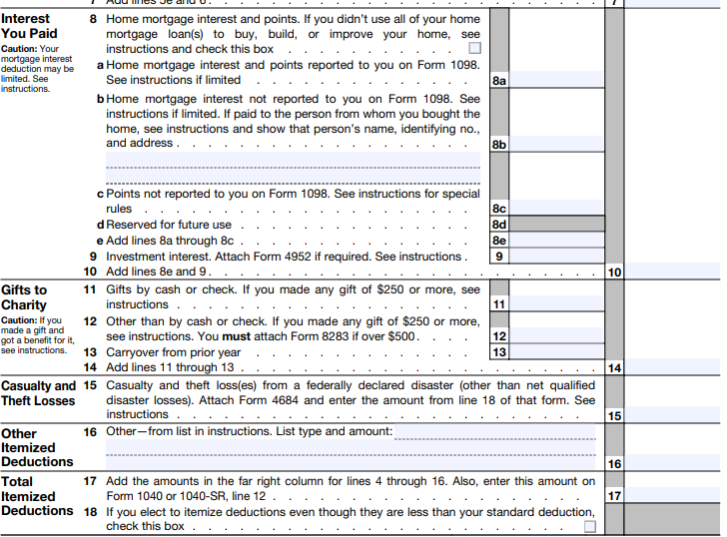
Schedule A
Visit: farhatlectures.com for complete course: Lectures, MCQs, TF, & Notes

Slide 3

Charitable Contribution
What is the idea?
Encourage/entice taxpayers to donate
Individuals and corporations may deduct contributions made to qualified domestic organizations.
  Not your needy neighbor!
Criteria for gift:
Contributor must have donative intent and expect nothing in return
  If contributor receives tangible benefit, the FMV of such benefit reduces the amount of the charitable contribution deduction
Visit: farhatlectures.com for complete course: Lectures, MCQs, TF, & Notes

Slide 4
Example
Sarah purchases a ticket for a special performance of the local symphony, which is a qualified charity.
The ticket is priced at $150, while a regular symphony concert ticket is $50. According to the rules, Sarah is only allowed a charitable contribution deduction of $100.
This means that she can only claim $100 as a deduction, even though she paid $150 for the ticket. It doesn't matter if Sarah attends the concert or not; the deduction is limited to $100.
However, if Sarah decides not to accept the ticket from the symphony or returns it before the event, she can deduct the full $150 as a charitable contribution.
Visit: farhatlectures.com for complete course: Lectures, MCQs, TF, & Notes

Slide 5

State Credit For Charitable Contribution
Several states offer tax credits to taxpayers who donate to specific state or local funds or public charities.
However, to address concerns about potential abuse and circumvention of the $10,000 limit on state and local tax deductions, the IRS has implemented rules to restrict the federal tax benefits of these contributions.
According to these rules, if taxpayers receive a state or local tax credit that exceeds 15% of their payments, they must reduce their charitable contribution deduction by the amount of that credit.
Visit: farhatlectures.com for complete course: Lectures, MCQs, TF, & Notes

Slide 6
Example
In 2023, Alex, a resident of State X, donated $7,000 to State X's Education Fund. This donation makes Alex eligible for a 40% state income tax credit, amounting to $2,800 ($7,000 × 40%).
This tax credit can be used to lower Alex's overall state income tax liability.
By making this contribution, Alex is attempting to convert a state income tax payment, subject to a $10,000 limit per year, into a charitable contribution, which has a limit of 30% of adjusted gross income (AGI).
However, when Alex files their 2023 Federal tax return, they must reduce the charitable contribution by $2,800 because the tax credit received exceeds 15% of the payment made.
As a result, Alex's charitable contribution deduction for this $7,000 donation is reduced to $4,200 ($7,000 payment - $2,800 state income tax credit).
Visit: farhatlectures.com for complete course: Lectures, MCQs, TF, & Notes

Slide 7

Contribution of Services
Contributions of services to a qualified charitable organization are not tax-deductible.
However, unreimbursed expenses related to those services may be deductible.
For example, expenses like required uniforms specifically for performing services may be deductible.
Also, deductions are allowed for transportation costs, reasonable lodging expenses, and meal costs incurred while away from home for the purpose of performing donated services.
  Instead of itemizing actual automobile costs, a standard mileage rate of 14 cents per mile (subject to change) is permitted.
Travel expenses are not deductible if they involve a significant personal element of pleasure, recreation, or vacation.
Visit: farhatlectures.com for complete course: Lectures, MCQs, TF, & Notes

Slide 8
Example
Sarah, a delegate representing her Church in Austin, Texas, travels to a two-day national conference in Chicago, Illinois, in May.
After the conference, Sarah spends a week exploring the city.
In this situation, none of the transportation, meals, or lodging expenses are deductible because the travel included a significant personal element of pleasure, recreation, or vacation.
Visit: farhatlectures.com for complete course: Lectures, MCQs, TF, & Notes

Slide 9

Nondeductible Contributions
Certain items are not eligible for deduction as charitable contributions. These include:
1. Dues, fees, or bills paid to country clubs, lodges, fraternal orders, or similar groups.
2. Cost of raffle, bingo, or lottery tickets.
3. Cost of tuition.
4. Payment for the right to purchase tickets for seating at an athletic event in a university stadium.
5. Value of blood given to a blood bank.
6. Donations to homeowners associations.
7. Gifts to individuals.
8. Rental value of property used by a qualified charity.
Visit: farhatlectures.com for complete course: Lectures, MCQs, TF, & Notes

Slide 10

Substantiation
To claim a deduction for charitable contributions, taxpayers must have proper documentation and substantiation.
The specific documentation requirements depend on the amount of the contribution and whether it was made in cash or noncash property.
Different rules may apply to gifts of specific types of property, such as used automobiles, due to past instances of taxpayer abuse identified by Congress.
Therefore, additional guidelines may be in place for such donations.
Visit: farhatlectures.com for complete course: Lectures, MCQs, TF, & Notes

Slide 11

Cash Contribution
To claim a deduction, taxpayers must possess a valid receipt (such as a canceled check or written statement from the charity) containing the charitable organization's name, contribution date, and amount.
If a payment exceeds $75 and includes both a contribution and goods or services, a written statement from the charity is necessary.
The statement should include an estimated value of the goods or services received by the donor.
Visit: farhatlectures.com for complete course: Lectures, MCQs, TF, & Notes

Slide 12

Noncash Gift
For non-monetary gifts, a receipt from the charity must be retained.
Clothing or household items can be deducted if they are in "good used condition or better" when donated.
However, if an item's value exceeds $500 and it is not in good condition, a deduction is possible if a "qualified appraisal" is included with the return.
Visit: farhatlectures.com for complete course: Lectures, MCQs, TF, & Notes

Slide 13

Boat, Airplane, Used Cars
The deduction for donating a car, boat, or airplane is typically limited to the amount the charity receives from its sale.
Taxpayers should obtain a statement from the charity to document the sales price.
If the deduction claimed exceeds $500, Form 1098-C (Contributions of Motor Vehicles, Boats, and Airplanes) must be included with the tax return.
Visit: farhatlectures.com for complete course: Lectures, MCQs, TF, & Notes

Slide 14

Cash or noncash gifts (including out-of-pocket expenses) of $250 or more
To deduct a cash or property contribution of $250 or more, taxpayers require a contemporaneous written acknowledgment (CWA) from the charity, including payroll deduction gifts.
The CWA must be obtained for donations of $250 or more in out-of-pocket expenses incurred while providing services to a charity.
It should contain the contribution amount, property description, details on any goods or services received, and their estimated value.
The CWA must be acquired by the earlier of the tax return filing date or its due date (including extensions).
Visit: farhatlectures.com for complete course: Lectures, MCQs, TF, & Notes

Slide 15

Noncash gifts of more than $500
For donated noncash property valued over $500, additional substantiation is needed on the tax return, including details on how the property was acquired and its basis.
If noncash contributions exceed $5,000 in value, qualified appraisals may be required.
Visit: farhatlectures.com for complete course: Lectures, MCQs, TF, & Notes

Slide 16

Antiques, paintings, jewelry, and other “tangible personal property”
The deduction for donated property depends on whether the charity uses it for a tax-exempt purpose.
If the charity uses the property for a related purpose, the deduction is based on the appreciated fair market value (FMV).
Otherwise, the deduction is limited to the property's cost.
Taxpayers should obtain a statement from the charity to document the property's use.
Visit: farhatlectures.com for complete course: Lectures, MCQs, TF, & Notes

Slide 17

Valuation
Property donated to a charity is typically (will discuss next) valued at fair market value when the gift is made.
The fair market value is defined as the price at which the property would be exchanged between willing buyers and sellers with reasonable knowledge and no obligation to buy or sell.
Charitable organizations usually do not provide the fair market value, so it's the taxpayer's responsibility to obtain written evidence of the donation from the charity and determine the appropriate value.
Visit: farhatlectures.com for complete course: Lectures, MCQs, TF, & Notes

