Slide 1

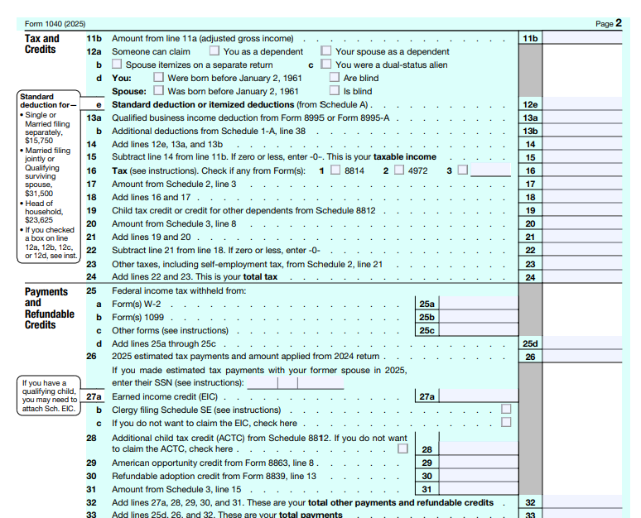
📹 Videos AICPA MCQs & Sims 🤖 Farhat AI Assistant🎙 Podcast Lessons 📊 CPA, CMA, EA Exam 💼Accounting & Finance Courses 🙌 Support by Farhat Team
🌐 farhatlectures.com | ⭐ Start Your Free Trial

Slide 2
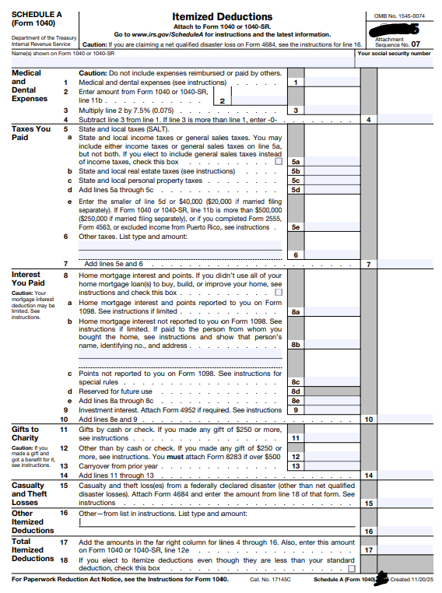
📹 Videos AICPA MCQs & Sims 🤖 Farhat AI Assistant🎙 Podcast Lessons 📊 CPA, CMA, EA Exam 💼Accounting & Finance Courses 🙌 Support by Farhat Team
🌐 farhatlectures.com | ⭐ Start Your Free Trial

Slide 3

Casualty and Theft Losses –
Overview
Losses on personal‑use property are generally not deductible (e.g., personal‑use car, personal furniture).​
Exception: Losses caused by fire, storm, shipwreck, other casualty, or theft may be deductible if they meet the tax law requirements.​
Personal casualty/theft losses are claimed from AGI as itemized deductions, subject to a per‑event reduction and an AGI floor.​
Under OBBBA (2026 and later), personal casualty losses are deductible only if attributable to a federally or qualifying state‑declared disaster area.​
  The $100 per‑event reduction and 10% of AGI floor for personal‑use disaster losses are made permanent.
📹 Videos AICPA MCQs & Sims 🤖 Farhat AI Assistant🎙 Podcast Lessons 📊 CPA, CMA, EA Exam 💼Accounting & Finance Courses 🙌 Support by Farhat Team
🌐 farhatlectures.com | ⭐ Start Your Free Trial

Slide 4

Example
In 2026, a major thunderstorm caused a river flood that damaged Noah’s basement, leaving a $10,000 loss after insurance.​
As a personal‑use property loss, this is not deductible unless the flood is part of a federally or qualifying state‑declared disaster area.​
If the flooded property is Noah’s rental home (income‑producing), the casualty loss is deductible under the business/income‑producing property rules (no $100/10% AGI limits).​
For a qualifying disaster affecting personal‑use property, the loss is deductible as an itemized deduction, subject to the $100 reduction per event and 10% of AGI floor.
📹 Videos AICPA MCQs & Sims 🤖 Farhat AI Assistant🎙 Podcast Lessons 📊 CPA, CMA, EA Exam 💼Accounting & Finance Courses 🙌 Support by Farhat Team
🌐 farhatlectures.com | ⭐ Start Your Free Trial

Slide 5

Casualty Losses – What Qualifies?
Event must be identifiable and damaging to property.​
Event must be sudden, surprising, unexpected, and unusual, and not caused by the taxpayer’s willful act or negligence.​
Typical casualty events: flood, hurricane, tornado, fire, earthquake.​
Personal‑use casualty events are deductible only if the property is in a federally or qualifying state‑declared disaster area.​
Events that are not casualties (based on cases):
  disease and insect damage, termite damage, gradual declines in value (e.g., from nearby landslides).​
These personal‑use losses remain non‑deductible unless covered by specific disaster‑relief provisions.​
📹 Videos AICPA MCQs & Sims 🤖 Farhat AI Assistant🎙 Podcast Lessons 📊 CPA, CMA, EA Exam 💼Accounting & Finance Courses 🙌 Support by Farhat Team
🌐 farhatlectures.com | ⭐ Start Your Free Trial

Slide 6

Theft Losses
Theft loss requires actual theft (larceny, embezzlement, robbery) – not mere misplacement or negligence.
Timing of deduction:
  Theft loss: Year of discovery.
  Casualty loss: Year the loss occurs.
Business and income‑producing theft losses remain deductible under §165 and are reported on the appropriate schedules (e.g., Schedule C or E).
Personal theft losses (e.g., stolen jewelry, wallet) are generally not deductible after OBBBA unless part of a qualified disaster event covered by specific relief rules.
If insurance is expected to fully cover the loss, no deduction is allowed.
  If insurance does not fully reimburse, a deduction may be claimed for the uncompensated portion.
Disaster area (President or qualifying state declaration): For eligible losses, the taxpayer may claim the loss in the year of the disaster or elect to claim it in the preceding year to accelerate relief.
📹 Videos AICPA MCQs & Sims 🤖 Farhat AI Assistant🎙 Podcast Lessons 📊 CPA, CMA, EA Exam 💼Accounting & Finance Courses 🙌 Support by Farhat Team
🌐 farhatlectures.com | ⭐ Start Your Free Trial

Slide 7

Amount of loss: Business or Income producing
Applies to business or income‑producing property (e.g., rental, Schedule C, Schedule E).​
Completely destroyed or stolen:
  Deductible loss = adjusted basis − insurance or other reimbursement.​
Partially destroyed:
  Deductible loss = lesser of (adjusted basis, or FMV before − FMV after), reduced by insurance or other reimbursement.​
Insurance proceeds reduce the deductible loss.​
Business/income‑producing casualty rules are unchanged by OBBBA; the $100 per‑event and 10% AGI limits apply only to personal‑use property.​
📹 Videos AICPA MCQs & Sims 🤖 Farhat AI Assistant🎙 Podcast Lessons 📊 CPA, CMA, EA Exam 💼Accounting & Finance Courses 🙌 Support by Farhat Team
🌐 farhatlectures.com | ⭐ Start Your Free Trial

Slide 8
Example
Flood damage totally destroyed Adam’s uninsured business equipment, valued at $8,000 with an adjusted basis of $12,000.​
  Deductible loss = $8,000 (lower of adjusted basis or value, fully unreimbursed), treated as a for‑AGI business deduction.​
Any later insurance recovery reduces the loss or creates income under the tax‑benefit rule.​
Adam’s uninsured business car was damaged in a crash:
  Pre‑accident FMV = $13,000; adjusted basis = $11,000; post‑accident FMV = $7,000.​
  Decline in FMV = $6,000; deductible loss = $6,000 (lesser of adjusted basis $11,000 or decline $6,000), treated as a for‑AGI business deduction.​
Business casualty losses are not subject to the $100 per‑event and 10% of AGI personal‑loss limits.​
📹 Videos AICPA MCQs & Sims 🤖 Farhat AI Assistant🎙 Podcast Lessons 📊 CPA, CMA, EA Exam 💼Accounting & Finance Courses 🙌 Support by Farhat Team
🌐 farhatlectures.com | ⭐ Start Your Free Trial

Slide 9

Amount of loss:
Personal use Property
Applies to personal‑use property in federally or qualifying state‑declared disaster areas.​
Loss before limitations:
  Loss = lesser of (adjusted basis, or FMV before − FMV after), reduced by any insurance or other reimbursement (including amounts that could have been claimed).​
Personal‑loss limitations (post‑OBBBA):
  $100 reduction per disaster event.​
  Total disaster‑related personal casualty losses are deductible only to the extent they exceed 10% of AGI for itemizers.​
Certain specially designated “qualified disaster” losses may use a $500 floor and no 10% AGI limit when provided by separate legislation.
📹 Videos AICPA MCQs & Sims 🤖 Farhat AI Assistant🎙 Podcast Lessons 📊 CPA, CMA, EA Exam 💼Accounting & Finance Courses 🙌 Support by Farhat Team
🌐 farhatlectures.com | ⭐ Start Your Free Trial

Slide 10

Personal Casualty Gains –
Netting Rules
Sometimes insurance proceeds exceed a property’s adjusted basis, creating a personal casualty gain.​
Personal casualty losses that are not tied to declared disasters may offset personal casualty gains, even though standalone losses would otherwise be non‑deductible.​
Netting process: net all personal casualty and theft gains and losses for the year.​
If the net result is a gain: treat the net gain as a capital gain and include it in the capital gain/loss netting process.​
If the net result is a loss:
  The net loss is deductible only to the extent it arises from federally or qualifying state‑declared disasters and is subject to the $100 per‑event reduction and 10% of AGI floor (now permanent under OBBBA).​
  Net personal casualty losses not tied to qualifying disasters remain non‑deductible.​
📹 Videos AICPA MCQs & Sims 🤖 Farhat AI Assistant🎙 Podcast Lessons 📊 CPA, CMA, EA Exam 💼Accounting & Finance Courses 🙌 Support by Farhat Team
🌐 farhatlectures.com | ⭐ Start Your Free Trial

Slide 11

MCQ from farhatlectures.com
Michael’s car was severely damaged in a car accident that was not his fault. His loss was $12,000 and he received an insurance payment of $9,000 for the damages. Ignoring AGI limitations, what amount of casualty loss can Michael claim on his tax return?
$3,000
$12,000
$2,900
$0
📹 Videos AICPA MCQs & Sims 🤖 Farhat AI Assistant🎙 Podcast Lessons 📊 CPA, CMA, EA Exam 💼Accounting & Finance Courses 🙌 Support by Farhat Team
🌐 farhatlectures.com | ⭐ Start Your Free Trial

