Slide 1
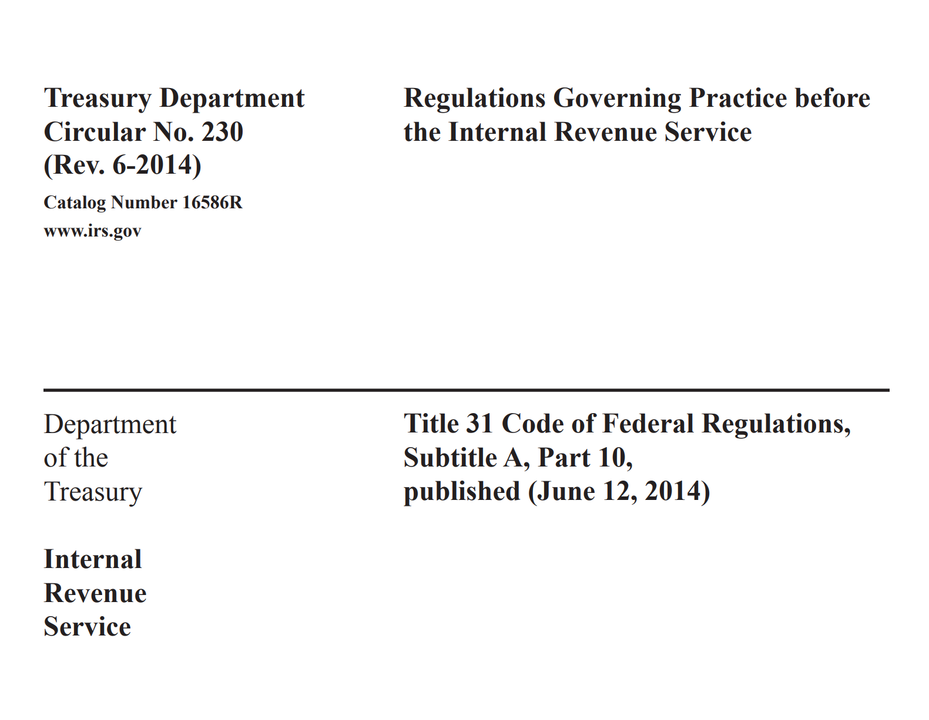

Slide 2
Circular 230

Slide 3


Who can Practice In Front of the IRS?
The following groups can practice before the IRS :
1) Attorneys
  Good Standing With IRS and State bar
  Not disbarred
  Written declaration by party authorized to represent
2) CPAs
  Qualified CPA in your State/Jurisdiction
    Not suspended
  Not suspended from practice by the IRS office of professional Responsibilities
  File written declaration by party authorized to represent,
3) “Enrolled” agents
  Designation issue by the IRS after passing EA exam.
4) Registered Tax Return Prepares

Slide 4
Rules of Conduct
Conflict of interest
Information to Be furnished
Due Diligence
Client Record
Knowledge of Client Noncompliance: Error or omission
Solicitation/Advertisement
Others

Slide 5

Conflict of interest
What is conflict of interest?
  a situation in which the concerns or aims of two different parties are incompatible
  Husband and Wife in a divorce case: Consent from Both parties
All parties must be informed about the conflict of interest
  Written consent must be within 30 days
No need to inform IRS!
Not Allowed:
  Practitioner believe their effectiveness to represent the parties is diminished by this conflict of interest (competent and diligent representing)

Slide 6

Information to be furnished to IRS
What if IRS asks for record and information?
Submit information or records properly and lawfully requested by a duly authorized officer or employee of the IRS UNLESS”
You have a teasonable believe (in good faith)
  the information is privileged or
  the request is not proper and lawful
If you know who has the information then you have to information the IRS

Slide 7

Due Diligence
What is diligence?
  Careful and persistent work or effort.
Exercise due diligence in terms of:
  Preparing and assisting in preparing return
  Filing retuned
  Documents and other papers related to IRS
Diligence assumed if:
  Relies upon the work product of another person and
  uses reasonable care in hiring/engaging, supervising training and evaluating the person
A practitioner may not unreasonably delay the any matter before the IRS.
Don’t drag your feet

Slide 8

Client Records
Must return client record
  Regardless of fee dispute
  Belong to the client
    Client need to file their return
Paperwork prepared by the practitioner is not required to be returned.
Exception for for some state law (permit withholding recording in a fee dispute):
  Return only record that is required to be attached with the return.
  Also, give them the right to review and copy
Client Records include any work done by third party of behalf of the client (Construction Company: Architect/engineer)

Slide 9

Client’s Noncompliance
In cases of noncompliance such client made an error or omission discovered:
  Required to advise the client of noncompliance and
  the consequences of such noncompliance, error, or omission under the Code and regulations.
Circular 230 does not require the practitioner to notify the IRS.
No Need to withdraw

Slide 10
Solicitation/Advertisement
Cannot have:
False, fraudulent, misleading, deceptive, or unfair statements or claims are not allowed.
private or public
Do not give any guarantees (Max refund, no Taxes to be paid!)
Expertise (Give credential)
Each of the following fees may be advertised:
  Fixed fees for specific routine services (must be honored for 30 days)
  A range of fees for particular services
  The fee for an initial consultation
  Hourly rates
  Availability of a written fee schedule
You can communicate in many ways:
  Radio, Email, TV, Newspaper,Etc.
  Keep records for 3 years

Slide 11
No! No!
Cannot endorse (negotiate) a check issued to a client to yourself
May not charge unconscionable fee in connect with any matter before IRS
Cannot Charge a contingent fee (commission or pay for performance Unless it is an IRS examination of
  Original return
  Amend Returned
  Claims for refund and credits
Cannot give advise the client to take frivolous tax position
  knowingly advanced in bad faith and is patently improper

Slide 12
Competent
Possess the appropriate level of skill and knowledge:
  Experience
  Education
  Research
  Consult with experts

Slide 13
Best Practices (Circular 230)
Provide highest quality representation.
Best practices include four general elements:
  Terms of the engagement: Communicating clearly with the client about the terms of the engagement. Engagement letter
  Conclusion must be supported by evidence (facts) and law➔ due diligence
  Advise the client about potential issues with the conclusions
    Might be challenged by the IRS
    Potential penalties if relied on the advice
  Acting fairly and with integrity in practice before the IRS
Firm makes sure all members and employees follow the standard (I/C)
  Disseminate, educate, train and test

Slide 14
Others
Must inform the client about:
  Any penalty reasonably likely to apply with respect to:
    any document submitted to the IRS
    Position taken on a tax return if advice was given or
    return prepared or signed
Information provided by the client:
  Rely in good faith with verification unless the information
    Incomplete
    Contradictory
    Wrong
    Questionable

Slide 15
Written Media
Written advice about any federal tax matter
  Base the advice on reasonable assumptions
  Comply with relevant facts/laws (no cherry picking) that are known or should be known
    Paper or electronic communication (email, Text)
The advice must not consider the possibility that either a tax return will not be audited or a matter will not be raised during the audit
Practitioner may rely in good faith on the advice of another practitioner only if that advice is reasonable given all the facts and circumstances.
The practitioner cannot rely on the advice of a person who either the practitioner knows or should know is not competent to provide the advice or has an unresolved conflict of interest.

Slide 16
In Case Of Violation
  The “Secretary of the Treasury” may
  censured (public reprimand),
  suspended, or
  disbarred from practice before the IRS.
  Any practitioner who
    Is shown to be incompetent or disreputable (not in good faith)
    Refuses to comply with the rules and regulations relating to practice before the IRS
    Willfully and knowingly, with intent to defraud, deceives, misleads, or threatens any client
  The following is a brief list of conduct that may result in suspension or disbarment:
    Being convicted of an offense involving dishonesty or breach of trust
    Providing false or misleading information to the Treasury Department, including the IRS
    Negotiating a client’s refund check or not promptly remitting a refund check
    Circulating or publishing matter related to practice before the IRS that is deemed libelous or malicious
    Using abusive language
    Suspension from practice as a CPA by any state licensing authority, any federal court of record, or any federal agency, body, or board
    Conviction of any felony involving conduct that renders the practitioner unfit to practice before the IRS
    Attempting to influence the official action of any IRS employee by bestowing a gift, favor, or anything of value
    Willfully evading or assisting others to evade any federal tax payments
  A notice of disbarment or suspension of a CPA from practice before the IRS is issued to IRS employees, interested departments and agencies of the federal government, and state licensing authorities.

