Slide 1
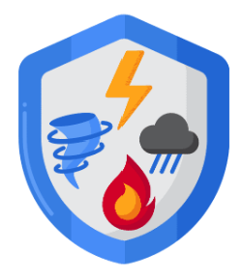
What is business resiliency? And why we need?
Business resiliency refers to an organization's ability to adapt, withstand, and quickly recover from disruptions or crises while maintaining its operations, competitive advantage, and long-term viability.
Disasters/accidents:
  Natural: Earthquakes, floods, fires, tornadoes
  Human Made (intentional or unintentional): Unhappy employee exposing the data, terrorist attack (9/11), hackers, viruses, lost of electric power etc.
It is a proactive approach that involves identifying potential threats, vulnerabilities, and risks, and implementing strategies and plans to minimize their impact.
A resilient business can maintain (continue to operate) or rapidly resume(get back on your feet) essential functions during and after a crisis, ensuring minimal disruption to its customers, employees, stakeholders, and reputation.
For more, visit:
www.farhatlectures.com

Slide 2

Business Resiliency Plan
4 Components to form proper business resiliency plan
  Organization Continuity Planning
  Systems Controls
  Crisis Management
  Disaster Recovery
For more, visit:
www.farhatlectures.com

Slide 3

Organization Continuity Planning
Organization Continuity Planning (OCP) is the process of creating a plan to ensure that an organization can continue to function in the event of a disaster or major disruption.
  OCP is an essential component of risk management, and it involves identifying potential risks, assessing their potential impact, and developing strategies to mitigate those risks.
The goal of OCP is to minimize the impact of a disruption on an organization's ability to function and to ensure that critical business functions can be restored as quickly as possible (how to bring things back “online”. OCP typically includes the following steps:
  Risk Assessment
  Business Impact Analysis (BIA)
  Development of Strategies
  Plan Development and Implementation
  Testing and Maintenance
For more, visit:
www.farhatlectures.com

Slide 4
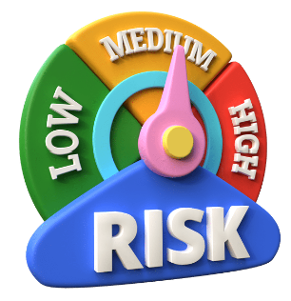
Risk Assessment (1 of 5)
Risk Assessment:
  Identifying potential risks and their potential impact on the organization
  Identify key business processes and their related risk
  Determine the acceptable downtime (5 seconds, 5 minutes, 5 hours or 5 days)
Example: A financial institution conducts a risk assessment to identify potential threats such as cyber-attacks, natural disasters, and power outages on their electronic trading platform
For more, visit:
www.farhatlectures.com

Slide 5

Business Impact Analysis (2 of 5)
Determining the critical business functions that need to be restored following a disruption and the timeframe in which they must be restored.
  Example: An e-commerce company conducts a BIA to determine the impact of a website outage on their revenue and customer satisfaction.
For more, visit:
www.farhatlectures.com

Slide 6
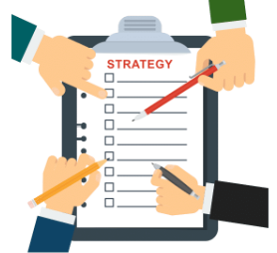
Development of Strategies (3 of 5)
Developing strategies to mitigate the potential impact of a disruption, such as implementing backup systems, identifying alternate suppliers, or establishing off-site backup facilities.
  Example: A manufacturing company develops a strategy to mitigate the risk of a supply chain disruption by identifying alternative suppliers and establishing relationships with them.
For more, visit:
www.farhatlectures.com

Slide 7
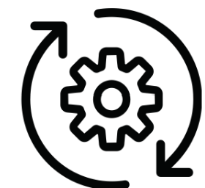
Plan Development and Implementation (4 of 5)
Developing and implementing a plan that outlines the steps that need to be taken in the event of a disruption.
  Example: An IT company develops a detailed OCP plan that outlines the roles and responsibilities of employees in the event of a cyber-attack and includes step-by-step procedures for data recovery.
For more, visit:
www.farhatlectures.com

Slide 8

Testing and Maintenance (5 of 5)
Regularly testing and updating the OCP plan to ensure that it remains effective and up-to-date.
  Example: An insurance company conducts regular OCP plan testing and updates the plan based on feedback and new risks identified in the risk assessment.
For more, visit:
www.farhatlectures.com

Slide 9
Business Resiliency Measures
4 Components to form proper business resiliency plan
  Organization Continuity Planning
  Systems Controls
  Crisis Management
  Disaster Recovery
For more, visit:
www.farhatlectures.com

