Slide 1

Business Resiliency Measures
4 Components to form proper business resiliency plan
  Organization Continuity Planning
  System (availability) Controls
  Crisis Management
  Disaster Recovery Plan (DRP)
For more, visit:
www.farhatlectures.com

Slide 2
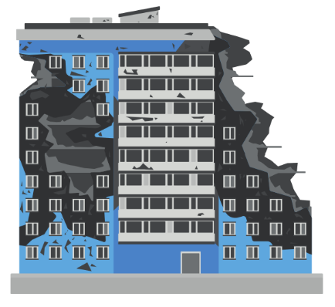
Disaster Recovery Plan (DRP)
A disaster recovery plan (DRP) is a documented process or set of procedures designed to help an organization recover from and resume normal operations after a disruptive event, such as a natural disaster, cyber-attack, or equipment failure.
  DRPs play a crucial role in minimizing downtime, protecting critical data and systems, and ensuring business continuity.
One of the key components of a DRP is the establishment of an alternative site for business operations in case the primary site becomes unusable. These alternative sites are categorized into cold, warm, and hot sites, depending on their readiness and level of infrastructure.
Starts with Steps in DRP
For more, visit:
www.farhatlectures.com

Slide 3
Steps in DRP
Risk assessment and business impact analysis: Identify potential threats and evaluate the impact that those threats could have on your organization's critical systems, data, and operations. Assess the likelihood and consequences of each risk, and prioritize them accordingly.
Establish recovery objectives: Determine the recovery time objective (RTO) and recovery point objective (RPO) for each critical system or function.
  The RTO is the maximum acceptable amount of time it should take to restore operations after a disruption
  RPO is the maximum amount of data loss that can be tolerated.
Identify critical systems and dependencies: List the essential systems, applications, and data that must be recovered to maintain business continuity. Identify the dependencies between these systems, and develop a prioritized recovery sequence.
Assign roles and responsibilities: Designate a disaster recovery team with clearly defined roles and responsibilities. This team should be responsible for executing the DRP, coordinating communication, and making decisions during a disaster.
Develop a communication plan: Outline a communication protocol to ensure that relevant stakeholders, including employees, vendors, and customers, are informed about the disaster and the recovery process. This plan should include communication channels, contact lists, and templates for announcements.
Document the DRP: Create a detailed written plan that includes all the components mentioned above, along with instructions, checklists, and contact information. This document should be accessible and easily understood by all members of the disaster recovery team.
Train and educate staff: Ensure that employees and members of the disaster recovery team are familiar with the DRP and their responsibilities. Conduct regular training sessions and workshops to keep them informed and prepared.
Test and update the DRP: Regularly test the DRP to ensure its effectiveness and identify any gaps or weaknesses. Conduct simulations, drills, or table-top exercises to evaluate the plan's feasibility. Update the DRP as needed to account for changes in the organization's systems, processes, or risk factors.
For more, visit:
www.farhatlectures.com

Slide 4

Cold Site
A cold site is a basic facility with minimal infrastructure and no pre-installed hardware, software, or telecommunications equipment. It provides physical space, power, and cooling systems, but the organization needs to provide and install all necessary equipment and configure the systems to resume operations.
  Cold sites are the least expensive option, but they require the longest recovery time.
Example: A warehouse or office space that is leased as a backup location in case of a disaster. The organization would need to transport and set up their equipment, establish connectivity, and restore data from backups before resuming operations.
For more, visit:
www.farhatlectures.com

Slide 5

Warm Site
A warm site is partially equipped with some hardware, software, and telecommunications equipment. It has a more advanced infrastructure than a cold site but is not fully operational.
  In the event of a disaster, the organization would need to install additional equipment and restore the data from backups.
  Warm sites have a shorter recovery time compared to cold sites and are moderately expensive.
Example: A data center with servers, storage, and network equipment partially set up, but not fully operational. The organization would need to complete the setup, establish connectivity, and restore data from backups before resuming operations.
For more, visit:
www.farhatlectures.com

Slide 6

Hot Site
A hot site is a fully equipped and operational facility with all necessary hardware, software, and telecommunications equipment in place. It mirrors the organization's primary site and is constantly updated with real-time data.
  In the event of a disaster, operations can be quickly switched to the hot site with minimal downtime. Hot sites are the most expensive option but offer the shortest recovery time.
Example: A data center with identical hardware, software, and network configurations as the primary site. The organization can switch operations to the hot site almost immediately after a disaster, ensuring minimal disruption to their business.
For more, visit:
www.farhatlectures.com

