Slide 1

Business Resiliency Measures
4 Components to form proper business resiliency plan
  Organization Continuity Planning
  System (availability) Controls
  Crisis Management
  Disaster Recovery
For more, visit:
www.farhatlectures.com

Slide 2
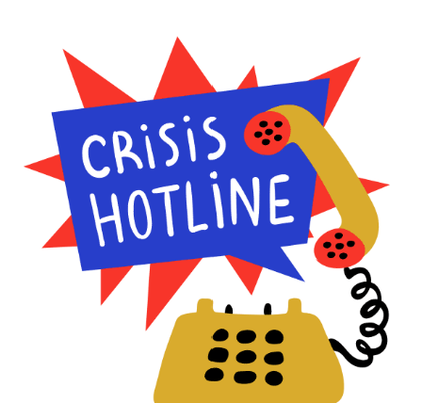


Crisis Management
Crisis management is the process of preparing for, responding to, and recovering from a significant event that threatens the business's operations, reputation, or survival.
  Crisis management is an essential aspect of business resilience, which is the ability of a company to adapt and recover from disruptions and maintain its operations.
Natural disasters: During Hurricane Katrina in 2005, Walmart set up a crisis management center to coordinate emergency response efforts, donated $20 million to relief efforts, and reopened stores as quickly as possible to provide essential supplies to affected communities.
Cybersecurity Incident: In 2017, Equifax suffered a massive data breach, affecting over 143 million consumers. Equifax implemented a crisis management plan, providing free identity theft protection to those affected and taking steps to improve its cybersecurity protocols.
For more, visit:
www.farhatlectures.com

Slide 3
Steps Involved In Crisis Management
Identify potential crises: The first step in crisis management is to identify potential crises that could affect the business. This includes conducting a risk assessment and identifying possible threats and vulnerabilities.
Develop a crisis management plan: The next step is to develop a crisis management plan.
  This plan should include procedures for responding to crises, identifying key stakeholders, and outlining communication protocols.
Establish a crisis management team: A crisis management team should be established, including key personnel from various departments, to coordinate the response to a crisis.
  This team should be trained and prepared to respond quickly and effectively.
  Effective communication is critical during a crisis.
    The crisis management team should communicate with key stakeholders, including employees, customers, suppliers, and the media, to provide timely and accurate information.
Test the plan! This includes activating the crisis management team, communicating with key stakeholders, and taking steps to mitigate the impact of the crisis.
After the crisis has been resolved/maintained, it's important to evaluate the response and identify areas for improvement.
  This includes reviewing the crisis management plan and procedures, identifying any gaps or weaknesses, and making changes as needed.
Update the crisis management plan: Based on the evaluation of the response, the crisis management plan should be updated and revised as needed to ensure that the organization is better prepared for future crises.
For more, visit:
www.farhatlectures.com

