Slide 1

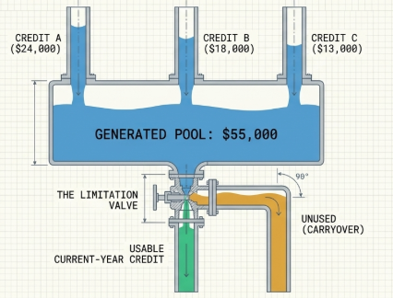
General Business Tax Credit
Congress uses tax credits to encourage qualifying business activities.
  Examples include research, rehabilitation of qualifying historic buildings, and employer-provided child care.
The general business credit combines component business credits within a common framework.
Each component has its own eligibility requirements and calculation.
Form 3800 generally combines the credits and determines the amount allowed against income tax.
📹 Videos AICPA MCQs & Sims 🤖 Farhat AI Assistant🎙 Podcast Lessons 📊 CPA, CMA, EA Exam 💼Accounting & Finance Courses 🙌 Support by Farhat Team
🌐 farhatlectures.com | ⭐ Start Your Free Trial

Slide 2
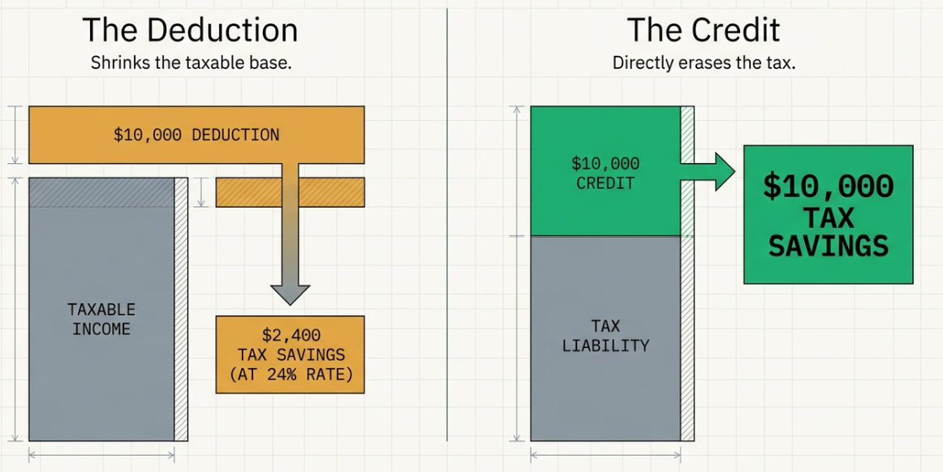
Tax Deduction vs. Tax Credit
📹 Videos AICPA MCQs & Sims 🤖 Farhat AI Assistant🎙 Podcast Lessons 📊 CPA, CMA, EA Exam 💼Accounting & Finance Courses 🙌 Support by Farhat Team
🌐 farhatlectures.com | ⭐ Start Your Free Trial

Slide 3
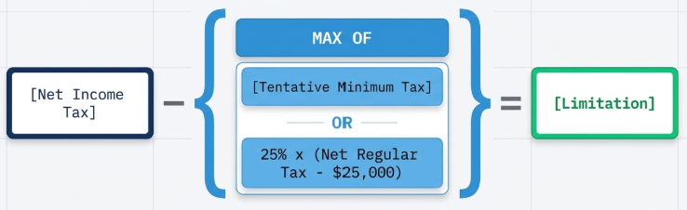

Limitation
Net regular tax liability ➔ Regular tax liability − specified allowable credits
Net income tax ➔ Regular tax liability + AMT − those same specified allowable credits
📹 Videos AICPA MCQs & Sims 🤖 Farhat AI Assistant🎙 Podcast Lessons 📊 CPA, CMA, EA Exam 💼Accounting & Finance Courses 🙌 Support by Farhat Team
🌐 farhatlectures.com | ⭐ Start Your Free Trial
Notes:
TMT is the tax calculated under the alternative minimum tax system.

Slide 4
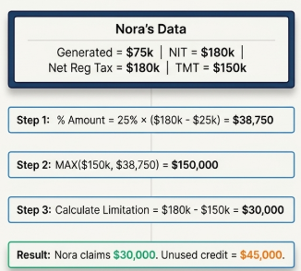
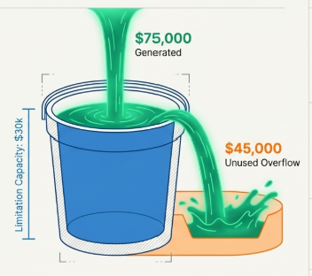
Example
📹 Videos AICPA MCQs & Sims 🤖 Farhat AI Assistant🎙 Podcast Lessons 📊 CPA, CMA, EA Exam 💼Accounting & Finance Courses 🙌 Support by Farhat Team
🌐 farhatlectures.com | ⭐ Start Your Free Trial

Slide 5
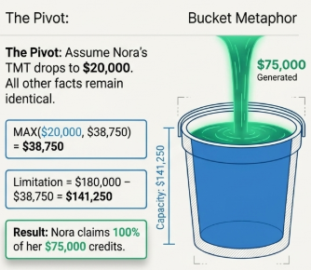
Change the Example
📹 Videos AICPA MCQs & Sims 🤖 Farhat AI Assistant🎙 Podcast Lessons 📊 CPA, CMA, EA Exam 💼Accounting & Finance Courses 🙌 Support by Farhat Team
🌐 farhatlectures.com | ⭐ Start Your Free Trial

Slide 6
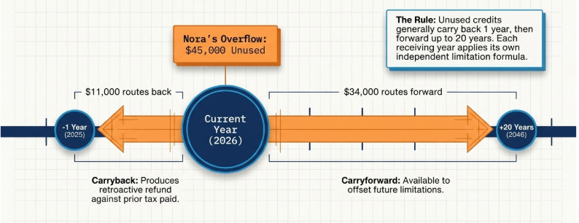
Carrybacks and Carryforwards
📹 Videos AICPA MCQs & Sims 🤖 Farhat AI Assistant🎙 Podcast Lessons 📊 CPA, CMA, EA Exam 💼Accounting & Finance Courses 🙌 Support by Farhat Team
🌐 farhatlectures.com | ⭐ Start Your Free Trial
Notes:
Assume 2025 has 11,000 of unsed limitation capacity

Slide 7
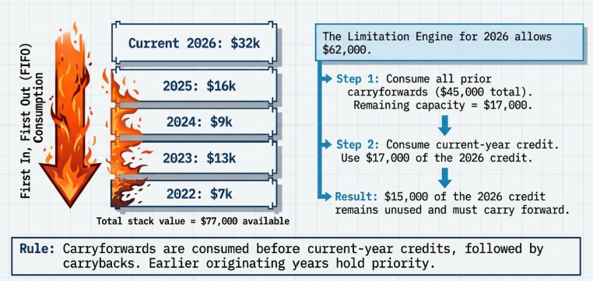
Ordering rules
📹 Videos AICPA MCQs & Sims 🤖 Farhat AI Assistant🎙 Podcast Lessons 📊 CPA, CMA, EA Exam 💼Accounting & Finance Courses 🙌 Support by Farhat Team
🌐 farhatlectures.com | ⭐ Start Your Free Trial

Slide 8
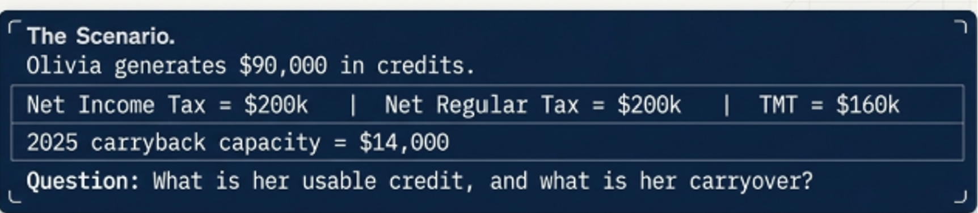
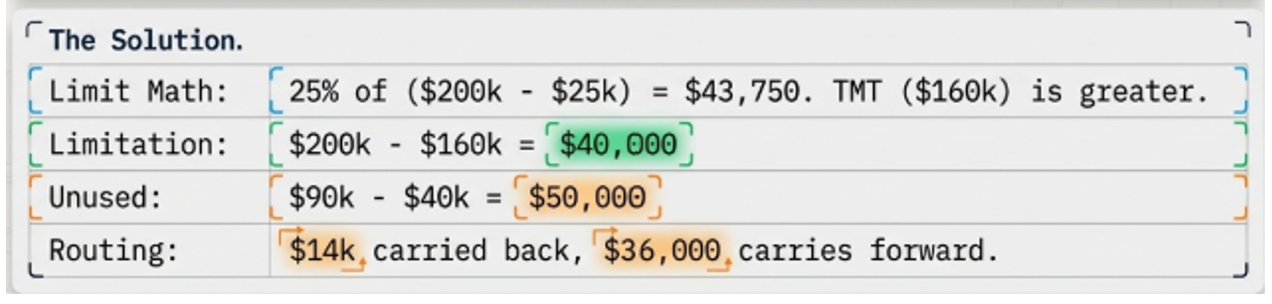
Comprehensive Example
📹 Videos AICPA MCQs & Sims 🤖 Farhat AI Assistant🎙 Podcast Lessons 📊 CPA, CMA, EA Exam 💼Accounting & Finance Courses 🙌 Support by Farhat Team
🌐 farhatlectures.com | ⭐ Start Your Free Trial

