Slide 1

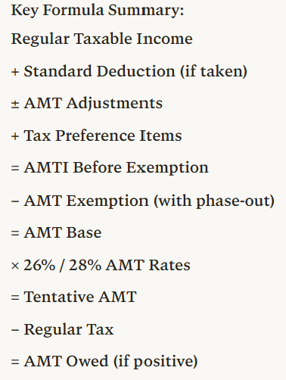
Step | Description | Operation | Notes
1 | Regular taxable income (TI) | Starting point | From Form 1040
2 | Plus: Standard deduction if taken | + | Add back if claimed
3 | Plus/minus: AMT adjustment items | ± adjustments | SALT, depreciation, ISO, etc.
4 | Plus: Tax preference items | + | Private activity bonds, etc.
5 | = AMTI before exemption | Subtotal | Alternative Minimum Taxable Income
6 | Minus: AMT exemption amount | − | Subject to phase-out
 | - MFJ: $140,200 (2026) |  | Phase-out starts at $1,000,000
 | - Single/HOH: $90,100 (2026) |  | Phase-out starts at $500,000
 | - Phase-out rate: 50% |  | Lose $0.50 per $1 over threshold
7 | = AMT base (AMTI after exemption) | Subtotal | Amount subject to AMT rates
8 | Multiplied by AMT tax rates | × 26% or 28% | Two-bracket system
 | - 26% on first $244,500 (MFJ) / $122,250 (MFS)
 | - 28% on amounts above these thresholds
9 | = Tentative AMT before credits | Subtotal | Preliminary AMT liability
10 | Minus: Allowable credits | − | Foreign tax credit, etc.
11 | = Tentative AMT | Subtotal | Final AMT calculation
12 | Less: Regular tax liability | − | From regular tax calculation
13 | = AMT owed (pay if positive) | FINAL | Additional tax beyond regular tax
📹 Videos AICPA MCQs & Sims 🤖 Farhat AI Assistant🎙 Podcast Lessons 📊 CPA, CMA, EA Exam 💼Accounting & Finance Courses 🙌 Support by Farhat Team
🌐 farhatlectures.com | ⭐ Start Your Free Trial

Slide 2
AMT CPA Simulation/Exercise
Olivia and Daniel are married filing jointly. Their AGI is $420,000. They report the following itemized deductions and AMT preference items.
Deduction | Amount
Medical expenses after floor | $6,200
State and local taxes | 32,500
Mortgage interest | 16,000
Charitable contributions | 20,000
Incentive Stock Option (ISO)
Olivia exercised 2,000 incentive stock options.
Exercise price = $22
Market value at exercise = $30
Assume regular tax liability = $74,000.
Depreciation on business equipment purchased during the year:
Asset | Cost | Regular MACRS Depreciation | AMT Depreciation
Computer equipment | $8,000 | $3,200 | $2,400
Office furniture | $15,000 | $3,750 | $2,813
📹 Videos AICPA MCQs & Sims 🤖 Farhat AI Assistant🎙 Podcast Lessons 📊 CPA, CMA, EA Exam 💼Accounting & Finance Courses 🙌 Support by Farhat Team
🌐 farhatlectures.com | ⭐ Start Your Free Trial

Slide 3
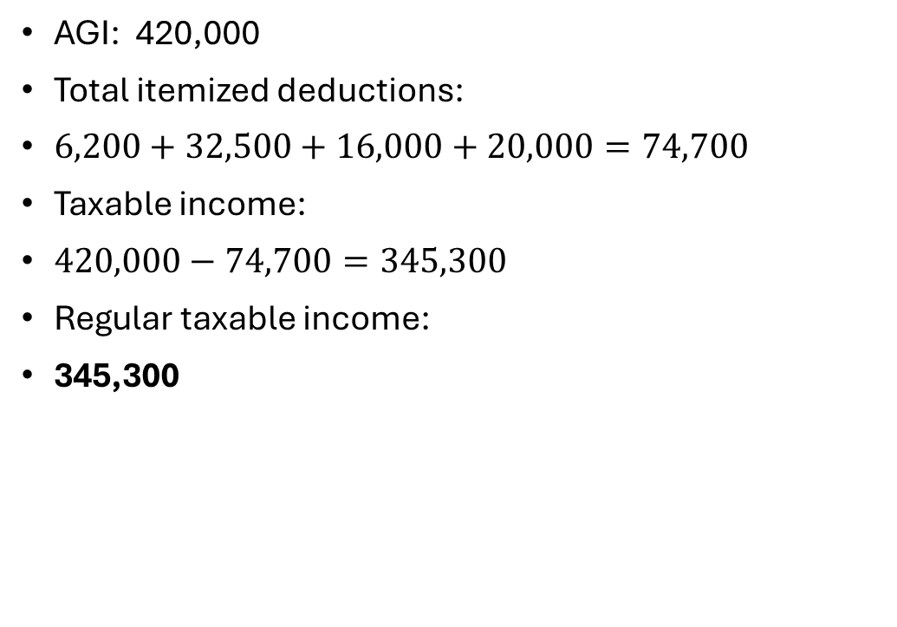
Compute Regular Taxable Income
AGI: 420,000
Total itemized deductions:
$6,200+32,500+16,000+20,000=74,700$
Taxable income:
$420,000−74,700=345,300$
Regular taxable income:
345,300
Deduction | Amount
Medical expenses after floor | $6,200
State and local taxes | 32,500
Mortgage interest | 16,000
Charitable contributions | 20,000
📹 Videos AICPA MCQs & Sims 🤖 Farhat AI Assistant🎙 Podcast Lessons 📊 CPA, CMA, EA Exam 💼Accounting & Finance Courses 🙌 Support by Farhat Team
🌐 farhatlectures.com | ⭐ Start Your Free Trial

Slide 4
Identify AMT Adjustments
Deduction Category | Regular Tax Treatment | AMT Treatment | AMT Adjustment
Medical Expenses | Deductible after AGI floor | Still deductible under AMT | 0
State and Local Taxes (SALT) | Deductible as itemized deduction | Not allowed for AMT | Add back full amount
Mortgage Interest | Deductible if acquisition debt | Allowed for AMT | 0
Charitable Contributions | Fully deductible (subject to limits) | Allowed for AMT | 0
Deduction | Amount
Medical expenses after floor | $6,200
State and local taxes | 32,500
Mortgage interest | 16,000
Charitable contributions | 20,000
📹 Videos AICPA MCQs & Sims 🤖 Farhat AI Assistant🎙 Podcast Lessons 📊 CPA, CMA, EA Exam 💼Accounting & Finance Courses 🙌 Support by Farhat Team
🌐 farhatlectures.com | ⭐ Start Your Free Trial

Slide 5
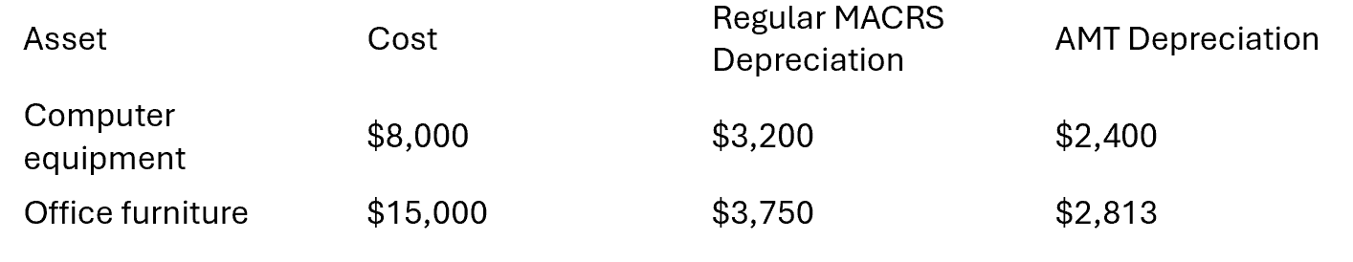
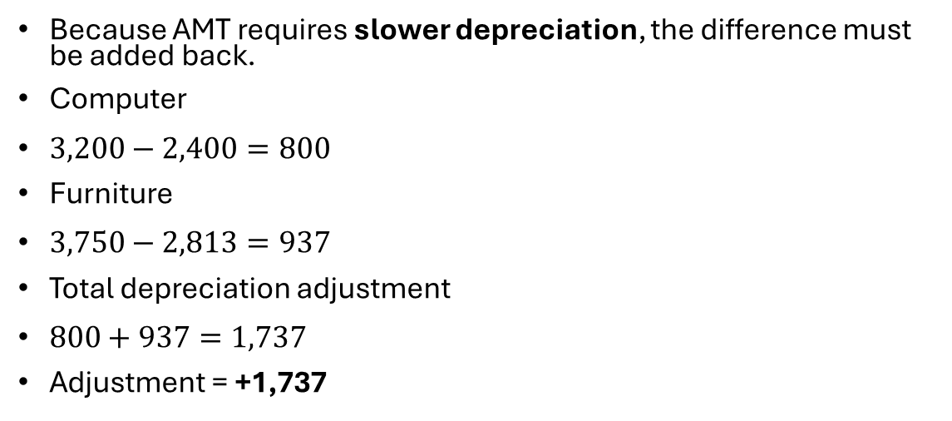
Depreciation Adjustment
Because AMT requires slower depreciation, the difference must be added back.
Computer
$3,200−2,400=800$
Furniture
$3,750−2,813=937$
Total depreciation adjustment
$800+937=1,737$
Adjustment = +1,737
📹 Videos AICPA MCQs & Sims 🤖 Farhat AI Assistant🎙 Podcast Lessons 📊 CPA, CMA, EA Exam 💼Accounting & Finance Courses 🙌 Support by Farhat Team
🌐 farhatlectures.com | ⭐ Start Your Free Trial

Slide 6
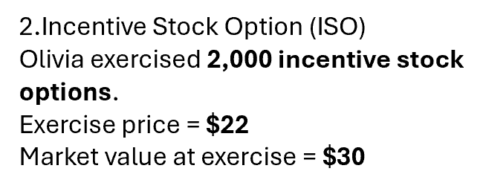
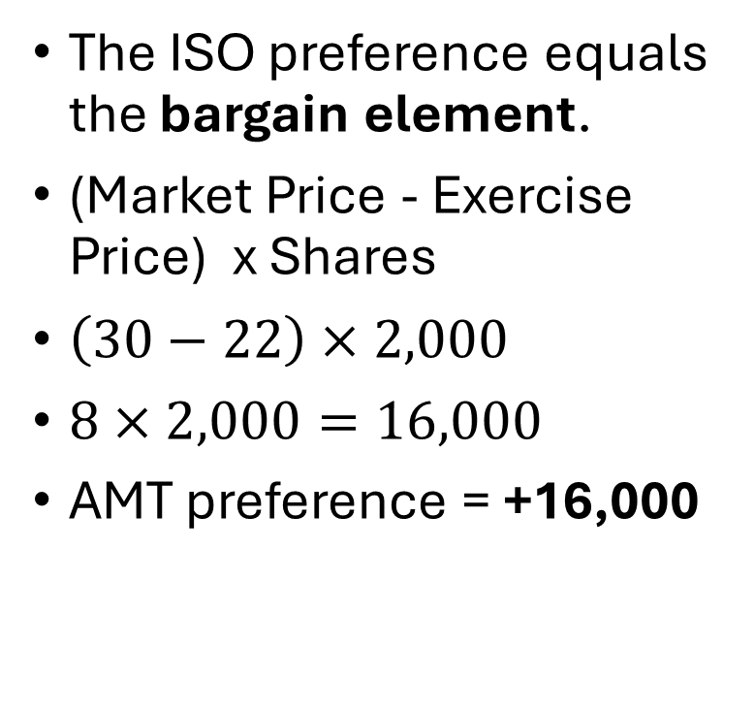
Incentive Stock Option Preference
The ISO preference equals the bargain element.
(Market Price - Exercise Price) x Shares
$\left(30−22\right)×2,000$
$8×2,000=16,000$
AMT preference = +16,000
📹 Videos AICPA MCQs & Sims 🤖 Farhat AI Assistant🎙 Podcast Lessons 📊 CPA, CMA, EA Exam 💼Accounting & Finance Courses 🙌 Support by Farhat Team
🌐 farhatlectures.com | ⭐ Start Your Free Trial

Slide 7
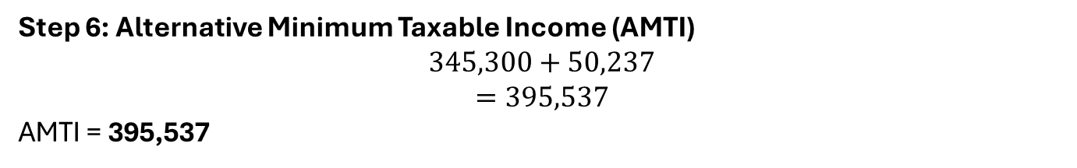

Total AMT Adjustments
Adjustment | Amount
SALT add-back | 32,500
Depreciation difference | 1,737
ISO preference | 16,000
Total adjustments
$$32,500+1,737+16,000=50,237$$
Step 6: Alternative Minimum Taxable Income (AMTI)
$$345,300+50,237$$
$$=395,537$$
AMTI = 395,537
📹 Videos AICPA MCQs & Sims 🤖 Farhat AI Assistant🎙 Podcast Lessons 📊 CPA, CMA, EA Exam 💼Accounting & Finance Courses 🙌 Support by Farhat Team
🌐 farhatlectures.com | ⭐ Start Your Free Trial

Slide 8
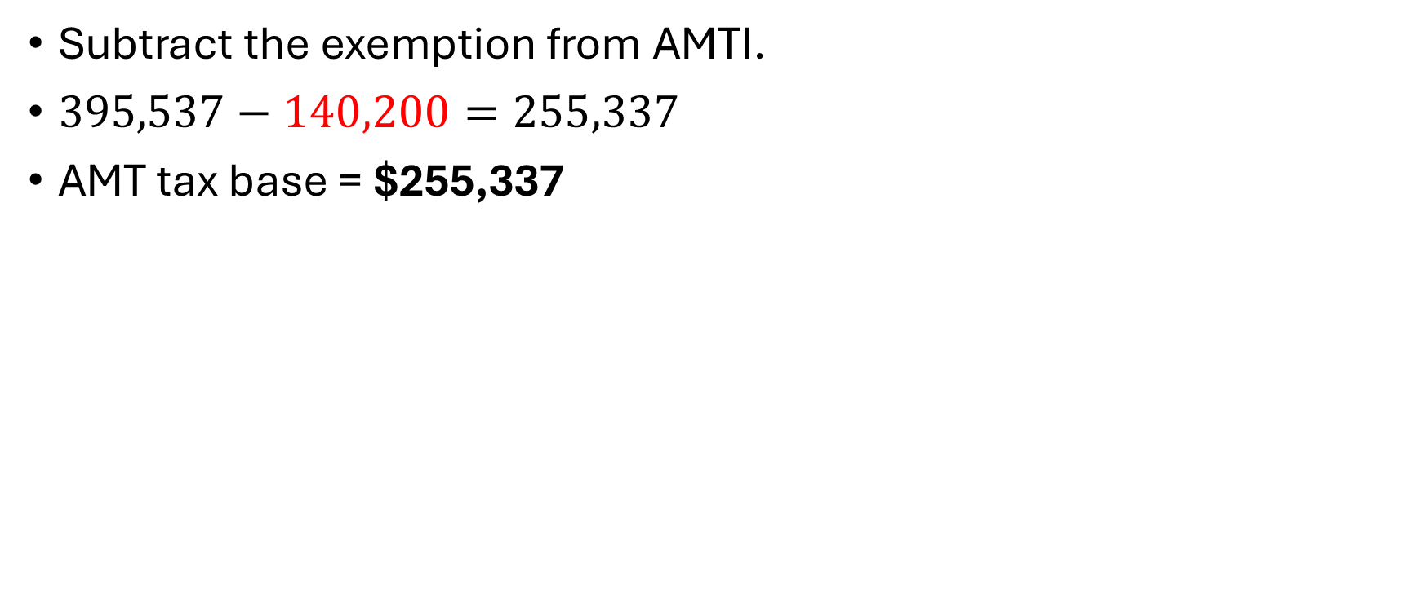
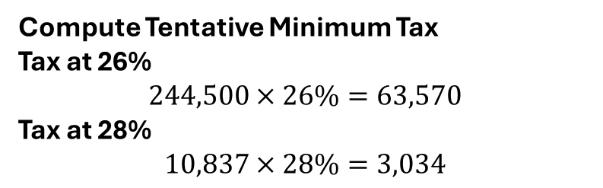

AMT Exemption
Subtract the exemption from AMTI.
$395,537−140,200=255,337$
AMT tax base = $255,337
Portion | Amount
26% bracket | First $244,500
28% bracket | Excess
Excess amount:
$$255,337−244,500=10,837$$
Compute Tentative Minimum Tax
Tax at 26%
$$244,500×26\%=63,570$$
Tax at 28%
$$10,837×28\%=3,034$$
63,570+3,034=66,604
Tentative Minimum Tax = $66,604
66,604<74,000. NO AMT Due
📹 Videos AICPA MCQs & Sims 🤖 Farhat AI Assistant🎙 Podcast Lessons 📊 CPA, CMA, EA Exam 💼Accounting & Finance Courses 🙌 Support by Farhat Team
🌐 farhatlectures.com | ⭐ Start Your Free Trial

