Slide 1

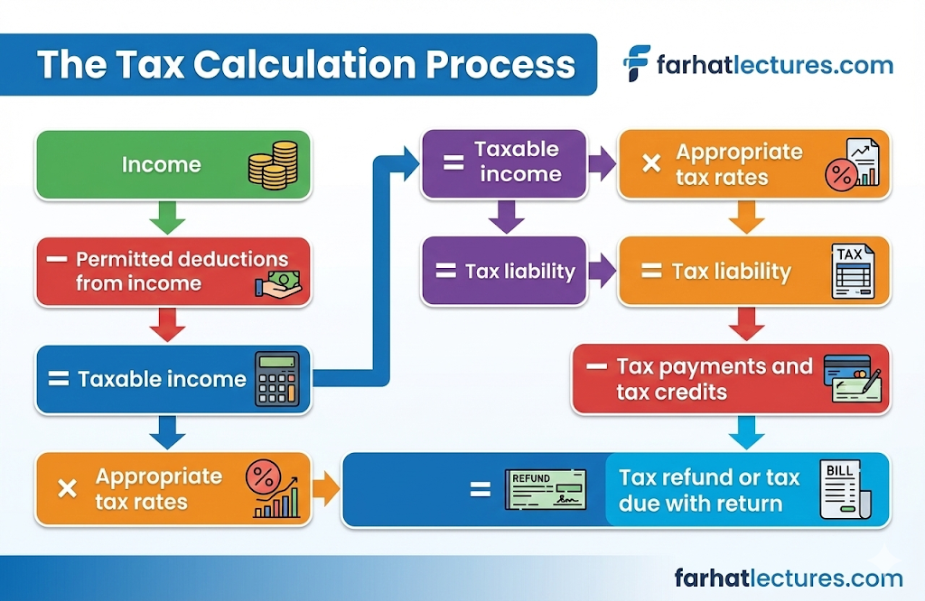
📹 Videos AICPA MCQs & Sims 🤖 Farhat AI Assistant🎙 Podcast Lessons 📊 CPA, CMA, EA Exam 💼Accounting & Finance Courses 🙌 Support by Farhat Team
🌐 farhatlectures.com | ⭐ Start Your Free Trial

Slide 2
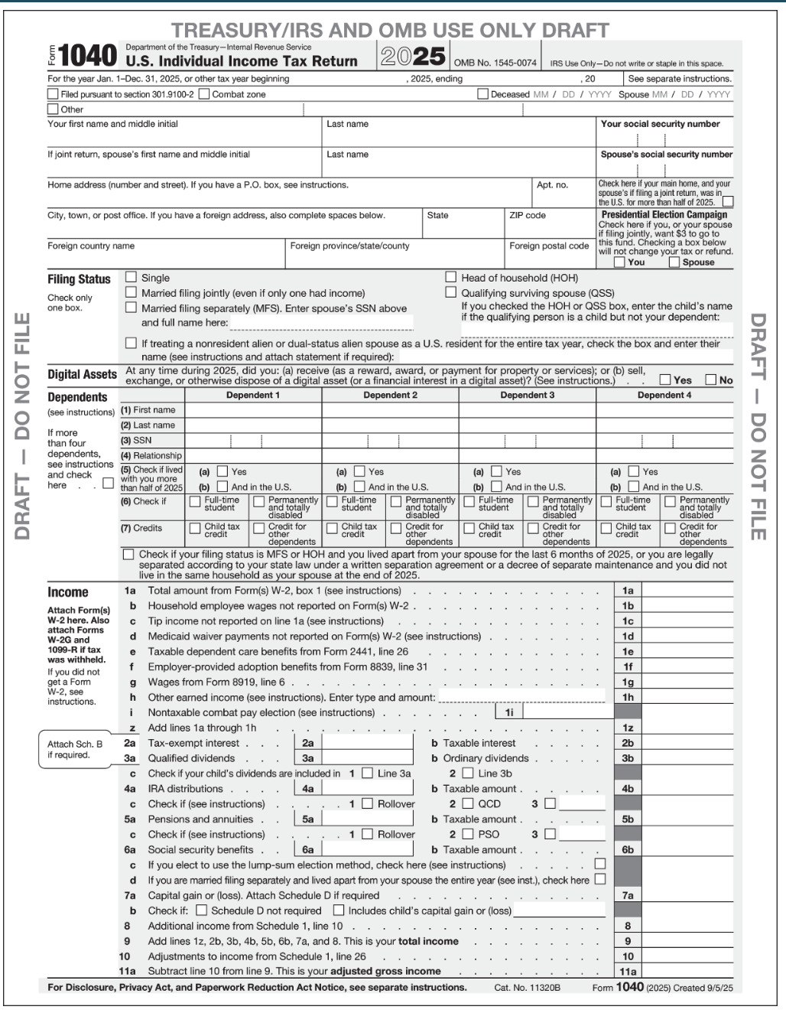
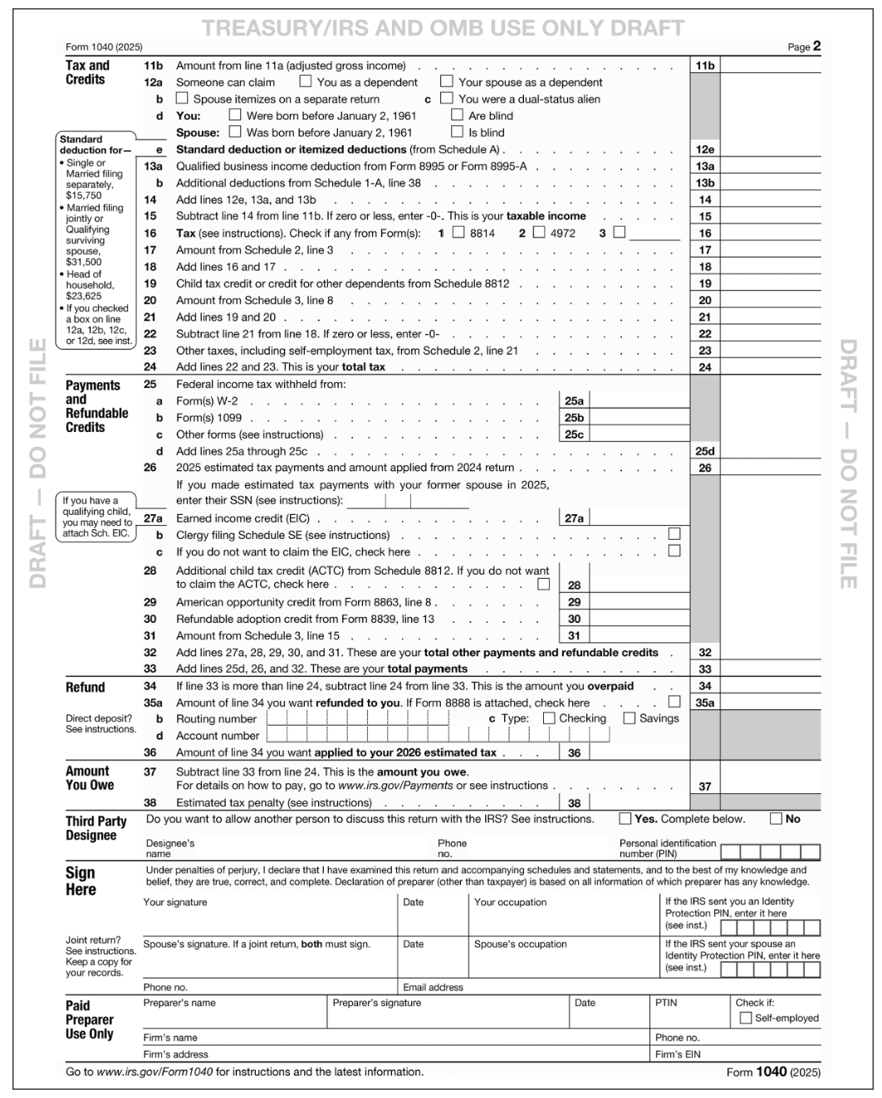
📹 Videos AICPA MCQs & Sims 🤖 Farhat AI Assistant🎙 Podcast Lessons 📊 CPA, CMA, EA Exam 💼Accounting & Finance Courses 🙌 Support by Farhat Team
🌐 farhatlectures.com | ⭐ Start Your Free Trial

Slide 3
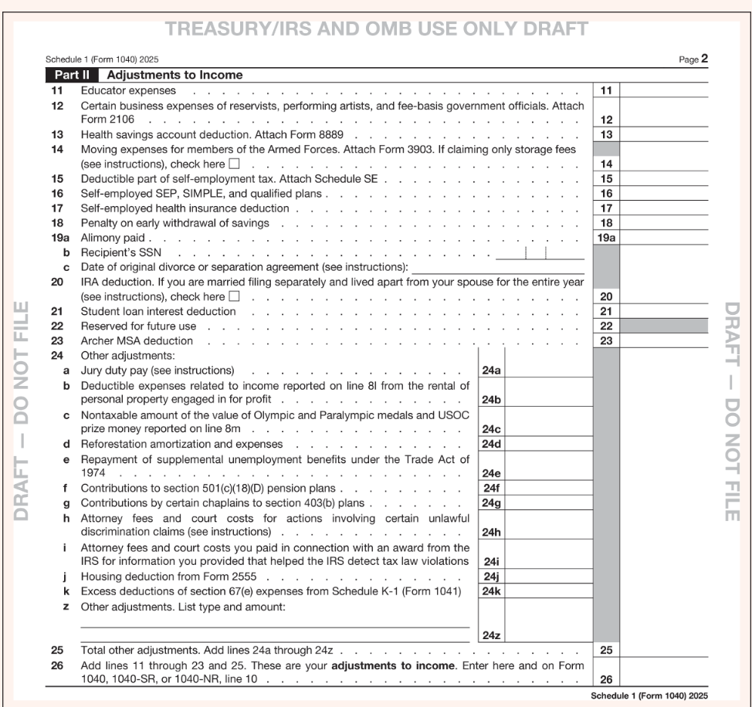
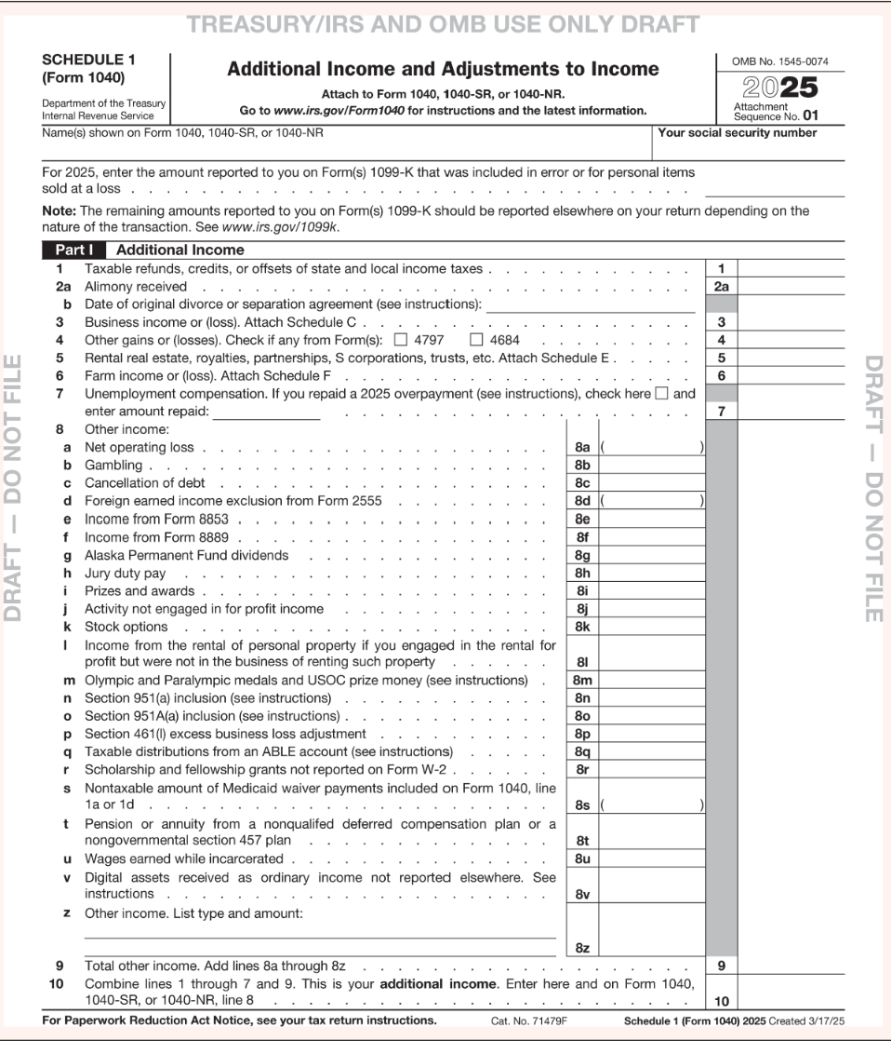
📹 Videos AICPA MCQs & Sims 🤖 Farhat AI Assistant🎙 Podcast Lessons 📊 CPA, CMA, EA Exam 💼Accounting & Finance Courses 🙌 Support by Farhat Team
🌐 farhatlectures.com | ⭐ Start Your Free Trial

Slide 4
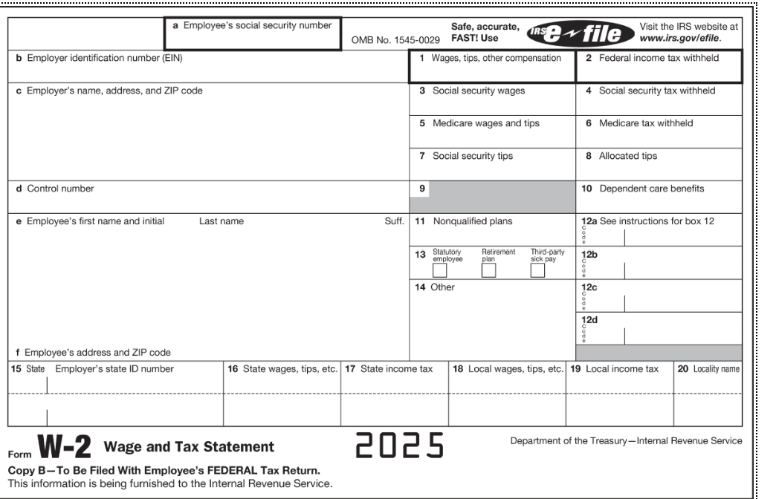
W-2 Wages
📹 Videos AICPA MCQs & Sims 🤖 Farhat AI Assistant🎙 Podcast Lessons 📊 CPA, CMA, EA Exam 💼Accounting & Finance Courses 🙌 Support by Farhat Team
🌐 farhatlectures.com | ⭐ Start Your Free Trial

Slide 5
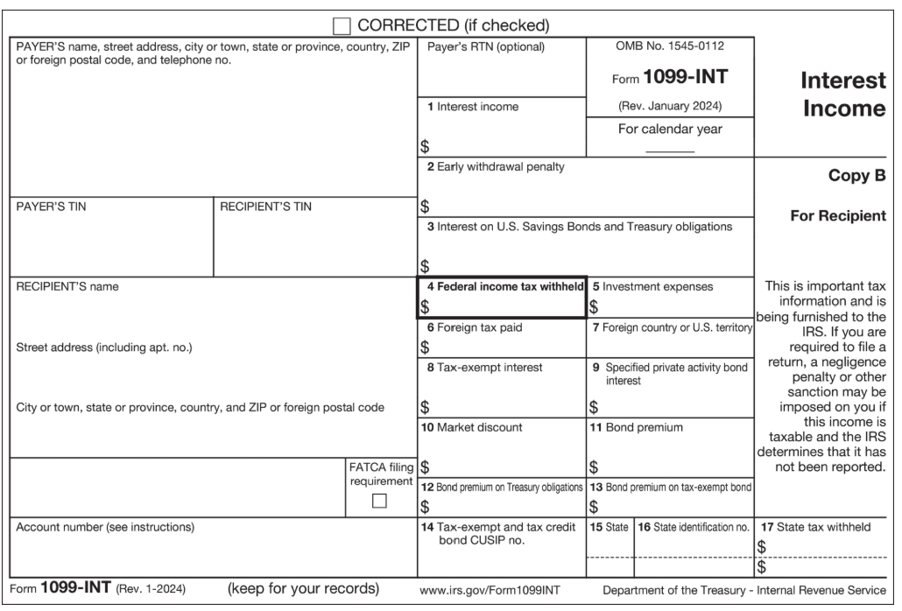
1099-Int
📹 Videos AICPA MCQs & Sims 🤖 Farhat AI Assistant🎙 Podcast Lessons 📊 CPA, CMA, EA Exam 💼Accounting & Finance Courses 🙌 Support by Farhat Team
🌐 farhatlectures.com | ⭐ Start Your Free Trial

Slide 6
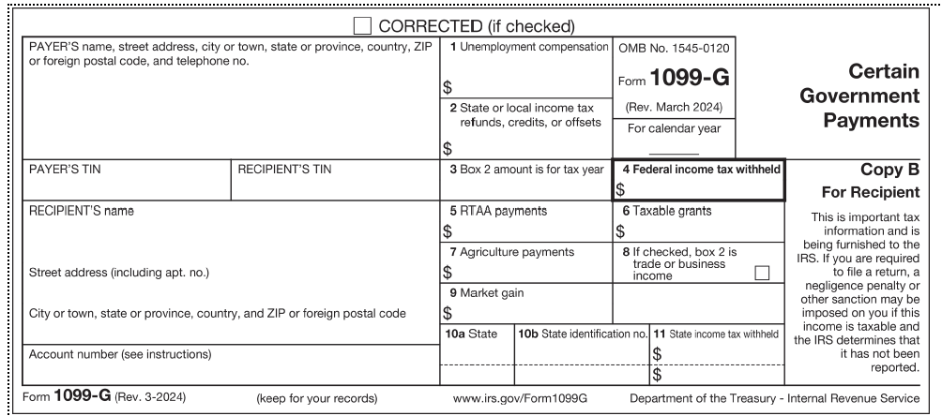
1099-G
📹 Videos AICPA MCQs & Sims 🤖 Farhat AI Assistant🎙 Podcast Lessons 📊 CPA, CMA, EA Exam 💼Accounting & Finance Courses 🙌 Support by Farhat Team
🌐 farhatlectures.com | ⭐ Start Your Free Trial

