Slide 1

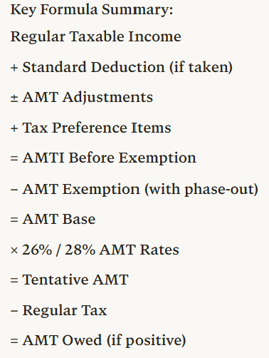
Step | Description | Operation | Notes
1 | Regular taxable income (TI) | Starting point | From Form 1040
2 | Plus: Standard deduction if taken | + | Add back if claimed
3 | Plus/minus: AMT adjustment items | ± adjustments | SALT, depreciation, ISO, etc.
4 | Plus: Tax preference items | + | Private activity bonds, etc.
5 | = AMTI before exemption | Subtotal | Alternative Minimum Taxable Income
6 | Minus: AMT exemption amount | − | Subject to phase-out
 | - MFJ: $140,200 (2026) |  | Phase-out starts at $1,000,000
 | - Single/HOH: $90,100 (2026) |  | Phase-out starts at $500,000
 | - Phase-out rate: 50% |  | Lose $0.50 per $1 over threshold
7 | = AMT base (AMTI after exemption) | Subtotal | Amount subject to AMT rates
8 | Multiplied by AMT tax rates | × 26% or 28% | Two-bracket system
 | - 26% on first $244,500 (MFJ) / $122,250 (MFS)
 | - 28% on amounts above these thresholds
9 | = Tentative AMT before credits | Subtotal | Preliminary AMT liability
10 | Minus: Allowable credits | − | Foreign tax credit, etc.
11 | = Tentative AMT | Subtotal | Final AMT calculation
12 | Less: Regular tax liability | − | From regular tax calculation
13 | = AMT owed (pay if positive) | FINAL | Additional tax beyond regular tax
📹 Videos AICPA MCQs & Sims 🤖 Farhat AI Assistant🎙 Podcast Lessons 📊 CPA, CMA, EA Exam 💼Accounting & Finance Courses 🙌 Support by Farhat Team
🌐 farhatlectures.com | ⭐ Start Your Free Trial

Slide 2
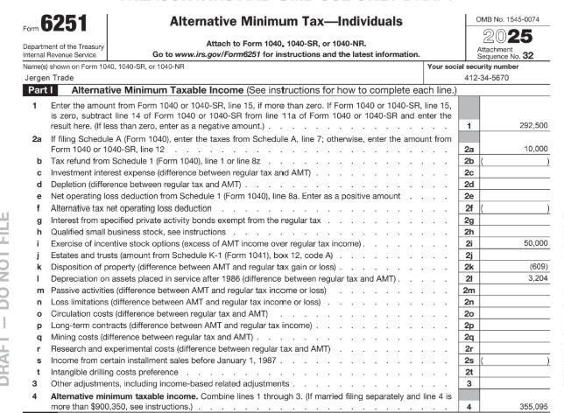
210,225
40,000
(646)
4,448
254,027
📹 Videos AICPA MCQs & Sims 🤖 Farhat AI Assistant🎙 Podcast Lessons 📊 CPA, CMA, EA Exam 💼Accounting & Finance Courses 🙌 Support by Farhat Team
🌐 farhatlectures.com | ⭐ Start Your Free Trial

Slide 3
Other AMT Adjustments
Incentive stock options adjustment
Long-term contracts
Are these the only ones? NO!
📹 Videos AICPA MCQs & Sims 🤖 Farhat AI Assistant🎙 Podcast Lessons 📊 CPA, CMA, EA Exam 💼Accounting & Finance Courses 🙌 Support by Farhat Team
🌐 farhatlectures.com | ⭐ Start Your Free Trial

Slide 4
Incentive Stock Options Adjustment
Right to buy the stock at a specific price for a period fo time ➔ Equity Compensation.
For regular tax purposes, no income is recognized when an incentive stock option is exercised. You are only buying the shares!
For AMT purposes, the positive adjustment is equal to the FMV of the stock less the amount the taxpayer paid for it (including any amount paid for the option).
Adam works for a large publicly traded company and regularly receives incentive stock options as bonuses. Adam exercises options to purchase 10,000 shares at $13 per share when the market value is $18.
Market value | 10,000 shares × $18 per share | = | $180,000
Cost of stock | 10,000 shares × $13 per share | = | 130,000
AMT adjustment (gain is taxed now!) |  |  | $ 50,000
What is the basis for the stock?
The stock basis is $130,000 for regular tax purposes and $180,000 for AMT.
Paying taxes for unrealized gain.
📹 Videos AICPA MCQs & Sims 🤖 Farhat AI Assistant🎙 Podcast Lessons 📊 CPA, CMA, EA Exam 💼Accounting & Finance Courses 🙌 Support by Farhat Team
🌐 farhatlectures.com | ⭐ Start Your Free Trial

Slide 5
210,225
40,000
50,000
(646)
4,448
304,027
📹 Videos AICPA MCQs & Sims 🤖 Farhat AI Assistant🎙 Podcast Lessons 📊 CPA, CMA, EA Exam 💼Accounting & Finance Courses 🙌 Support by Farhat Team
🌐 farhatlectures.com | ⭐ Start Your Free Trial

Slide 6
Long-term contracts
For AMT purposes, a taxpayer must use the percentage of completion method rather than the completed contract method to report the income from long-term contracts. (Intermediate Accounting).
The adjustment is the difference between the income under the percentage of completion method and income determined for regular tax.
In the year in question, if AMT income is smaller, the adjustment is negative.
  A negative adjustment is likely to occur in the year the contract is completed.
    This adjustment rarely, if ever, affects individual taxpayers.
📹 Videos AICPA MCQs & Sims 🤖 Farhat AI Assistant🎙 Podcast Lessons 📊 CPA, CMA, EA Exam 💼Accounting & Finance Courses 🙌 Support by Farhat Team
🌐 farhatlectures.com | ⭐ Start Your Free Trial

Slide 7
Other AMT Adjustments
 | Year 20X4 | Year 20X5 | Year 20X6 | Year 20X7 | Total
Percentage of completion(tax every year, AMT) | 25,000 | 25,000 | 25,000 | 25,000 | 100,000
Completed Contract method. Regular tax | 0 | 0 | 0 | 100,000 | 100,000
Adjustment | 25,000 | 25,000 | 25,000 | (-75,000) | 0
Important to understand this concept of reversing income.
📹 Videos AICPA MCQs & Sims 🤖 Farhat AI Assistant🎙 Podcast Lessons 📊 CPA, CMA, EA Exam 💼Accounting & Finance Courses 🙌 Support by Farhat Team
🌐 farhatlectures.com | ⭐ Start Your Free Trial

Slide 8
210,225
40,000
50,000
(646)
4,448
25,000
329,027
📹 Videos AICPA MCQs & Sims 🤖 Farhat AI Assistant🎙 Podcast Lessons 📊 CPA, CMA, EA Exam 💼Accounting & Finance Courses 🙌 Support by Farhat Team
🌐 farhatlectures.com | ⭐ Start Your Free Trial

Slide 9
Preferences. Always Added to AMT
Preferences tend to arise because of deductions or exclusions that provide substantial tax benefits
  Unlike adjustments, preferences can only be positive (increase AMTI)
  Thus, preferences reduce the benefits initially received when computing regular tax
  Examples:
    Private Activity Bonds. Not Muni bond!
    Percentage depletion deduction (excess over adjusted basis)
📹 Videos AICPA MCQs & Sims 🤖 Farhat AI Assistant🎙 Podcast Lessons 📊 CPA, CMA, EA Exam 💼Accounting & Finance Courses 🙌 Support by Farhat Team
🌐 farhatlectures.com | ⭐ Start Your Free Trial

Slide 10
Private activity bond (PAB)
A private activity bond (PAB) is a municipal bond where a significant part of the proceeds benefits a private business or borrower, even though it is issued by a state or local government.
  For qualified PABs, the interest is tax‑exempt for regular federal income tax, but that interest becomes a tax preference item for AMT and is added into AMTI.
📹 Videos AICPA MCQs & Sims 🤖 Farhat AI Assistant🎙 Podcast Lessons 📊 CPA, CMA, EA Exam 💼Accounting & Finance Courses 🙌 Support by Farhat Team
🌐 farhatlectures.com | ⭐ Start Your Free Trial

Slide 11
AMT Preferences
Assumptions (Single Taxpayer)
Tax-exempt interest from a municipal bond: $5,000
Tax-exempt interest from a qualified private activity bond (PAB): $20,000
Step 1: Regular Tax Calculation
Both types of municipal interest are excluded from regular taxable income.
Step 2: AMT Adjustment
For AMT purposes, private activity bond interest must be added back.
Add: PAB interest (AMT preference)
= + $20,000
📹 Videos AICPA MCQs & Sims 🤖 Farhat AI Assistant🎙 Podcast Lessons 📊 CPA, CMA, EA Exam 💼Accounting & Finance Courses 🙌 Support by Farhat Team
🌐 farhatlectures.com | ⭐ Start Your Free Trial

Slide 12
210,225
40,000
20,000
50,000
(646)
4,448
25,000
349,027
📹 Videos AICPA MCQs & Sims 🤖 Farhat AI Assistant🎙 Podcast Lessons 📊 CPA, CMA, EA Exam 💼Accounting & Finance Courses 🙌 Support by Farhat Team
🌐 farhatlectures.com | ⭐ Start Your Free Trial

Slide 13

MCQ from farhatlecturs.com
When a taxpayer exercises an incentive stock option (ISO), what is the AMT adjustment?
A. No adjustment is required because no income is recognized
B. The adjustment equals the exercise price minus the fair market value
C. The adjustment equals the fair market value of the stock minus the amount paid
D. The adjustment equals the capital gain recognized on sale
A. Incorrect. Although regular tax recognizes no income when an ISO is exercised, AMT requires an adjustment.
B. Incorrect. The adjustment is not calculated as exercise price minus FMV.
C. Correct. For AMT purposes, the adjustment equals the fair market value of the stock minus the amount paid for the shares.
D. Incorrect. The adjustment occurs when the option is exercised, not when the stock is sold.
📹 Videos AICPA MCQs & Sims 🤖 Farhat AI Assistant🎙 Podcast Lessons 📊 CPA, CMA, EA Exam 💼Accounting & Finance Courses 🙌 Support by Farhat Team
🌐 farhatlectures.com | ⭐ Start Your Free Trial

