Slide 1

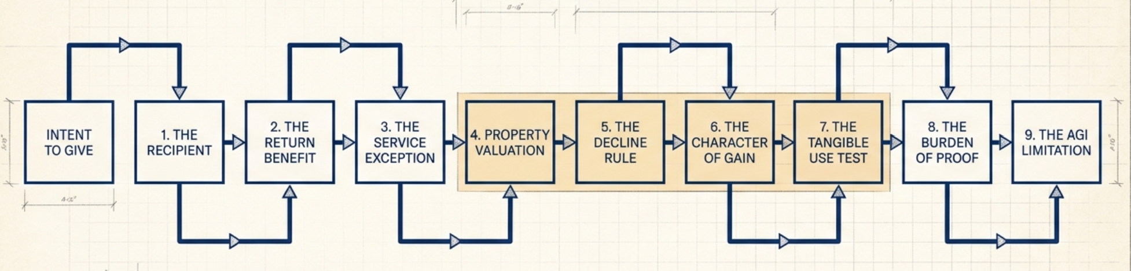
Non-Cash Contribution
📹 Videos AICPA MCQs & Sims 🤖 Farhat AI Assistant🎙 Podcast Lessons 📊 CPA, CMA, EA Exam 💼Accounting & Finance Courses 🙌 Support by Farhat Team 🌐 farhatlectures.com | ⭐ Start Your Free Trial
Notes:
Here is the framework that will guide the entire lesson. Every charitable contribution problem can be attacked using this sequence. First, determine whether the recipient is a qualified charitable organization. Second, determine whether the donor received anything of value in return. Third, identify what was contributed. Cash is generally straightforward. Services are treated very differently. Property requires several additional questions. For property, we compare adjusted basis and fair market value. We consider the holding period. We determine what type of gain or income would have resulted if the property had been sold. For certain tangible property, we also consider how the charity will use the property. After valuation, we examine documentation. Only after we establish the amount of the contribution do we move to the annual AGI percentage limitations. Think of this as an analytical machine. Put the facts into the machine in the proper order, and the tax result comes out the other side.

Slide 2
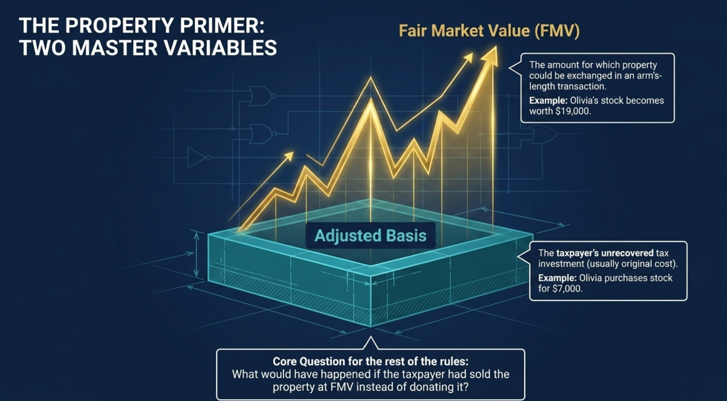
Property Contributions
📹 Videos AICPA MCQs & Sims 🤖 Farhat AI Assistant🎙 Podcast Lessons 📊 CPA, CMA, EA Exam 💼Accounting & Finance Courses 🙌 Support by Farhat Team 🌐 farhatlectures.com | ⭐ Start Your Free Trial
Notes:
For noncash property contributions, two numbers become extremely important: adjusted basis and fair market value. Adjusted basis generally represents the taxpayer's unrecovered tax investment in the property. In a simple example, if you purchase a desk for $500 and nothing has changed its basis, your basis is $500. Fair market value is the property's current economic value. It represents the amount that a willing buyer and willing seller would agree upon in an arm's-length transaction. Basis looks backward. Fair market value looks at today. Property contribution questions become difficult because those two numbers are often different.
Whenever you see donated property, ask one question before you calculate anything. What would have happened if the taxpayer had sold the property at its fair market value instead of donating it? This is our golden question. Would the taxpayer have recognized a loss? Would the taxpayer have recognized short-term gain? Would the sale have generated long-term capital gain? Would the transaction have produced ordinary business income? The answer helps us determine the property's character for charitable contribution purposes. This single question resolves a large portion of the complexity in property donation problems.

Slide 3
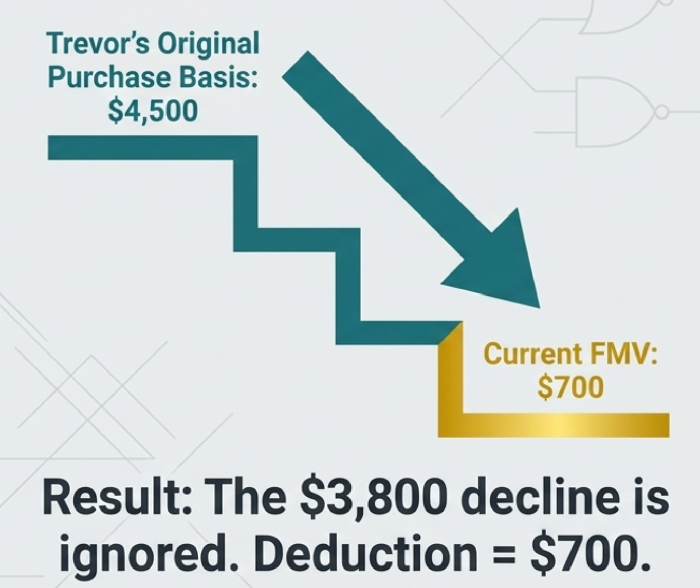
Depreciated Property
If FMV < basis → think FMV
• The charitable deduction is generally limited to the lower current value.
Trevor’s Computer (personal use)
• Ask: What economic value was actually transferred
📹 Videos AICPA MCQs & Sims 🤖 Farhat AI Assistant🎙 Podcast Lessons 📊 CPA, CMA, EA Exam 💼Accounting & Finance Courses 🙌 Support by Farhat Team 🌐 farhatlectures.com | ⭐ Start Your Free Trial
Notes:
Deduction is limited to lower AB or FMV. Cannot take a deduction for your perior use.
Think about trade an old car. They will not give you the original sticker price.
No deduction for personal losses

Slide 4
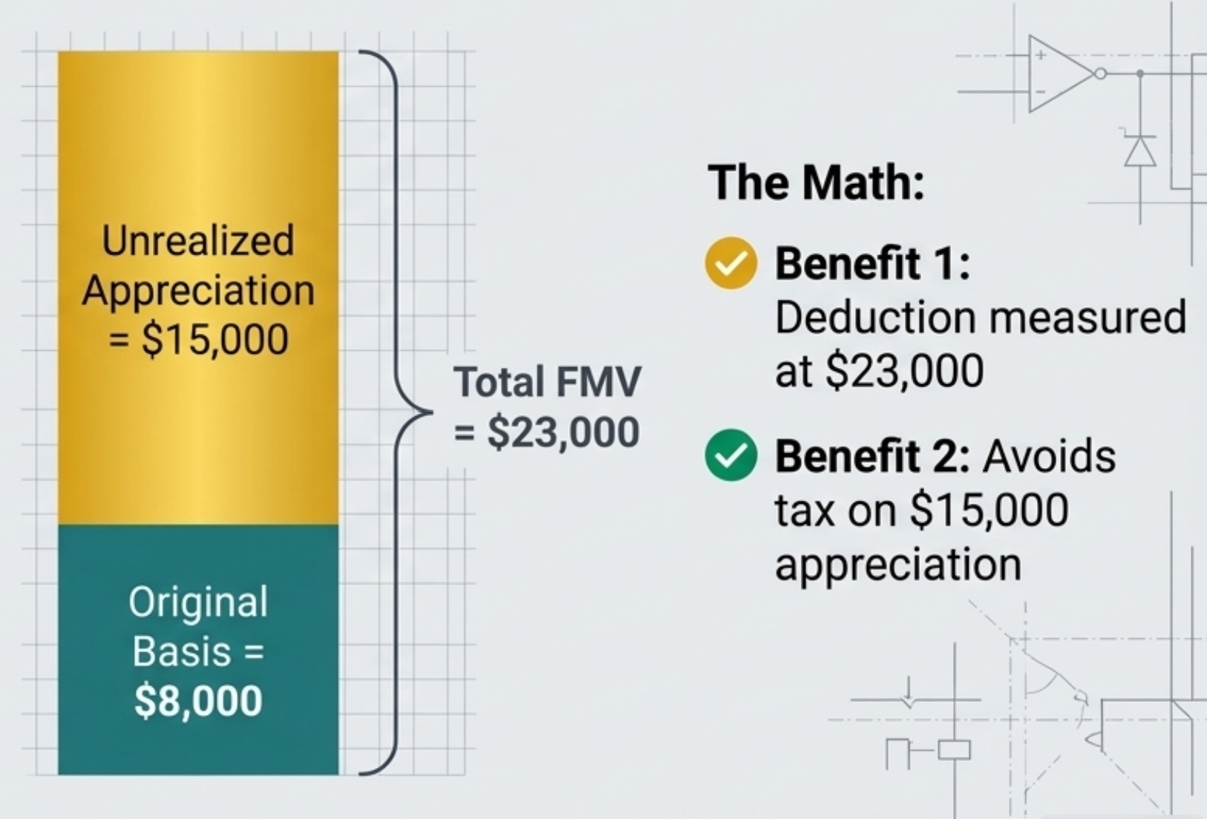
Appreciated Property (LONG TERM)
• When FMV > basis, classification becomes critical.
• Ask: If sold today, what type of gain would result?
• Generally: appreciated investment property held more than 1 year
  Long-term capital gain property
• General deduction rule: FMV
Daniel's Appreciated Stock
📹 Videos AICPA MCQs & Sims 🤖 Farhat AI Assistant🎙 Podcast Lessons 📊 CPA, CMA, EA Exam 💼Accounting & Finance Courses 🙌 Support by Farhat Team 🌐 farhatlectures.com | ⭐ Start Your Free Trial
Notes:
Let’s go the other direction. Bough some share and stiock went up. 15,000.
Treatment of LTG is theopposite. You can use the FMV!
Double win:
Apprciated property and avid the tax.
Think about. He would have to pay taxes but he avoided and contributed the full amount
Be careful about the holding period

Slide 5
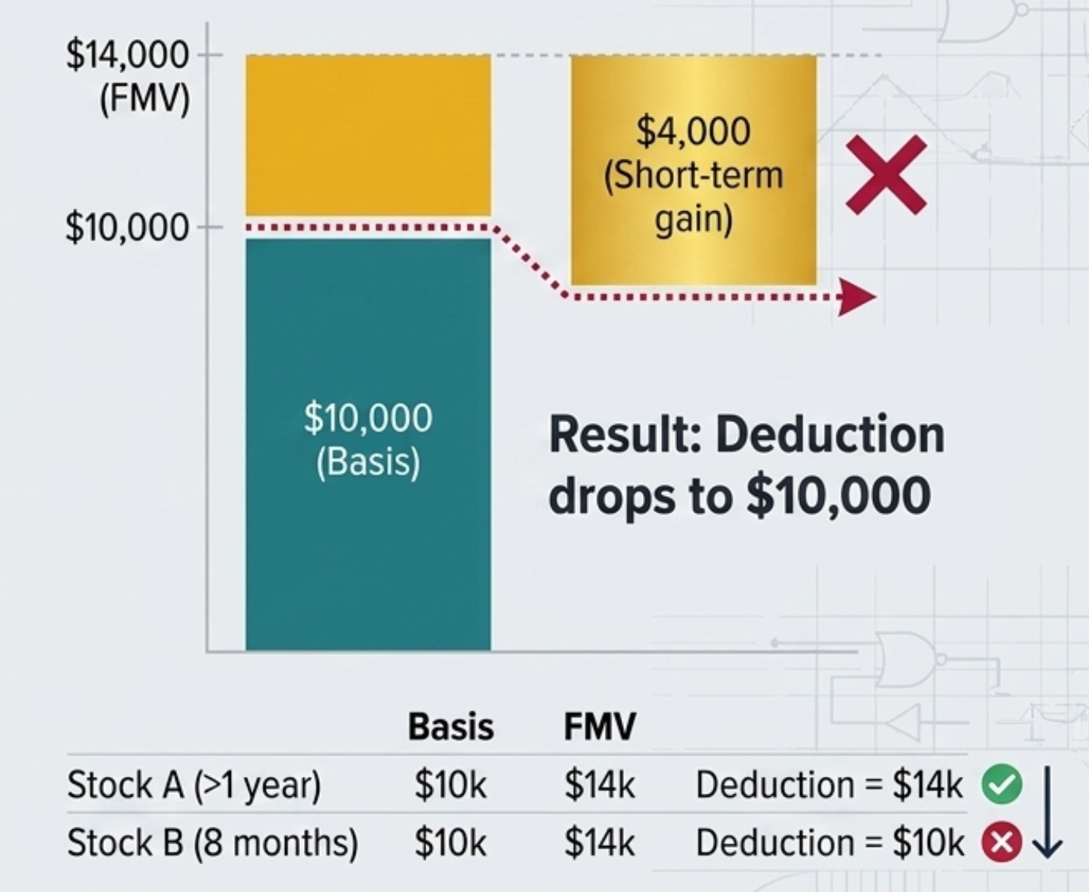
Short-Term Appreciated Property
• Held 1 year or less?
• Gain is short-term.
• For charitable contribution purposes: ordinary income property treatment
• Deduction generally reduced by appreciation.
📹 Videos AICPA MCQs & Sims 🤖 Farhat AI Assistant🎙 Podcast Lessons 📊 CPA, CMA, EA Exam 💼Accounting & Finance Courses 🙌 Support by Farhat Team 🌐 farhatlectures.com | ⭐ Start Your Free Trial
Notes:
You are penzlized by the calendar
Now change only one fact. Suppose the appreciated stock has been held for eight months rather than several years. That single fact changes the entire result. If the taxpayer sold the property after eight months, the gain would be short-term. For charitable contribution purposes, that puts the property into the ordinary-income-property framework discussed in our lesson. The tax law does not generally allow the donor to receive a deduction for appreciation that would have produced ordinary or short-term income. Instead, the deduction is reduced by that built-in income component. In many exam problems, that effectively brings us back to basis.

Slide 6
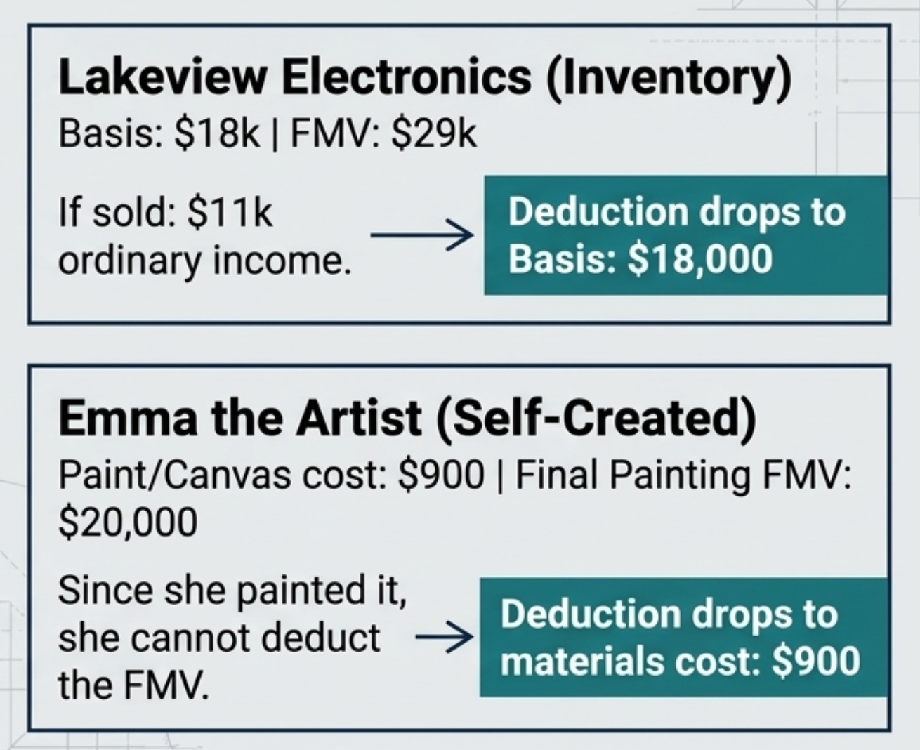
Inventory & Self-Created property
• Inventory sold in the ordinary course of business produces ordinary business income.
• Therefore: deduction generally limited to basis
• Self-created property can also be ordinary income property.
• Key issue: What income would the creator recognize if the property were sold?
Emma vs. the Collector
• Same painting — different taxpayer — different result
Emma, the creator: ordinary income → basis treatment
Long-term investor: potential long-term capital gain → FMV may apply
📹 Videos AICPA MCQs & Sims 🤖 Farhat AI Assistant🎙 Podcast Lessons 📊 CPA, CMA, EA Exam 💼Accounting & Finance Courses 🙌 Support by Farhat Team 🌐 farhatlectures.com | ⭐ Start Your Free Trial
Notes:
Ordinary income property is not limited to short-term investment property. Inventory is another major example. Suppose a retailer owns merchandise held for sale to customers. If the retailer sells that merchandise, the profit is ordinary business income. Therefore, donated inventory generally falls into the ordinary income property framework. Once again, the appreciation that would have become ordinary income is generally removed from the charitable contribution value. That frequently leaves the taxpayer with a deduction equal to basis.
The Services Rule Returns
• Why can’t Emma deduct $20,000?
• Because much of the value represents Emma’s own untaxed labor.
Recall: donated services = $0

Slide 7
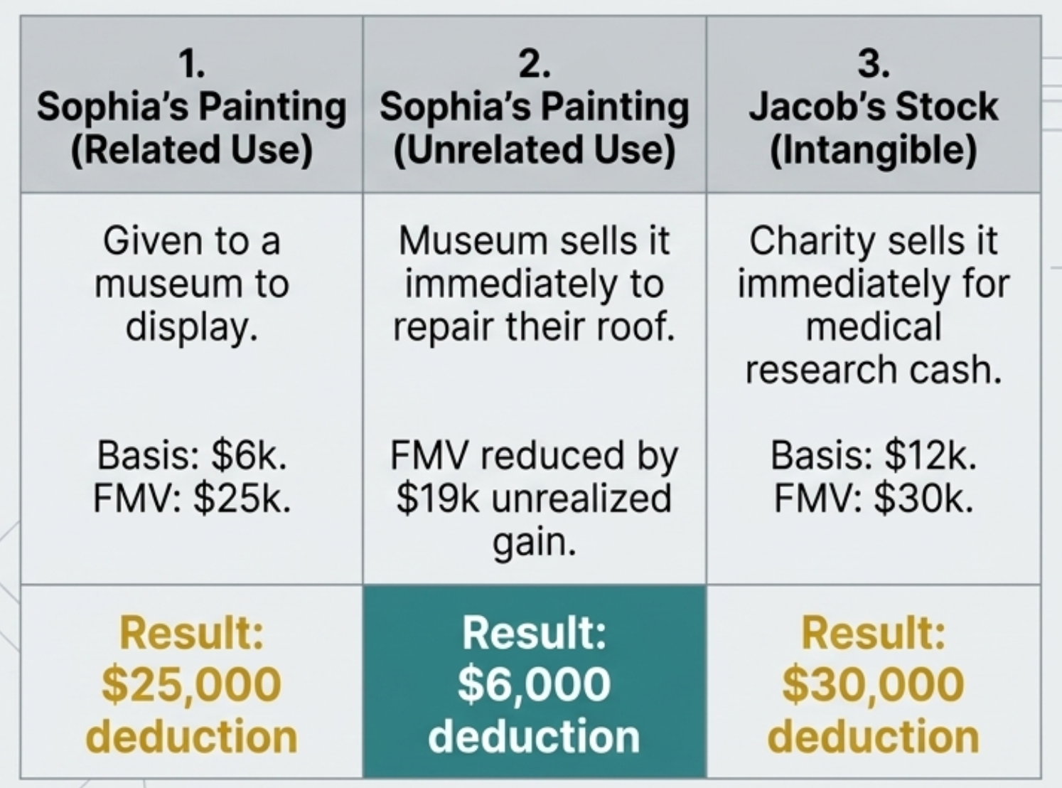
Tangible Personal Property and Related/Unrelated Use
• Tangible personal property (TPP):
physical movable property
• Examples: paintings, furniture, jewelry, coins, cars, sculptures
Not: real estate, stock, bonds
The Related-Use Rule Versus Unrelated Use
Related-use rule applies to tangible personal property.
It generally does not apply the same way to stock, bonds, and other intangible investment assets.
Charity may sell donated stock immediately.
Jacob's Stock
📹 Videos AICPA MCQs & Sims 🤖 Farhat AI Assistant🎙 Podcast Lessons 📊 CPA, CMA, EA Exam 💼Accounting & Finance Courses 🙌 Support by Farhat Team 🌐 farhatlectures.com | ⭐ Start Your Free Trial
Notes:
Suppose the taxpayer owns long-term capital gain property and we think fair market value should apply. We are not necessarily finished. If the property is tangible personal property, there is an additional issue. Tangible means the asset has physical substance. Personal property means we are not dealing with land or buildings. Examples include paintings, furniture, jewelry, rare coins, automobiles, and sculptures. For this category of property, we must determine how the charity intends to use the donated item. This is known as the related-use rule.
When appreciated tangible personal property is contributed, ask one more question. What will the charitable organization actually do with the item? If the charity uses the property in a manner related to its exempt purpose, the donor may preserve the favorable fair market value treatment. If the charity's use is unrelated to its exempt purpose, the appreciation may be removed from the deduction. In many exam questions, that means the deduction falls from fair market value to basis. The exam is therefore asking you to analyze not only the donor and the property, but also the charity's intended use of the property.
Sophia owns a historically significant painting. Her basis is $6,000, and its current fair market value is $25,000. She has owned it for many years. Sophia contributes the painting to a qualified history museum. The museum places the painting in an exhibition that teaches visitors about early American life. That use is directly connected to the museum's educational mission. Therefore, the museum's use is related to its exempt purpose. Under the framework of our lesson, Sophia may retain the $25,000 fair market value contribution. Everything aligns: long-term capital gain property, tangible personal property, and a related charitable use.
• Same painting: basis $6,000; FMV $25,000
• Museum immediately sells it and uses cash to repair the roof.
• Unrelated use
• Deduction reduced to $6,000 basis
Now change the facts. Sophia gives the exact same painting to the exact same museum. But instead of displaying it, the museum immediately sells the painting for $25,000. The museum then uses the cash to repair its roof. Roof repairs certainly help the museum. But that is not the question. The question is whether the donated painting itself was used in a manner related to the museum's exempt educational purpose. It was not. The painting was simply converted into cash. Under the unrelated-use rule presented in our lesson, Sophia loses the deduction attributable to the appreciation. Her charitable contribution falls from the $25,000 fair market value to her $6,000 basis.
The Vegetarian Steak Analogy

Slide 8
Introduction Charitable Contribution Deduction
📹 Videos AICPA MCQs & Sims 🤖 Farhat AI Assistant🎙 Podcast Lessons 📊 CPA, CMA, EA Exam 💼Accounting & Finance Courses 🙌 Support by Farhat Team 🌐 farhatlectures.com | ⭐ Start Your Free Trial
Notes:
Here is the framework that will guide the entire lesson. Every charitable contribution problem can be attacked using this sequence. First, determine whether the recipient is a qualified charitable organization. Second, determine whether the donor received anything of value in return. Third, identify what was contributed. Cash is generally straightforward. Services are treated very differently. Property requires several additional questions. For property, we compare adjusted basis and fair market value. We consider the holding period. We determine what type of gain or income would have resulted if the property had been sold. For certain tangible property, we also consider how the charity will use the property. After valuation, we examine documentation. Only after we establish the amount of the contribution do we move to the annual AGI percentage limitations. Think of this as an analytical machine. Put the facts into the machine in the proper order, and the tax result comes out the other side.

Slide 9
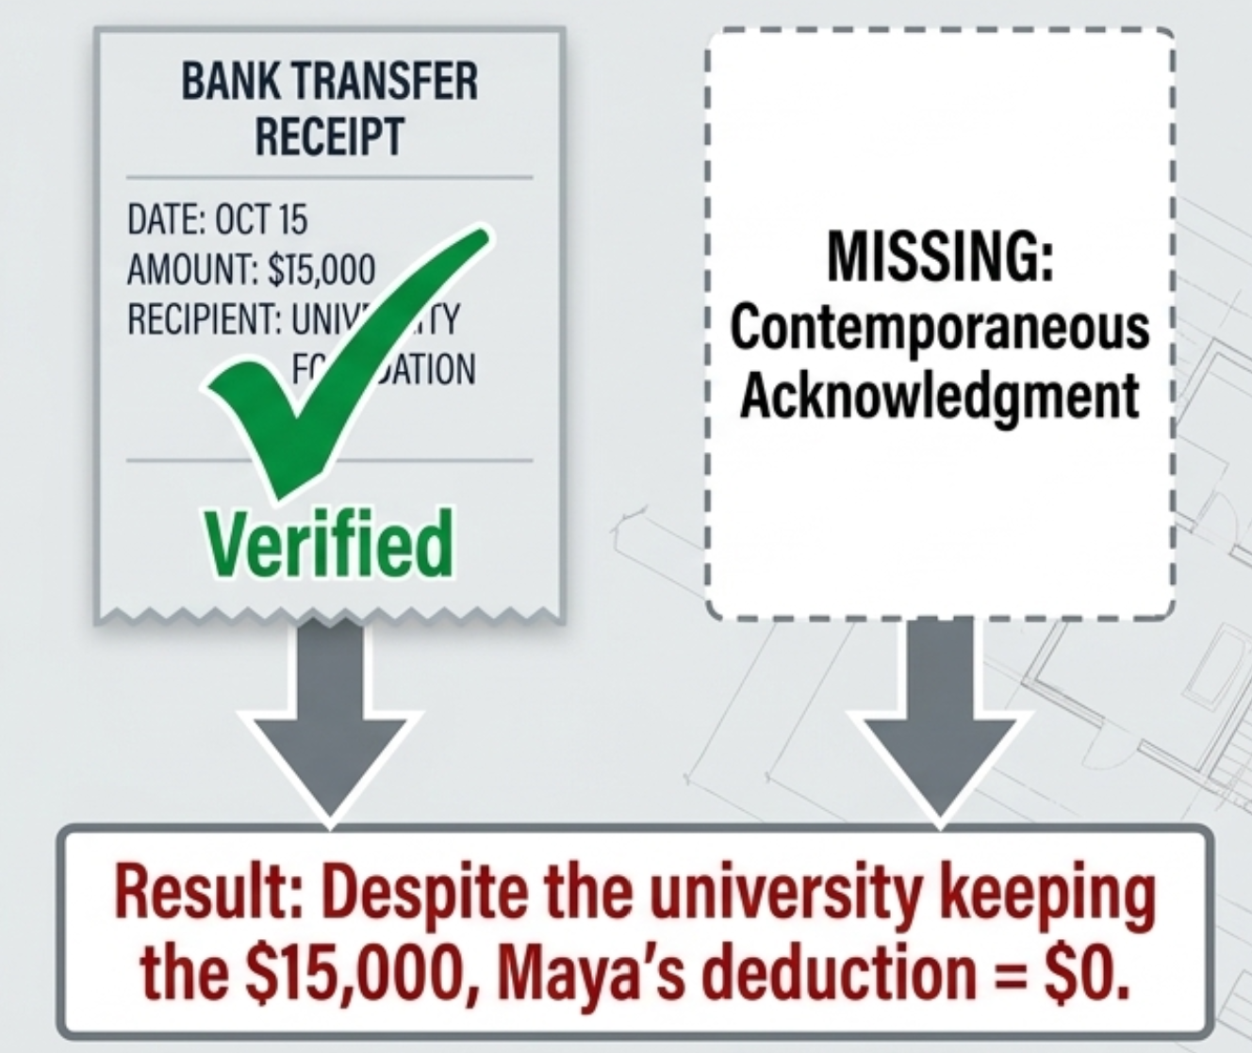
Documentation Is a Separate Requirement
• Correct valuation does not guarantee a deduction.
• The taxpayer must satisfy substantiation requirements.
• Two separate questions:
  1. How much is the contribution worth?
  2. Can the taxpayer prove it?
Maya's Missing Receipt
📹 Videos AICPA MCQs & Sims 🤖 Farhat AI Assistant🎙 Podcast Lessons 📊 CPA, CMA, EA Exam 💼Accounting & Finance Courses 🙌 Support by Farhat Team 🌐 farhatlectures.com | ⭐ Start Your Free Trial
Charitable Contributions — CPA Exam Lesson | 42
Notes:
We now reach another major CPA exam trap. You can perform every valuation calculation correctly and still lose the deduction. Why? Documentation. Tax law distinguishes between the existence of a charitable gift and the taxpayer's legal ability to substantiate the deduction. Those are separate issues. The taxpayer may actually have transferred the property. The charity may actually have received it. The taxpayer may have correctly calculated fair market value. But if the required records are missing, the deduction can still fail. Documentation is not merely administrative housekeeping. It is part of the tax law.
Maya gives $15,000 to a qualified university foundation. The money leaves Maya's bank account. The university receives it. The university uses the funds to purchase computers. There is no dispute that a real transfer occurred. But Maya fails to obtain the required written acknowledgment. Under the substantiation framework in our lesson, the deduction is lost. This illustrates a critical concept. Tax law operates in the documented world. A transaction may be real, but the taxpayer still has the burden of establishing the legal right to claim the deduction. On the CPA exam, never treat missing documentation as an insignificant side fact. It may completely change the answer.

Slide 10
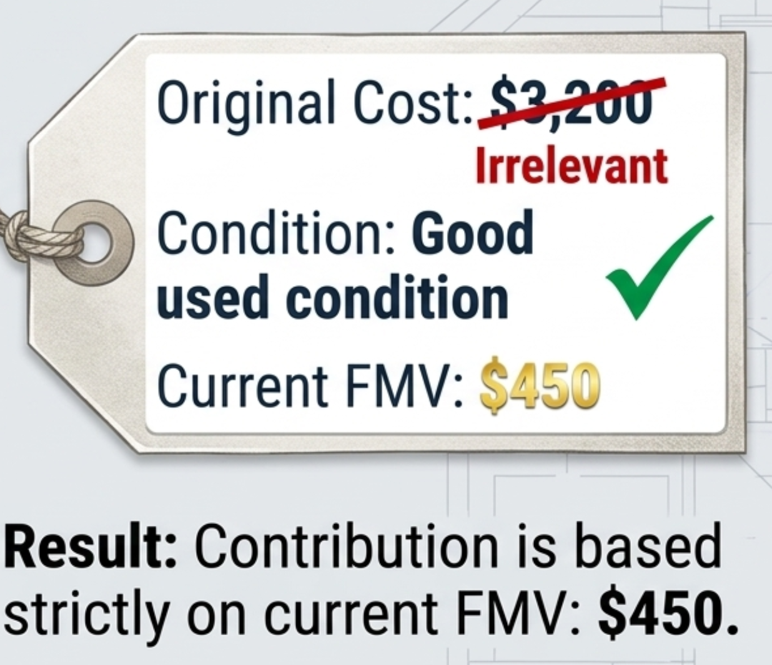
Documentation Thresholds
$250 or more: contemporaneous written acknowledgment
• Property over $500: additional reporting — Form 8283
• Property over $5,000: qualified appraisal required
Clothing and Household Goods
  • Good used condition or better
  • Clothing and household goods generally must satisfy a minimum condition requirement.
• Then apply normal valuation rules.
📹 Videos AICPA MCQs & Sims 🤖 Farhat AI Assistant🎙 Podcast Lessons 📊 CPA, CMA, EA Exam 💼Accounting & Finance Courses 🙌 Support by Farhat Team 🌐 farhatlectures.com | ⭐ Start Your Free Trial
Notes:
The lesson highlights several documentation thresholds. For a contribution of $250 or more, the taxpayer generally needs a contemporaneous written acknowledgment from the charitable organization. Contemporaneous means the acknowledgment must be obtained within the required time period, generally before the taxpayer files the return. You cannot wait until an audit several years later and attempt to recreate the documentation after the fact. For property contributions above $500, additional reporting requirements become relevant, including Form 8283 under the framework presented in our lesson. For property contributions above $5,000, a qualified appraisal generally becomes important. The exam may give you every valuation fact you need and then hide a documentation failure in the final sentence. Always read the entire fact pattern.
Another rule applies to common donations of clothing and household goods. The property generally must be in good used condition or better to qualify under the rule presented in our lesson. This requirement exists because taxpayers historically claimed deductions for items that had little or no practical value to charities. Think about torn clothing, unusable furniture, or household goods that should simply have been discarded. The tax system does not want charities functioning as disposal sites merely so donors can claim deductions. Once the condition requirement is satisfied, we still apply the normal valuation rules. For used personal items, fair market value is often dramatically lower than original purchase price.
Priya cleans out her closet and contributes clothing to a qualified organization. She originally paid $3,200 for the clothing. Today, the clothing has a thrift-store fair market value of approximately $450. Assume the items are in good used condition. What is Priya's deduction? Return to our depreciated property rule. Fair market value is lower than basis. Therefore, fair market value controls. Priya's charitable contribution is $450. Her original $3,200 cost does not represent the economic value transferred to the charity today. This is the same principle we applied to Trevor's used furniture.

Slide 11
The AGI Limitation for Charitable Contribution
📹 Videos AICPA MCQs & Sims 🤖 Farhat AI Assistant🎙 Podcast Lessons 📊 CPA, CMA, EA Exam 💼Accounting & Finance Courses 🙌 Support by Farhat Team 🌐 farhatlectures.com | ⭐ Start Your Free Trial
Notes:
Here is the framework that will guide the entire lesson. Every charitable contribution problem can be attacked using this sequence. First, determine whether the recipient is a qualified charitable organization. Second, determine whether the donor received anything of value in return. Third, identify what was contributed. Cash is generally straightforward. Services are treated very differently. Property requires several additional questions. For property, we compare adjusted basis and fair market value. We consider the holding period. We determine what type of gain or income would have resulted if the property had been sold. For certain tangible property, we also consider how the charity will use the property. After valuation, we examine documentation. Only after we establish the amount of the contribution do we move to the annual AGI percentage limitations. Think of this as an analytical machine. Put the facts into the machine in the proper order, and the tax result comes out the other side.

