Slide 1

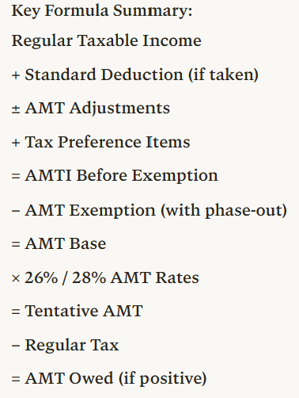
Step | Description | Operation | Notes
1 | Regular taxable income (TI) | Starting point | From Form 1040
2 | Plus: Standard deduction if taken | + | Add back if claimed
3 | Plus/minus: AMT adjustment items | ± adjustments | SALT, depreciation, ISO, etc.
4 | Plus: Tax preference items | + | Private activity bonds, etc.
5 | = AMTI before exemption | Subtotal | Alternative Minimum Taxable Income
6 | Minus: AMT exemption amount | − | Subject to phase-out
 | - MFJ: $140,200 (2026) |  | Phase-out starts at $1,000,000
 | - Single/HOH: $90,100 (2026) |  | Phase-out starts at $500,000
 | - Phase-out rate: 50% |  | Lose $0.50 per $1 over threshold
7 | = AMT base (AMTI after exemption) | Subtotal | Amount subject to AMT rates
8 | Multiplied by AMT tax rates | × 26% or 28% | Two-bracket system
 | - 26% on first $244,500 (MFJ) / $122,250 (MFS)
 | - 28% on amounts above these thresholds
9 | = Tentative AMT before credits | Subtotal | Preliminary AMT liability
10 | Minus: Allowable credits | − | Foreign tax credit, etc.
11 | = Tentative AMT | Subtotal | Final AMT calculation
12 | Less: Regular tax liability | − | From regular tax calculation
13 | = AMT owed (pay if positive) | FINAL | Additional tax beyond regular tax
📹 Videos AICPA MCQs & Sims 🤖 Farhat AI Assistant🎙 Podcast Lessons 📊 CPA, CMA, EA Exam 💼Accounting & Finance Courses 🙌 Support by Farhat Team
🌐 farhatlectures.com | ⭐ Start Your Free Trial

Slide 2
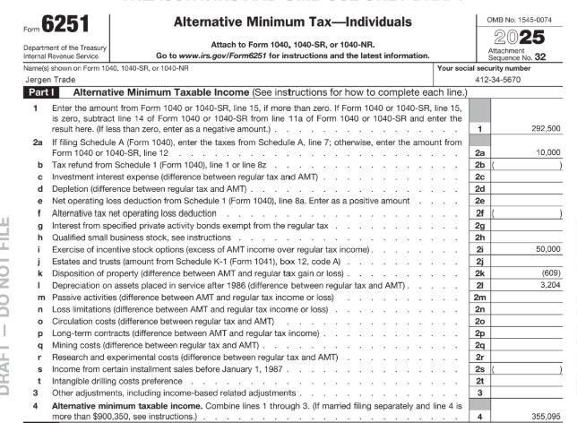
210,225
40,000
250,225
📹 Videos AICPA MCQs & Sims 🤖 Farhat AI Assistant🎙 Podcast Lessons 📊 CPA, CMA, EA Exam 💼Accounting & Finance Courses 🙌 Support by Farhat Team
🌐 farhatlectures.com | ⭐ Start Your Free Trial

Slide 3
Schedule A adjustments: “easy ones”
Standard deduction is not allowed → Add Back
The following ARE allowed for AMT deductions:
  Medical deduction (same as regular tax)
  Mortgage interest (home acquisition debt only)
  Charity contributions
NOT allowed for AMT - Must ADD BACK:
State and local tax (SALT) deductions State, local, and foreign taxes
  SALT completely disallowed for AMT purposes
    Higher SALT deduction = Larger AMT adjustment
📹 Videos AICPA MCQs & Sims 🤖 Farhat AI Assistant🎙 Podcast Lessons 📊 CPA, CMA, EA Exam 💼Accounting & Finance Courses 🙌 Support by Farhat Team
🌐 farhatlectures.com | ⭐ Start Your Free Trial

Slide 4
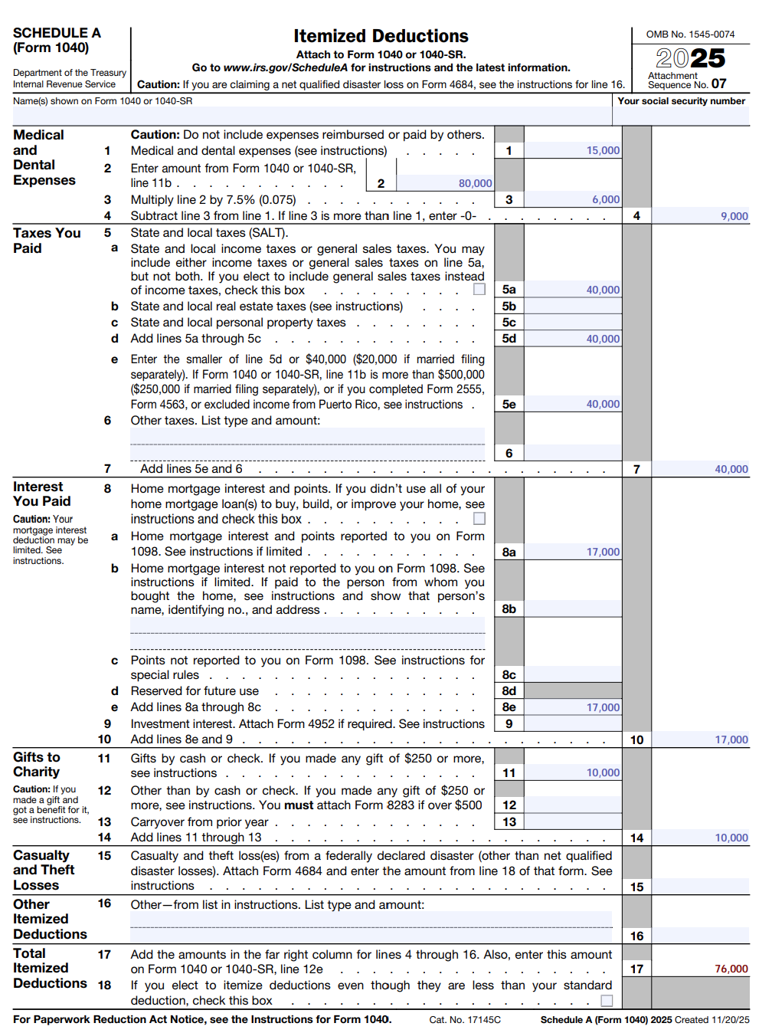
Itemized Deduction | Regular Tax | AMT Deduction | AMT Adjustment
Medical | $9,000 | $9,000 | $0
State & Local Taxes (SALT) | $40,000 | $0 | $40,000
Mortgage Interest | $17,000 | $17,000 | $0
Charitable Contribution | $10,000 | $10,000 | $0
Total | $133,650 | $93,650 | $40,000*
📹 Videos AICPA MCQs & Sims 🤖 Farhat AI Assistant🎙 Podcast Lessons 📊 CPA, CMA, EA Exam 💼Accounting & Finance Courses 🙌 Support by Farhat Team
🌐 farhatlectures.com | ⭐ Start Your Free Trial

Slide 5
210,225
40,000
250,225
📹 Videos AICPA MCQs & Sims 🤖 Farhat AI Assistant🎙 Podcast Lessons 📊 CPA, CMA, EA Exam 💼Accounting & Finance Courses 🙌 Support by Farhat Team
🌐 farhatlectures.com | ⭐ Start Your Free Trial

Slide 6
Depreciation Adjustments
Regular Tax
AMT
Real property placed after 1986 –before 1999 – SL
  27.5 years life of all Rental-residential
  39 for non-residential real property
Real property after 1998 – no AMT adjustment
Personal property post 1999 – 200% Double declining balance
Real property placed after 1986 –before 1999 – SL
  40 Year Life for both
Real property after 1998 – no AMT adjustment
*Personal property post 1999 – 150% Double declining balance
📹 Videos AICPA MCQs & Sims 🤖 Farhat AI Assistant🎙 Podcast Lessons 📊 CPA, CMA, EA Exam 💼Accounting & Finance Courses 🙌 Support by Farhat Team
🌐 farhatlectures.com | ⭐ Start Your Free Trial

Slide 7
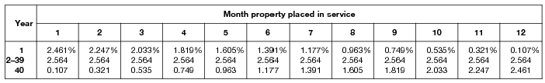
Example: Commercial Property
Adam purchased a warehouse for $310,000 in August 1998. The regular depreciation and AMT depreciation for 2026 are calculated as follows:
Regular Tax Depreciation (39-year life):
$310,000 × 2.564% = $7,948
AMT Depreciation (40-year life):
$310,000 × 2.5% = $7,750
AMT Adjustment:
Difference of $198 (add back to AMTI)
📹 Videos AICPA MCQs & Sims 🤖 Farhat AI Assistant🎙 Podcast Lessons 📊 CPA, CMA, EA Exam 💼Accounting & Finance Courses 🙌 Support by Farhat Team
🌐 farhatlectures.com | ⭐ Start Your Free Trial

Slide 8
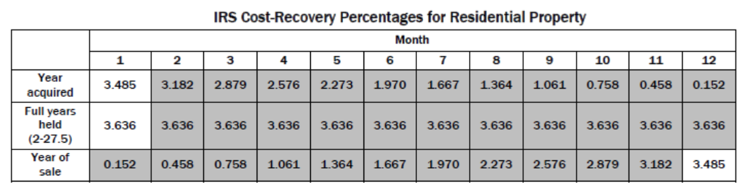
Example: Residential Apartment Building
Adam purchased a rental residential property for $310,000 in August 1998. The regular depreciation and AMT depreciation for 2026 are calculated as follows:
310,000 X 3.637% = 11,275 Regular tax depreciation
310,000 x 2.5% = 7,750 AMT depreciation
Difference of $3,525
📹 Videos AICPA MCQs & Sims 🤖 Farhat AI Assistant🎙 Podcast Lessons 📊 CPA, CMA, EA Exam 💼Accounting & Finance Courses 🙌 Support by Farhat Team
🌐 farhatlectures.com | ⭐ Start Your Free Trial

Slide 9
210,225
40,000
250,225
📹 Videos AICPA MCQs & Sims 🤖 Farhat AI Assistant🎙 Podcast Lessons 📊 CPA, CMA, EA Exam 💼Accounting & Finance Courses 🙌 Support by Farhat Team
🌐 farhatlectures.com | ⭐ Start Your Free Trial

Slide 10
Personal Property AMT in 2026
Sarah's Tech Company purchased office equipment in February 2026:
Computer servers: $50,000
Office furniture: $30,000
Total: $80,000
Item | Regular Tax | AMT | Adjustment
Depreciation deduction | $80,000 | $80,000 | $0
Result: No AMT adjustment when using bonus depreciation!
Why? Bonus depreciation is the same for both regular tax and AMT (IRC §168(k))
📹 Videos AICPA MCQs & Sims 🤖 Farhat AI Assistant🎙 Podcast Lessons 📊 CPA, CMA, EA Exam 💼Accounting & Finance Courses 🙌 Support by Farhat Team
🌐 farhatlectures.com | ⭐ Start Your Free Trial

Slide 11
Scenario B: Opting Out of Bonus Depreciation
Sarah elects out of bonus depreciation to preserve basis for cost segregation or other planning.
Using MACRS 200% DB (7-year property):
Year | Regular Tax (200% DB) | AMT (150% DB) | AMT Adjustment
2026 (Year 1) | $11,440 (14.29%) | $10,715 (13.39%) | +$725
2027 (Year 2) | $19,602 (24.49%) | $18,335 (22.92%) | +$1,267
2028 (Year 3) | $13,998 (17.49%) | $13,095 (16.37%) | +$903
Cumulative 3-year adjustment: +$2,895 (add to AMTI)
📹 Videos AICPA MCQs & Sims 🤖 Farhat AI Assistant🎙 Podcast Lessons 📊 CPA, CMA, EA Exam 💼Accounting & Finance Courses 🙌 Support by Farhat Team
🌐 farhatlectures.com | ⭐ Start Your Free Trial

Slide 12
Scenario C: Electing Straight-Line to Avoid AMT Adjustment
Sarah elects straight-line depreciation for regular tax:
Year | Regular Tax (Straight-line) | AMT (Straight-line) | AMT Adjustment
All years | $11,429 (1/7) | $11,429 (1/7) | $0
Result: No AMT adjustment, but slower regular tax deductions
📹 Videos AICPA MCQs & Sims 🤖 Farhat AI Assistant🎙 Podcast Lessons 📊 CPA, CMA, EA Exam 💼Accounting & Finance Courses 🙌 Support by Farhat Team
🌐 farhatlectures.com | ⭐ Start Your Free Trial

Slide 13
Gain/Loss Example
Suppose we purchased furniture on February 10, 2023, for $6,000. On March 2, 2026, we sold the furniture for $4,300.
Assumption: Taxpayer opted out of 100% bonus depreciation and used MACRS.
Year | Depreciation | Cumulative
2023 | $857 | $857
2024 | $1,469 | $2,326
2025 | $1,050 | $3,376
2026 (partial) | $375 | $3,751
Adjusted basis: $6,000 - $3,751 = $2,249
Consideration received: $4,300
Gain for regular tax: $4,300 - $2,249 = $2,051
📹 Videos AICPA MCQs & Sims 🤖 Farhat AI Assistant🎙 Podcast Lessons 📊 CPA, CMA, EA Exam 💼Accounting & Finance Courses 🙌 Support by Farhat Team
🌐 farhatlectures.com | ⭐ Start Your Free Trial

Slide 14
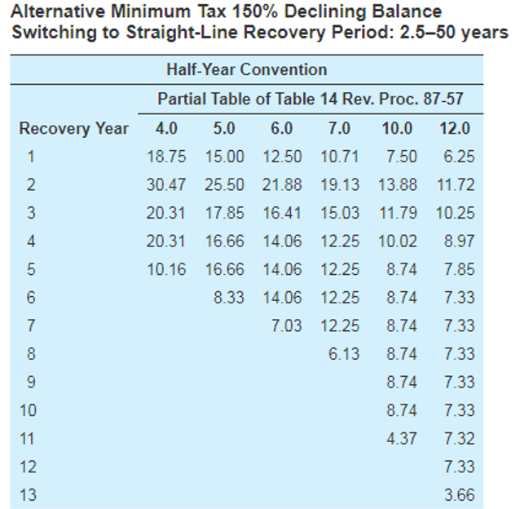
AMT (7-year, 150% DB)
Year | Depreciation | Cumulative
2023 | $643 | $643
2024 | $1,125 | $1,768
2025 | $985 | $2,753
2026 (partial) | $352 | $3,105
Adjusted basis for AMT: $6,000 - $3,105 = $2,895
Consideration received: $4,300
Gain for AMT: $4,300 - $2,895 = $1,405
AMT Adjustment on Sale:
Item | Regular Tax | AMT | Difference
Gain recognized | $2,051 | $1,405 | $646
AMT adjustment |  |  | ($646)
Negative adjustment = subtract from AMTI (AMT gain is lower)
Why? Higher AMT depreciation over the years → higher AMT basis → lower AMT gain
📹 Videos AICPA MCQs & Sims 🤖 Farhat AI Assistant🎙 Podcast Lessons 📊 CPA, CMA, EA Exam 💼Accounting & Finance Courses 🙌 Support by Farhat Team
🌐 farhatlectures.com | ⭐ Start Your Free Trial

Slide 15
210,225
40,000
(646)
4,448
254,027
📹 Videos AICPA MCQs & Sims 🤖 Farhat AI Assistant🎙 Podcast Lessons 📊 CPA, CMA, EA Exam 💼Accounting & Finance Courses 🙌 Support by Farhat Team
🌐 farhatlectures.com | ⭐ Start Your Free Trial

Slide 16

MCQ from farhatlecturs.com
Which of the following itemized deductions is not allowed for Alternative Minimum Tax (AMT) purposes and must be added back to taxable income when computing AMTI?
A. Charitable contributions
B. Mortgage interest on acquisition debt
C. State and local taxes
D. Medical expenses
A. Incorrect. Charitable contributions are allowed for AMT.
B. Incorrect. Mortgage interest on acquisition indebtedness remains deductible for AMT purposes.
C. Correct. State and local tax deductions (SALT) are completely disallowed under AMT and must be added back when calculating Alternative Minimum Taxable Income (AMTI).
D. Incorrect. Medical expenses remain deductible under AMT rules using the same limitation as the regular tax system.
📹 Videos AICPA MCQs & Sims 🤖 Farhat AI Assistant🎙 Podcast Lessons 📊 CPA, CMA, EA Exam 💼Accounting & Finance Courses 🙌 Support by Farhat Team
🌐 farhatlectures.com | ⭐ Start Your Free Trial

