Slide 1


Tax Rate Structures
A foundational concept in taxation is understanding how tax rates are applied to a tax base.
Tax systems do not rely on a single uniform approach; instead, taxing authorities use different rate structures depending on policy objectives, revenue needs, and fairness considerations.
These rate structures determine how the amount of tax owed changes as the tax base increases.
There are three primary tax rate structures commonly used within tax systems at the local, state, and federal levels:
  Progressive rate structure
  Proportional rate structure
  Regressive rate structure
Most tax systems incorporate one or more of these structures when assessing taxes.
📹 Videos AICPA MCQs & Sims 🤖 Farhat AI Assistant🎙 Podcast Lessons 📊 CPA, CMA, EA Exam 💼Accounting & Finance Courses 🙌 Support by Farhat Team
🌐 farhatlectures.com | ⭐ Start Your Free Trial

Slide 2
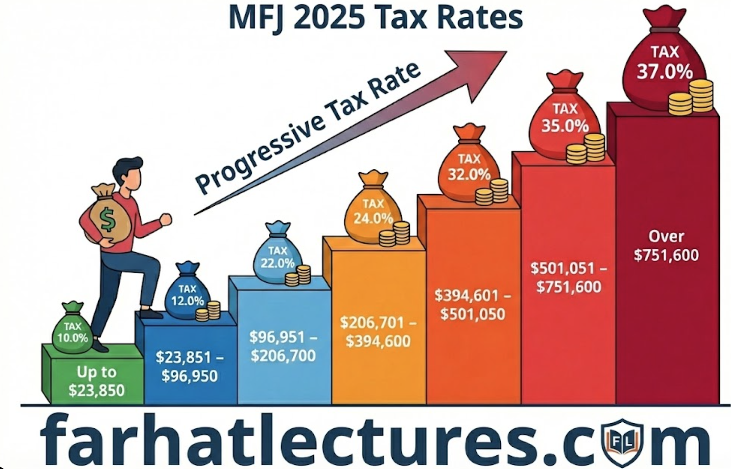
Progressive Rate Structure
Under a progressive rate structure, the tax rate increases as the tax base increases.
  Higher levels of the tax base are subject to higher marginal rates, while lower levels are taxed at lower rates. The tax is calculated by applying the appropriate rate to each portion of the tax base within designated ranges.
This structure is designed to place a relatively greater tax burden on those with a greater ability to pay.
  As a result, the effective or average tax rate is typically lower than the highest marginal rate applied.
📹 Videos AICPA MCQs & Sims 🤖 Farhat AI Assistant🎙 Podcast Lessons 📊 CPA, CMA, EA Exam 💼Accounting & Finance Courses 🙌 Support by Farhat Team
🌐 farhatlectures.com | ⭐ Start Your Free Trial

Slide 3

Marginal and Average Tax Rates
Two important concepts arise under a progressive tax system:
  Marginal tax rate refers to the rate applied to the next additional unit of the tax base.
  Average tax rate represents the overall tax burden, calculated by comparing total tax liability to the total tax base.
Because a progressive system applies multiple rates to different portions of the tax base, the average tax rate will generally be lower than the highest marginal rate.
📹 Videos AICPA MCQs & Sims 🤖 Farhat AI Assistant🎙 Podcast Lessons 📊 CPA, CMA, EA Exam 💼Accounting & Finance Courses 🙌 Support by Farhat Team
🌐 farhatlectures.com | ⭐ Start Your Free Trial

Slide 4

Progressive Tax Structure
Taxpayers move through successive rate levels as their taxable income increases, with each level taxed independently rather than applying a single rate to the entire amount.
Individual Income Tax Rate Brackets for Married Taxpayers
Taxable Income Range | Marginal Tax Rate
Up to $23,850 | 10.0%
$23,851 – $96,950 | 12.0%
$96,951 – $206,700 | 22.0%
$206,701 – $394,600 | 24.0%
$394,601 – $501,050 | 32.0%
$501,051 – $751,600 | 35.0%
Over $751,600 | 37.0%
Alex and Jordan are married, file a joint federal income tax return, and report taxable income of $275,000.
$23,850 × 10% = $ 2,385.00
($96,950 − $23,850) × 12% = 8,772.00
($206,700 − $96,950) × 22% = 24,145.00
($275,000 − $206,700) × 24% = 16,392.00
----------
Total tax liability $51,694.00
📹 Videos AICPA MCQs & Sims 🤖 Farhat AI Assistant🎙 Podcast Lessons 📊 CPA, CMA, EA Exam 💼Accounting & Finance Courses 🙌 Support by Farhat Team
🌐 farhatlectures.com | ⭐ Start Your Free Trial

Slide 5
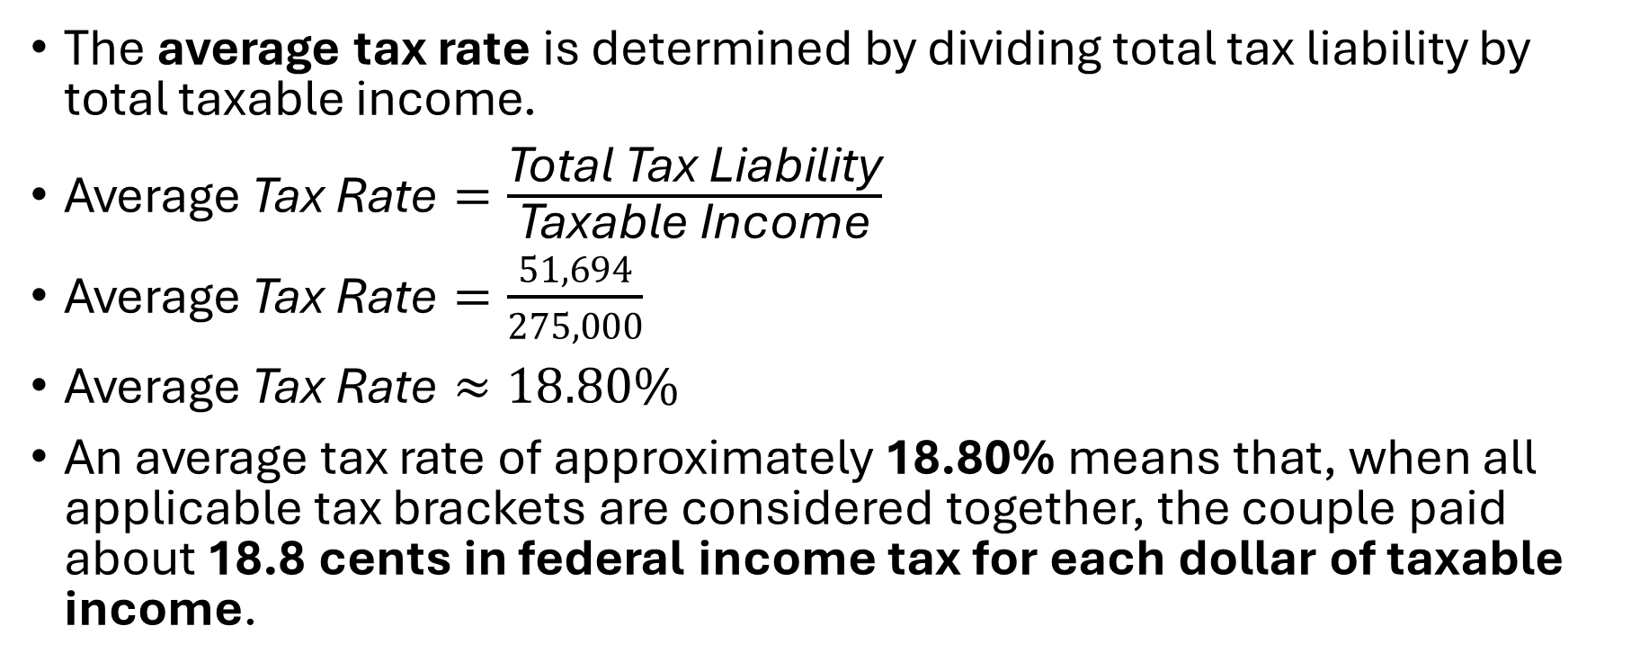
Average Tax Rate Calculation
The average tax rate is determined by dividing total tax liability by total taxable income.
$\text{Average} \text{Tax} \text{Rate}=\frac{\text{Total} \text{Tax} \text{Liability}}{\text{Taxable} \text{Income}}$
$\text{Average} \text{Tax} \text{Rate}=\frac{51,694}{275,000}$
$\text{Average} \text{Tax} \text{Rate}≈18.80\%$
An average tax rate of approximately 18.80% means that, when all applicable tax brackets are considered together, the couple paid about 18.8 cents in federal income tax for each dollar of taxable income.
📹 Videos AICPA MCQs & Sims 🤖 Farhat AI Assistant🎙 Podcast Lessons 📊 CPA, CMA, EA Exam 💼Accounting & Finance Courses 🙌 Support by Farhat Team
🌐 farhatlectures.com | ⭐ Start Your Free Trial

Slide 6

MCQ from farhatlectures.com
A CPA candidate states that moving into a higher tax bracket causes all taxable income to be taxed at the higher rate.
Which response is most accurate?
A. The statement is correct under federal tax law
B. The statement is incorrect because only the excess income is taxed at the higher rate
C. The statement is correct only for joint filers
D. The statement applies only to state income taxes
B is correct because progressive tax brackets apply higher rates only to income above each threshold.
A is incorrect and reflects a common misunderstanding.
C and D are incorrect because bracket mechanics are consistent regardless of filing status or jurisdiction.
📹 Videos AICPA MCQs & Sims 🤖 Farhat AI Assistant🎙 Podcast Lessons 📊 CPA, CMA, EA Exam 💼Accounting & Finance Courses 🙌 Support by Farhat Team
🌐 farhatlectures.com | ⭐ Start Your Free Trial

