Slide 1

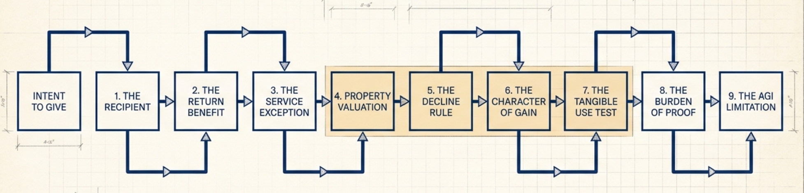
Introduction Charitable Contribution Deduction
📹 Videos AICPA MCQs & Sims 🤖 Farhat AI Assistant🎙 Podcast Lessons 📊 CPA, CMA, EA Exam 💼Accounting & Finance Courses 🙌 Support by Farhat Team 🌐 farhatlectures.com | ⭐ Start Your Free Trial

Slide 2

📹 Videos AICPA MCQs & Sims 🤖 Farhat AI Assistant🎙 Podcast Lessons 📊 CPA, CMA, EA Exam 💼Accounting & Finance Courses 🙌 Support by Farhat Team 🌐 farhatlectures.com | ⭐ Start Your Free Trial

Slide 3
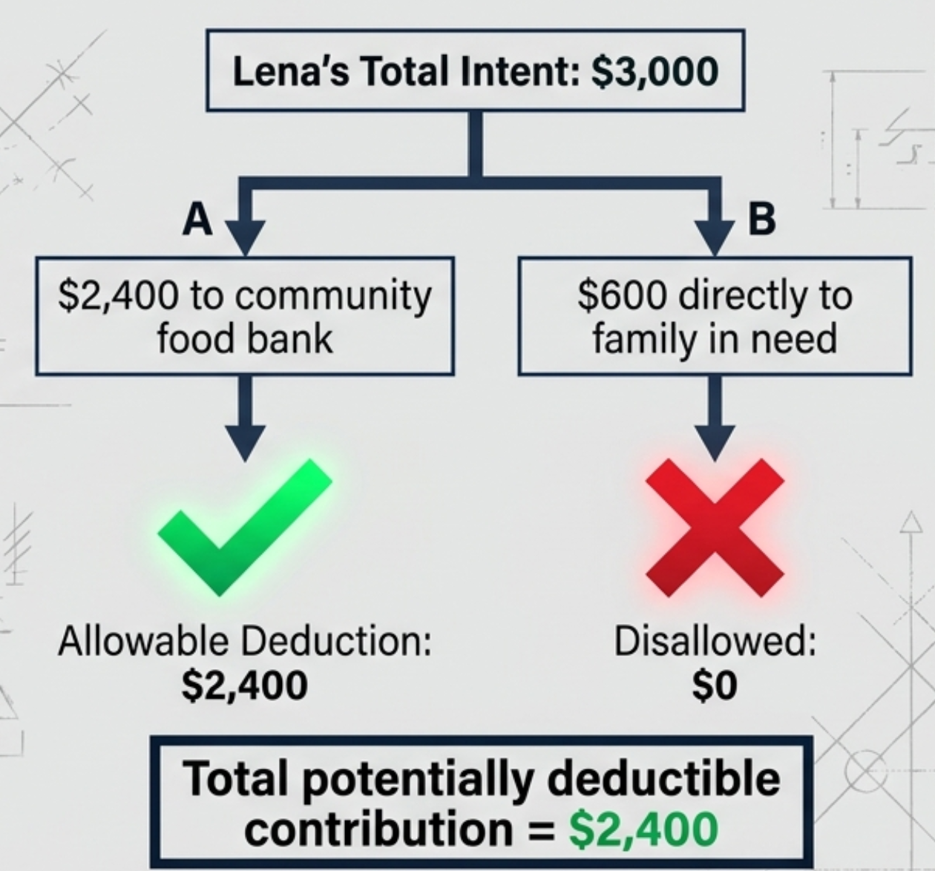
Qualified Organization
• Deductible contributions must be made to a qualified organization.
• Examples:
  religious organizations,
  educational organizations,
  hospitals,
  charitable organizations,
  scientific organizations,
  food banks.
•Direct gifts to individuals: not deductible
Political contribution are not deducted.
📹 Videos AICPA MCQs & Sims 🤖 Farhat AI Assistant🎙 Podcast Lessons 📊 CPA, CMA, EA Exam 💼Accounting & Finance Courses 🙌 Support by Farhat Team 🌐 farhatlectures.com | ⭐ Start Your Free Trial
Notes:
Our first hurdle is the identity of the recipient. A taxpayer generally receives a charitable contribution deduction only when the contribution is made to a qualified organization. Typical examples include religious organizations, universities, hospitals, scientific organizations, food banks, and other organizations operating for recognized charitable purposes. Now notice what is missing from that list: individuals. A person may be desperately in need of assistance, but that does not automatically make that individual a qualified charitable organization. That distinction is extremely important for the CPA exam. A direct gift to an individual may be generous. It may be compassionate. It may even save someone's life. But generosity and deductibility are separate questions.
Why does the tax system draw such a strict line? The answer is not that helping individuals is undesirable. The issue is verification. A qualified charitable organization operates within a formal structure. It has records. It has governance. It has an identifiable charitable purpose

Slide 4
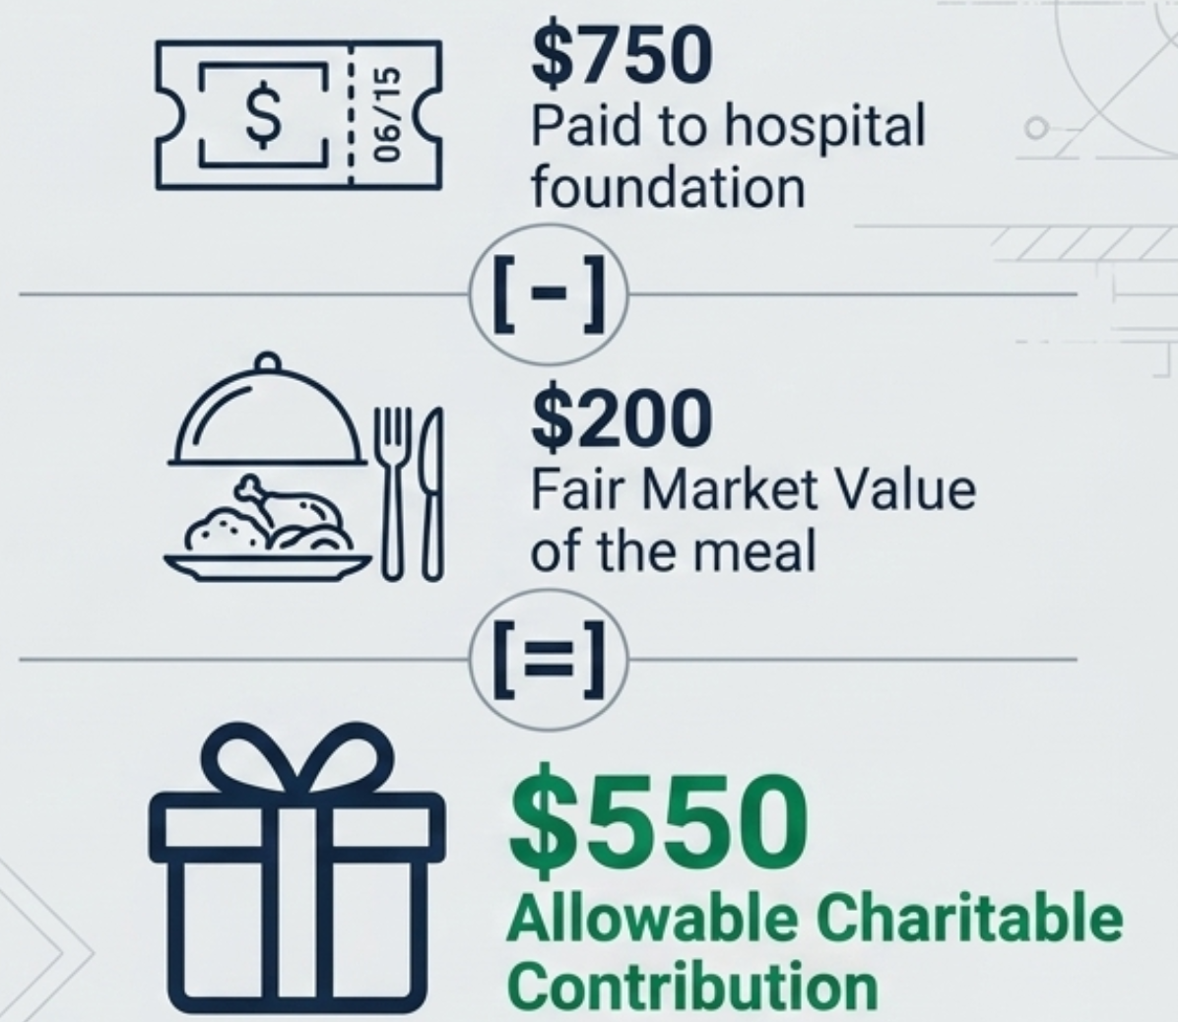

Did the Donor Receive Something Back?
• Quid pro quo contributions
Michael's Charity Gala
  • Michael pays: $750
  • FMV of dinner and entertainment: $200
  Deductible contribution: $750 − $200 = $550
📹 Videos AICPA MCQs & Sims 🤖 Farhat AI Assistant🎙 Podcast Lessons 📊 CPA, CMA, EA Exam 💼Accounting & Finance Courses 🙌 Support by Farhat Team 🌐 farhatlectures.com | ⭐ Start Your Free Trial
Notes:
Now suppose the taxpayer gives money to a perfectly qualified charitable organization. Are we finished? No. We must ask our second question. What did the taxpayer receive in return? If the donor receives goods, services, entertainment, meals, admission, or another economic benefit, the taxpayer has not necessarily made a charitable contribution equal to the entire payment. Part of the payment may simply represent a purchase. The general concept is straightforward. Take the total amount paid and subtract the fair market value of the benefit received by the donor. The remaining amount represents the charitable portion. This is commonly described as a quid pro quo contribution.

Slide 5
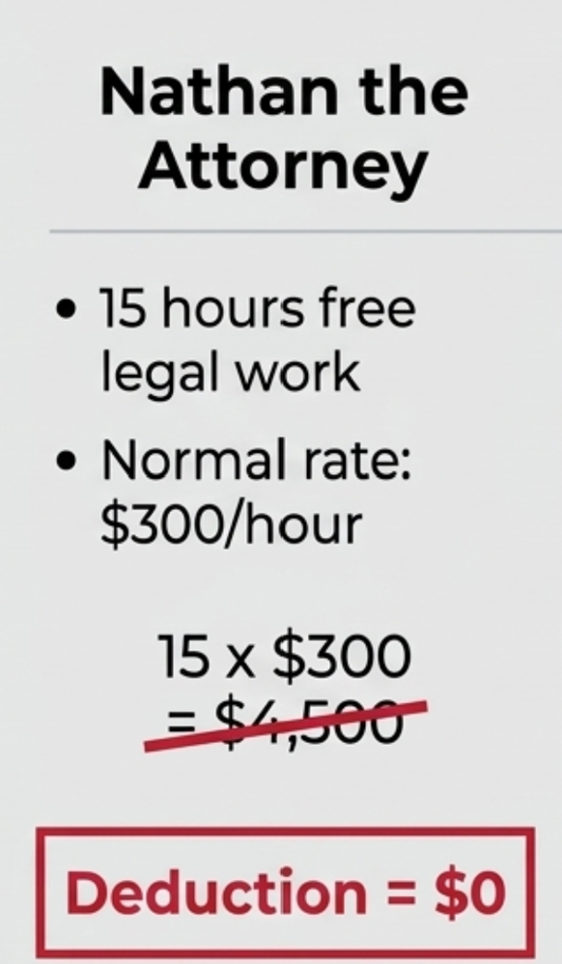
Donated Services
Value of donated time or services = $0 deduction
• Examples: legal services, accounting services, consulting, medical services, manual labor, professional expertise
You cannot deduct something that was never included in income.
• Asking a store for a refund on a television you never purchased.
• If Nathan billed a client: income +$4,500;
cash donated −$4,500; net taxable effect $0
• If Nathan volunteers directly: income recognized $0;
service deduction allowed $0; net taxable effect $0
📹 Videos AICPA MCQs & Sims 🤖 Farhat AI Assistant🎙 Podcast Lessons 📊 CPA, CMA, EA Exam 💼Accounting & Finance Courses 🙌 Support by Farhat Team 🌐 farhatlectures.com | ⭐ Start Your Free Trial

Slide 6
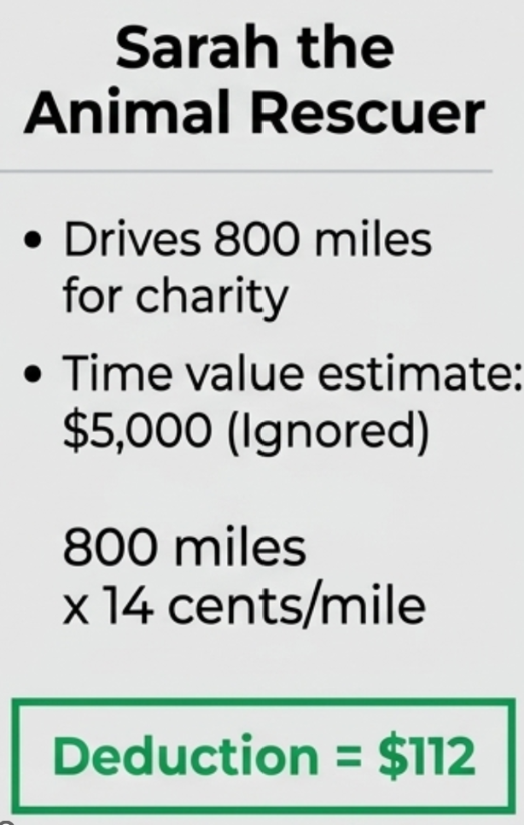
Expenses Related to Volunteer Work
• Services: not deductible
• But certain unreimbursed out-of-pocket expenses related to charitable service may qualify.
• Examples: transportation, supplies, other qualifying expenses
Sarah's Volunteer Mileage
• Value of Sarah’s lost consulting time: not deductible!?
• Cash: amount contributed
• Donated time: $0
• Professional services: $0
• Qualifying unreimbursed expenses: potentially deductible
📹 Videos AICPA MCQs & Sims 🤖 Farhat AI Assistant🎙 Podcast Lessons 📊 CPA, CMA, EA Exam 💼Accounting & Finance Courses 🙌 Support by Farhat Team 🌐 farhatlectures.com | ⭐ Start Your Free Trial
Notes:
There is an important distinction. The value of your time is not deductible. But actual out-of-pocket expenses you incur while performing qualifying charitable services may be deductible. For example, suppose you purchase supplies for the charity and are not reimbursed. That may represent an actual economic expenditure. Or suppose you drive your personal vehicle solely to perform charitable services. The qualifying transportation expense may be deductible. The key distinction is between the subjective value of labor and an objective amount actually spent. Time equals zero. Potentially qualifying unreimbursed expenses are different.

Slide 7
Non-Cash Contribution
📹 Videos AICPA MCQs & Sims 🤖 Farhat AI Assistant🎙 Podcast Lessons 📊 CPA, CMA, EA Exam 💼Accounting & Finance Courses 🙌 Support by Farhat Team 🌐 farhatlectures.com | ⭐ Start Your Free Trial
Notes:
Here is the framework that will guide the entire lesson. Every charitable contribution problem can be attacked using this sequence. First, determine whether the recipient is a qualified charitable organization. Second, determine whether the donor received anything of value in return. Third, identify what was contributed. Cash is generally straightforward. Services are treated very differently. Property requires several additional questions. For property, we compare adjusted basis and fair market value. We consider the holding period. We determine what type of gain or income would have resulted if the property had been sold. For certain tangible property, we also consider how the charity will use the property. After valuation, we examine documentation. Only after we establish the amount of the contribution do we move to the annual AGI percentage limitations. Think of this as an analytical machine. Put the facts into the machine in the proper order, and the tax result comes out the other side.

