Slide 1

What is Alternative Minimum Tax (AMT)
and Purpose of AMT
Taxpayer 1: 22 years old
Taxpayer 2: 35 years old
Wages: 65,000
Interest: 100
Total income of 65,100
Taxable income = 65,100 – SD (16,100) =
49,000 Taxable income
Work at a CPA firm!
Wages: 100,000
Municipal interest: 10,000
Tax and interest deductions on schedule A
Gives to Charity
Owns 2 rental homes
  25,000 Mom and pop deduction
Started a business and incurred losses: (10,000)
Taxable income = 34,000
📹 Videos AICPA MCQs & Sims 🤖 Farhat AI Assistant🎙 Podcast Lessons 📊 CPA, CMA, EA Exam 💼Accounting & Finance Courses 🙌 Support by Farhat Team
🌐 farhatlectures.com | ⭐ Start Your Free Trial

Slide 2
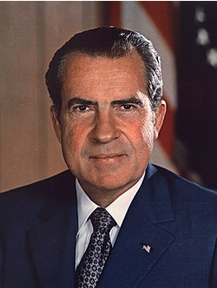
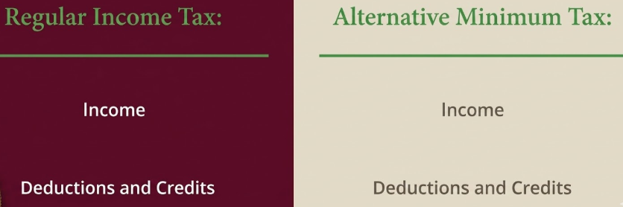
Purpose of AMT
Provide equitable distribution for tax burden
Raising the tax without raising the tax rate (politicians love it)
George H. W. Bush’s famous line:
  “Read my lips: no new taxes”
* 2 tax returns
📹 Videos AICPA MCQs & Sims 🤖 Farhat AI Assistant🎙 Podcast Lessons 📊 CPA, CMA, EA Exam 💼Accounting & Finance Courses 🙌 Support by Farhat Team
🌐 farhatlectures.com | ⭐ Start Your Free Trial

Slide 3
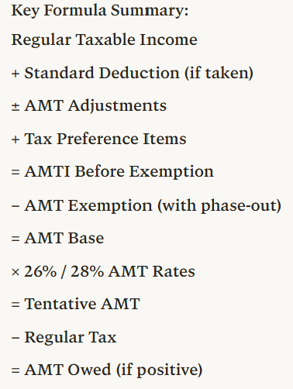
Step | Description | Operation | Notes
1 | Regular taxable income (TI) | Starting point | From Form 1040
2 | Plus: Standard deduction if taken | + | Add back if claimed
3 | Plus/minus: AMT adjustment items | ± adjustments | SALT, depreciation, ISO, etc.
4 | Plus: Tax preference items | + | Private activity bonds, etc.
5 | = AMTI before exemption | Subtotal | Alternative Minimum Taxable Income
6 | Minus: AMT exemption amount | − | Subject to phase-out
 | - MFJ: $140,200 (2026) |  | Phase-out starts at $1,000,000
 | - Single/HOH: $90,100 (2026) |  | Phase-out starts at $500,000
 | - Phase-out rate: 50% |  | Lose $0.50 per $1 over threshold
7 | = AMT base (AMTI after exemption) | Subtotal | Amount subject to AMT rates
8 | Multiplied by AMT tax rates | × 26% or 28% | Two-bracket system
 | - 26% on first $244,500 (MFJ) / $122,250 (MFS)
 | - 28% on amounts above these thresholds
9 | = Tentative AMT before credits | Subtotal | Preliminary AMT liability
10 | Minus: Allowable credits | − | Foreign tax credit, etc.
11 | = Tentative AMT | Subtotal | Final AMT calculation
12 | Less: Regular tax liability | − | From regular tax calculation
13 | = AMT owed (pay if positive) | FINAL | Additional tax beyond regular tax
📹 Videos AICPA MCQs & Sims 🤖 Farhat AI Assistant🎙 Podcast Lessons 📊 CPA, CMA, EA Exam 💼Accounting & Finance Courses 🙌 Support by Farhat Team
🌐 farhatlectures.com | ⭐ Start Your Free Trial

Slide 4
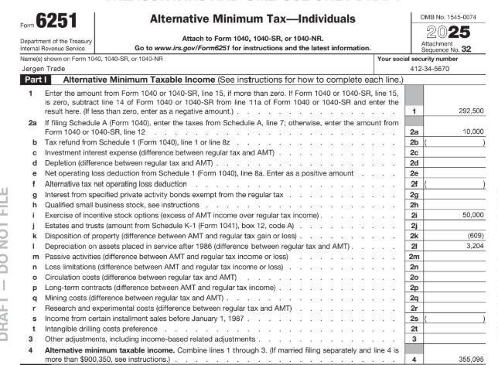
210,225
40,000
250,225
📹 Videos AICPA MCQs & Sims 🤖 Farhat AI Assistant🎙 Podcast Lessons 📊 CPA, CMA, EA Exam 💼Accounting & Finance Courses 🙌 Support by Farhat Team
🌐 farhatlectures.com | ⭐ Start Your Free Trial

Slide 5

MCQ from farhatlecturs.com
The primary purpose of the Alternative Minimum Tax (AMT) system is to:
A. Provide an additional deduction for taxpayers with high income
B. Ensure that taxpayers who claim significant deductions and preferences pay at least a minimum level of tax
C. Replace the regular income tax for high-income taxpayers
D. Reduce the tax burden on individuals with large capital gains
A. Incorrect. AMT does not provide additional deductions; in fact, it often disallows certain deductions permitted under the regular tax system.
B. Correct. The AMT system was designed to ensure that taxpayers who benefit from numerous deductions, exclusions, or preferential tax treatments still pay a minimum amount of tax.
C. Incorrect. AMT does not replace the regular tax system. Instead, taxpayers compute both regular tax and AMT and pay the higher of the two.
D. Incorrect. AMT does not reduce taxes related to capital gains; its objective is to limit the benefit of certain deductions and preferences.
📹 Videos AICPA MCQs & Sims 🤖 Farhat AI Assistant🎙 Podcast Lessons 📊 CPA, CMA, EA Exam 💼Accounting & Finance Courses 🙌 Support by Farhat Team
🌐 farhatlectures.com | ⭐ Start Your Free Trial

