Slide 1

Don’t Put all Your Eggs in One Basket
What type of risks are you expose to when you buy a stock?
General economic conditions (A), such as
business cycles
inflation
interest rates
exchange rates and
others
Firm- Specific Risk (B), such as
Manufacturing Cost target
Production delays
Supply chain constraints
Skilled workers
Management styles and philosophy
Regulation specific to the industry and competition from other companies
Elon musk Tweets or smoking weed!
Perception about electric cars, price of gasoline, access to charging facilities etc.
Firm – specific factors are those that affect Tesla without noticeably affecting other firms
How to solve ? Diversification!

Slide 2
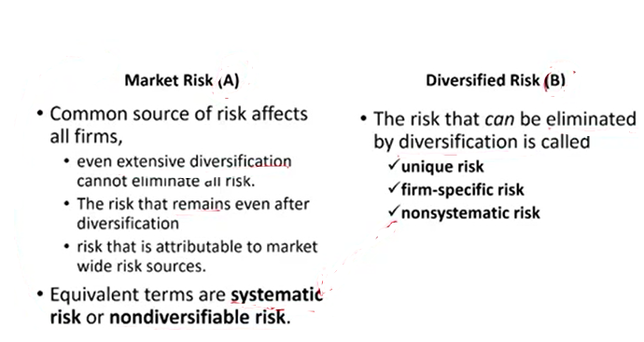

Slide 3
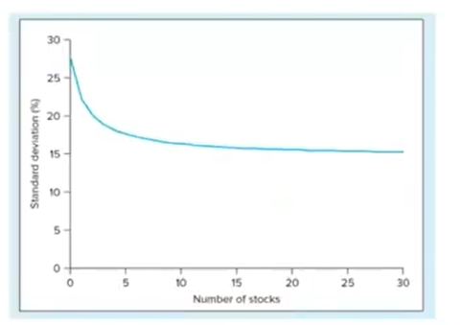
Notes:
Accounting is an information and measurement system that identifies, records, and communicates an organization’s business activities.
Identifying business activities requires that we select relevant transactions and events.
Recording business activities requires that we keep a chronological log of transactions and events measured in dollars.
Communicating business activities includes preparing accounting reports such as financial statements, which we analyze and interpret.
Recordkeeping, or bookkeeping, includes the recording of transactions and events and is just one part of accounting.

Slide 4
