Slide 1
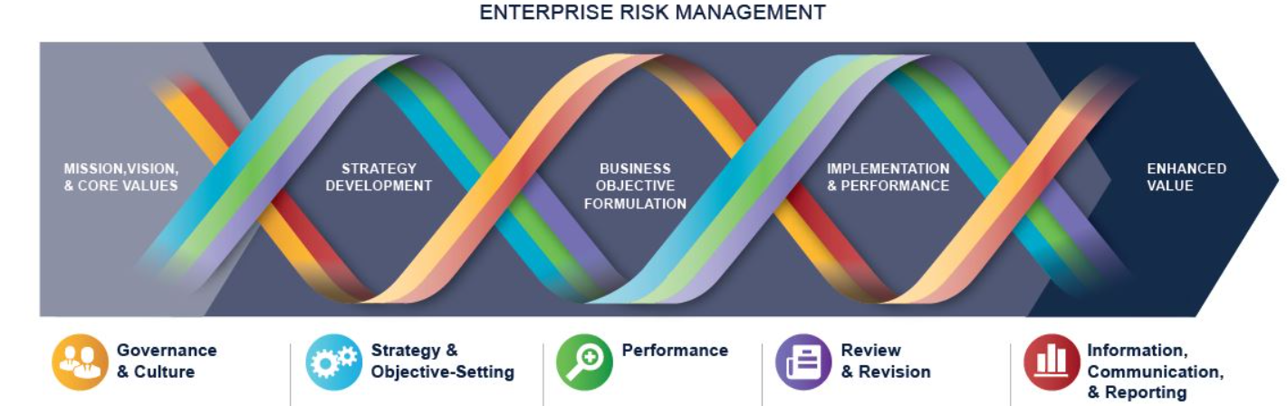
COSO Enterprise Risk Management (ERM) Integrated Framework
ERM is defined as
  The culture, capabilities, and practices, integrated with strategy-setting and performance, that organizations rely on to manage risk in creating, preserving, and realizing value.
  Consists of five interrelated components. Twenty principles are distributed among the components.
Governance and culture (5)
Strategy and objective-setting (4)
Performance (5)
Review and revision (3)
Information, communication, and reporting (3)

Slide 2
Information, communication, and reporting
Leveraging Information System
Communicate Risk Information
Reporting on Risk
Student or CPA Candidate? Visit
www.farhatlectures.com

Slide 3

Leveraging Information System
Leverage information system to support ERM
  How?
Data: raw facts collected for analysis.
Capture, collect, process data into useful information
  Information has to be relevant to help us make better decision
  Airline companies colleting data about competitor pricing model from open sources
Two types of Data (TBD):
1.Structure Data: Well organized and easily searchable
  Excel sheet, public index, database file,
2.Unstructured data: No predefined pattern
  Emails, word document, photos, website, text files
Student or CPA Candidate? Visit
www.farhatlectures.com

Slide 4
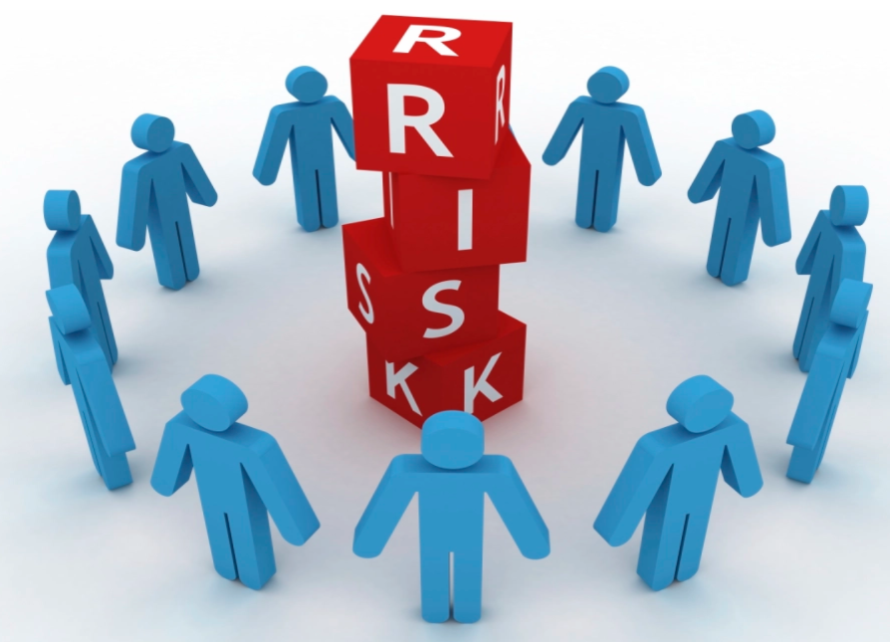
Communicate Risk Information
Identified risk, assess, prioritize etc…
Communicate risk to support ERM.
  Open communication channels
Communicate to internal and external parties as needed.
Continuous discussion between BOD and management about company risk appetite.
How to communicate the risk?
  Email, written document (policies and procedures), public board, town hall meetings, one on one discussion, whistle-blower hotlines
Student or CPA Candidate? Visit
www.farhatlectures.com

Slide 5
Reporting on Risk
Report on risk, culture, and performance at multiple levels ad across the organization
Why?
Support personnel:
  Understand the relationship among risk, culture performance
  Decision making related to:
    Setting strategy
    Governance
    Day to day operations
Information has to be accurate, complete clear and help make forward looking decision.
How often?
  Depend on the severity of the risk and priority of risk.
Student or CPA Candidate? Visit
www.farhatlectures.com

Slide 6
KRI vs KPI
Key Risk Indicators (KRIs) are critical predictors of unfavorable events that can adversely impact organizations.
  They monitor changes in the levels of risk exposure and contribute to the early warning signs that enable organizations to report risks, prevent crises and mitigate them in time.
    can be quantified in terms of percentages, numbers etc.
    Upward trend in default rate by large customer in a specific industry
Key Performance Indicators are typically designed to offer a high-level overview of organizational performance.
  not adequately offer early warning signals of a developing risk, they are important to analyze trends and monitor performance.
  An event already occur 5% of loan portfolio (historical)
Student or CPA Candidate? Visit
www.farhatlectures.com

Slide 7
COSO Enterprise Risk Management (ERM) Integrated Framework
ERM is defined as
  The culture, capabilities, and practices, integrated with strategy-setting and performance, that organizations rely on to manage risk in creating, preserving, and realizing value.
  Consists of five interrelated components. Twenty principles are distributed among the components.
Governance and culture (5)
Strategy and objective-setting (4)
Performance (5)
Review and revision (3)
Information, communication, and reporting (3)

