Slide 1
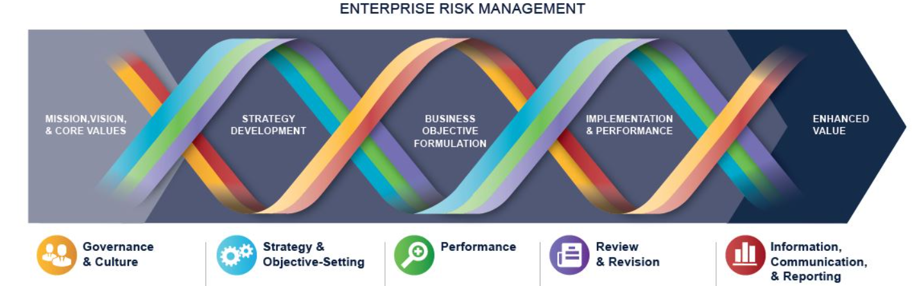
COSO Enterprise Risk Management (ERM) Integrated Framework
ERM is defined as
  The culture, capabilities, and practices, integrated with strategy-setting and performance, that organizations rely on to manage risk in creating, preserving, and realizing value.
  Consists of five interrelated components. Twenty principles are distributed among the components.
Governance and culture (5)
Strategy and objective-setting (4)
Performance (5)
Review and revision (3)
Information, communication, and reporting

Slide 2
Review and Revision (4 of 5)
Assess Substantial Changes
Review Risk
Improvement in ERM
Student or CPA Candidate? Visit
www.farhatlectures.com

Slide 3
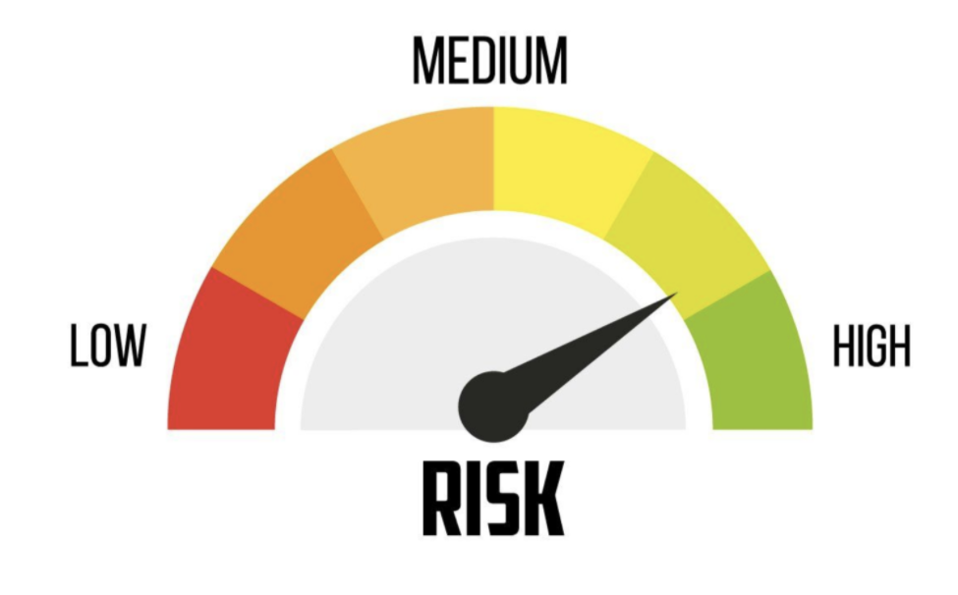
Assess Substantial Changes (1 of 3)
Are there any new or changes in risk to be integrate in our risk portfolio?
How to identify changes?
1) Internal Environment
  Rapid Growth
  Innovations
  EE Turnover
  Mew CEO/CFO/CRO etc.
2) External Environment
  Regulatory environment
  Economic recession
  New Administration
  Covid 19
Student or CPA Candidate? Visit
www.farhatlectures.com

Slide 4
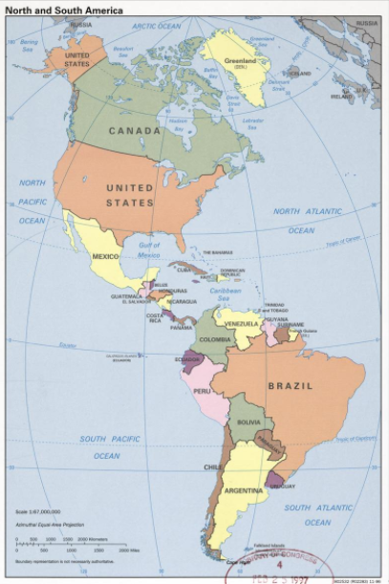
Review Risk (2 of 3)
Periodically review risk and related performance.
  How are we doing?
Are there any risk that is greater than our risk tolerance.
  Actual risk< tolerance
Look for unidentified risk
  Use Data, AI, new research etc.
Improperly assess risk
  Did we estimate the risk properly?
Opportunities to accept more risk
  Are we taking sufficient risk?
Need to revise target performance or tolerance
  Business objectives, strategy, culture, risk prioritization, risk responses and risk appetite
  Approval by the board
Student or CPA Candidate? Visit
www.farhatlectures.com

Slide 5
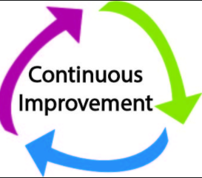
Improvement in ERM (3 of 3)
Continually improve ERM at all levels
  Dynamic environment
Methods for improving ERM:
  Technology
    Big Data, Data mining
  Review historically weak areas
    Foreign currency projections
  Restructure to better align with risk management
  Changes risk appetite
    New Product was more/less volatile than expected
  Add new risk categories:
    Cyber security
  Benchmarking and industry peer data
Student or CPA Candidate? Visit
www.farhatlectures.com

