Slide 1
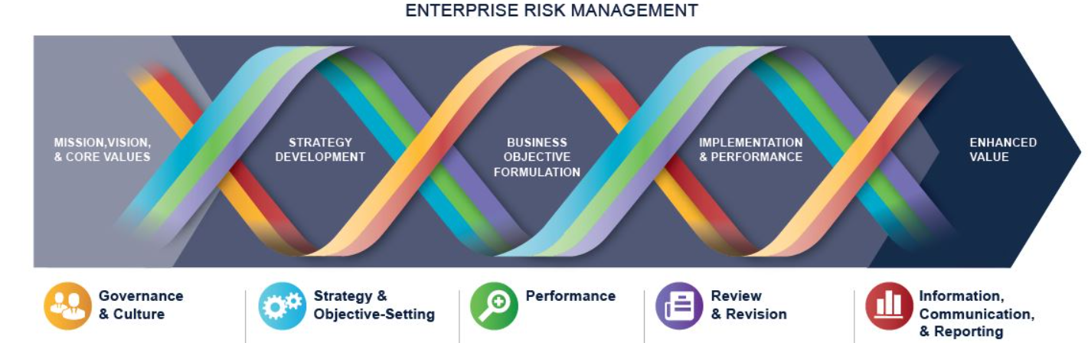
COSO Enterprise Risk Management (ERM) Integrated Framework
ERM is defined as
  The culture, capabilities, and practices, integrated with strategy-setting and performance, that organizations rely on to manage risk in creating, preserving, and realizing value.
  Consists of five interrelated components. Twenty principles are distributed among the components.
Governance and culture (5)
Strategy and objective-setting (4)
Performance
Information, communication, and reporting
Review and revision
Student or CPA Candidate? Visit
www.farhatlectures.com

Slide 2
Strategy and objective-setting
Analyze Business Context
Define Risk Appetite
Evaluate Alternative Strategies
Formulate Business Objectives
Student or CPA Candidate? Visit
www.farhatlectures.com

Slide 3

Core Values (4 of 5). Prior session
Organization essential beliefs about what is acceptable and what is not.
What they say and do. Reflected in their actions
Mission statement and Vision
Johnson & Johnson core values comprise “growth & innovation, investing in future, global diversity, citizenship and sustainability, developing diversity, and global supply base.”
Johnson & Johnson mission statement is that “our credo stems from a belief that consumers, employees and the community are all equally important.”
Johnson & Johnson vision statement is “for every person to use their unique experiences and backgrounds, together – to spark solutions that create a better, healthier world.”
Student or CPA Candidate? Visit
www.farhatlectures.com

Slide 4
Analyze Business Context (1 of 4)
Organization mission, visions, and core values must be supported by a strategy.
Integrate ERM with strategy to understand the risk profile related strategy and business objectives.
What is business context?
  Events, relationship, trends and other factors that influence the organization’s strategy and business objectives.
Internal Environment | External Environment
Capital: Assets, cash, PPE, Intangible assets
Political: Trump Vs. Biden
People: knowledge, skills, culture, values
Economic: Interest, Inflation, credit
Process: Activities, task, processes, change in management
Social: Customer preferences, demographic
Technology: New
Technology: AI, Big data, R&D
Legal: Laws, regulations, industry regulation
Environmental: Climate Change, natural catastrophe
Student or CPA Candidate? Visit
www.farhatlectures.com

Slide 5
Type of Business Context (1 of 4)
 |  | Changes occurs rapidly & unanticipated
Dynamic
Complex
Unpredictable
Many Interdependencies and interconnections
Low Barriers of Entry.
Changing risk can appear anytime
Transnational Companies across the world
Unique External Environmental Factors
Student or CPA Candidate? Visit
www.farhatlectures.com

Slide 6
Define Risk Appetite (2 of 4)
Risk: The Possibility that events that will occur and affect the achievement of the strategy and business objectives.
  Restaurant, airline, beachfront property
What is risk appetite?
  How much risk you are willing to take on (accept)
Risk is considered within the context of mission, vision, culture, prior strategy and risk capacity (maximum risk).
Risk can be expressed
  qualitatively (low, medium, high).
  Quantitively (% of sales, standard deviation, beta etc.)
      1% of
Risk Inventory: All identified risks that effect that effects strategy and business objectives
Inherent Risk: is the risk in the absence of management action to curtail/reduce the risk.
  Actual Residual risk: remain after management action to later its severity
The board approves risk appetite and communicate throughout the organization
Student or CPA Candidate? Visit
www.farhatlectures.com

Slide 7
Evaluate Alternative Strategies (3 of 4)
The organization evaluates alternative strategies and their effects on
  the risk profile and
  must be aligned with its mission, vision, core values, and risk appetite
How?
  scenario analysis. Sales increase or decrease by certain percentage
  SWOT (Strengths-Weaknesses-Opportunities-Threats) analysis
  competitor analysis
Strategy should be changed if it fails to create, realize, or preserve value.
What is create value?
Benefit > Cost. NPV.
What is realize?
Benefit is transfer to shareholder “cash out”.
What is Preserve?
Sustaining the company resources (maintenance, R&D)
Value Eroded:
When management don’t produce/or create value.
Student or CPA Candidate? Visit
www.farhatlectures.com

Slide 8
Formulate Business Objectives (4 of 4)
Within risk appetite and core value, mission statement and vision
Formulate 4 Types of Business Objectives:
  Strategic Objectives. (big picture) Mission statement. Direction. Conquer new market
  Operational Objectives (day to day operation) Effective use of resources
    Reduce employee turnover
  Reporting: Financial internal and external. Reliable, Accurate, Objective
  Compliance: Laws, regulation, company policies
Business objectives should be
  specific
  measurable
  observable and
  obtainable
Student or CPA Candidate? Visit
www.farhatlectures.com

