Slide 1
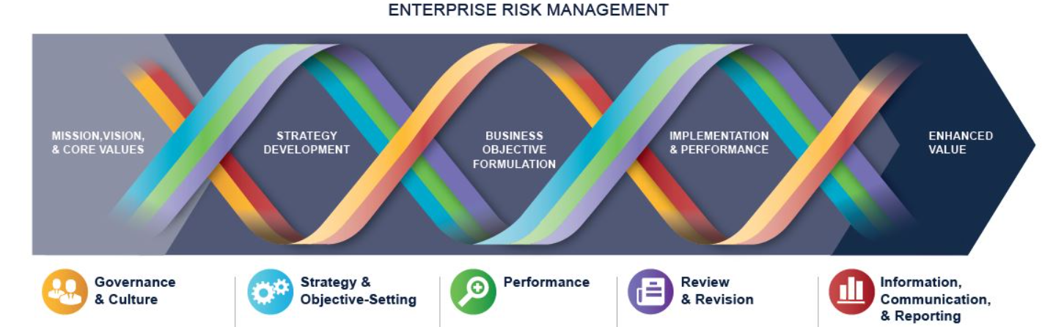
COSO Enterprise Risk Management (ERM) Integrated Framework
ERM is defined as
  The culture, capabilities, and practices, integrated with strategy-setting and performance, that organizations rely on to manage risk in creating, preserving, and realizing value.
  Consists of five interrelated components. Twenty principles are distributed among the components.
Governance and culture
Strategy and objective-setting
Performance
Information, communication, and reporting
Review and revision

Slide 2
Governance and culture (1 of 5)
Five Principles:
Board Oversight
Operating Structure
Culture
Core Value
Attract, Develop and Retain Staff
Student or CPA Candidate? Visit
www.farhatlectures.com

Slide 3

Board Oversight (1 of 5)
Independent and competent
Independent:
  No financial interest in the entity
  Should not have executive power
  Conflict of interest (member of another board)
  Material contractual obligation
  Personal relationship with key shareholders
  Extending period of time (new set of eyes)
Competent:
  Should have necessary skills, experience and business industry
  Understand business context
  Understand organization biases
  Bully CEO
  Reliance on data to make decision
  Challenge established norms
Student or CPA Candidate? Visit
www.farhatlectures.com

Slide 4
Board Oversight (1 of 5)
Responsible for risk oversight.
  Set the tone
  Company mind set.
Make management responsible and accountable
  Create subcommittee to delegate certain aspects
    Risk Committee
    Compensation committee
    Recruiting committee
Review and challenging decision related to strategy:
  Risk Appetite
  Merger and acquisition
  Approve top management compensation
  Stakeholder relations
Student or CPA Candidate? Visit
www.farhatlectures.com

Slide 5

Operating Structures (2 of 5)
How the entity is organized and carries out its day-to-day operations.
  Centralized versus decentralized
  Legal structure determines how the entity operates
    Single legal entity or as multiple, distinct legal entities. (J&J)
  2.The management structure establishes reporting lines
      Direct reporting versus secondary reporting
Factors to consider when establishing and evaluating operating structures include the entity’s
    Strategy and business objectives, including related risks;
      Strategy: communicate how organization achieve its mission
      Business objective: steps taken to achieve the strategy
    Nature, size , and geographic distribution;
      Nature: Online or brick and mortar
      Large, medium or small
      Local or international
    Assignment of authority, accountability, and responsibility at all levels
    Types of reporting lines and communication channels; and
    Reporting requirements (e.g., financial, tax, regulatory, and contractual).
Student or CPA Candidate? Visit
www.farhatlectures.com

Slide 6

Culture (3 of 5)
The board and management are responsible for defining culture.
Culture is shaped by internal and external factors (aggressive or conservative)
Internal factors:
  The level of judgment and autonomy allowed to personnel
    Salespeople
  Standards and rules (formal or informal)
    Health Companies going to cloud (risk of privacy)
  The reward system in place (Wells Fargo)
External factors include
  Legal requirements
  Expectations of stakeholders such customers and investors (image).
Risk Culture (profile): How much you can tolerate?
  Risk Averse: Reluctant to take risks. Conservative. Established. Nuclear Power Plant.
  Risk neutral: seek highest return regardless of risk assumed (not common)
  Risk aggressive: willing to risk more for the possibility of better returns. Early growth, start up.
  Capital structure: Debt versus equity
Student or CPA Candidate? Visit
www.farhatlectures.com

Slide 7
Core Values (4 of 5)
Organization essential beliefs about what is acceptable and what is not.
What they say and do. Reflected in their actions
Mission statement and Vision
Johnson & Johnson core values comprise “growth & innovation, investing in future, global diversity, citizenship and sustainability, developing diversity, and global supply base.”
Johnson & Johnson mission statement is that “our credo stems from a belief that consumers, employees and the community are all equally important.”
Johnson & Johnson vision statement is “for every person to use their unique experiences and backgrounds, together – to spark solutions that create a better, healthier world.”
Student or CPA Candidate? Visit
www.farhatlectures.com

Slide 8
Attract, Develop and Retain Staff (5 of 5)
BOD selects CEO, CFO Top management
Hiring Committee
Management is responsible for defining the human capital necessary (the needed competencies) to achieve strategy and business objectives.
The human resources function assists management in developing competency requirements through processes that attract, train, mentor, evaluate, reward, and retain competent individuals.
Student or CPA Candidate? Visit
www.farhatlectures.com

Slide 9
COSO Enterprise Risk Management (ERM) Integrated Framework
ERM is defined as
  The culture, capabilities, and practices, integrated with strategy-setting and performance, that organizations rely on to manage risk in creating, preserving, and realizing value.
  Consists of five interrelated components. Twenty principles are distributed among the components.
Governance and culture (5)
Strategy and objective-setting (4)
Performance
Information, communication, and reporting
Review and revision

