Slide 1
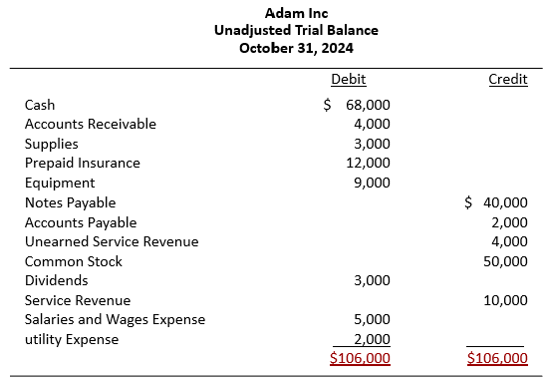
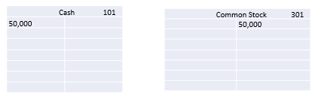


What is the accounting cycle?
What is accounting?
  Analyzing, recording, processing and classifying transactions then reporting financial information to interested users.
Analyze transactions from “source documents”.
Journalize transactions.
Post journal entries to accounts.
Determine account balances and prepare a trial balance.
Journalize and post adjusting entries.
Prepare financial statements and reports.
Journalize and post closing entries.
Prepare a post-closing trial balance.
Start Again…
Data Capture
Data Capture
Storage/Processing
Storage/Processing
Data Capture
Storage/Processing
Output/reporting
Data Capture
Storage/Processing
Storage/Processing
Student or CPA Candidate?
www.farhatlectiures.com

Slide 2

Set of Interrelated Cycles, Processes Modules
Revenue Cycle/Process:
Transaction with Customers
Sales of goods and Services
+ Cash
Financing cycles
+/- Cash.
Expenditure Cycle/Process:
Transactions with suppliers
Purchased of goods and services
- Cash
Production (manufacturing) Cycle/process:
Direct Labor + Direct Material + and Overhead = Finished Good
-Cash
General Ledger and Reporting:
Financial reporting to external users
HR/Payroll Cycle Process:
Hire, train develop and pay labor
- Cash
Student or CPA Candidate?
www.farhatlectiures.com

