Slide 1
Data Visualization
Humans are visually biased.
A picture is worth a thousand words.
  Infographics
Presentation of data in a pictorial or graphical format.
Purpose: Helps decision makers to see analytics presented visually
  User can grasp/understand difficult concepts or
  identify new patterns
Data analytics are effective if you can communicate and make the data understandable.
  An art and not science.
Student or CPA Candidate?
www.farhatlectures.com

Slide 2
Purpose and Type of Data
Purpose:
  Declarative: Explaining the results of previously done analysis
    Wanting to “declare” or present your findings to an audience.
  Exploratory: exploring the data via visualization
    Gaining insights while you are interacting with the data (don’t know initially what you are looking for)
    Data mining, data discovery, knowledge discovery
Type of data:
  Quantitative data: Data Driven
  Qualitative data: Conceptual
Student or CPA Candidate?
www.farhatlectures.com

Slide 3
Qualitative Data
Categorical data.
  Count them and group them, and
  in some cases, you can rank them.
Qualitative data can be further defined in two ways:
  Nominal data
    Simplest: hair color, gender, and ethnic groups. Cannot Rank or average
  Ordinal data.
    Counted and categorized but also ranked
    Gold, silver, and bronze medals
    1–5 rating scales on teacher evaluations
    letter grades (count, categorize and rank). No averages, SD
Proportion:
  Number of people with blond hair (20) as part of the total (100)
Qualitative data (both nominal and ordinal) can also be referred to as “conceptual” data because such data are text-driven and represent concepts instead of numbers.
Student or CPA Candidate?
www.farhatlectures.com

Slide 4
Quantitative Data
More complex (more than just counting)
Made up of observations counted and ranked, (ordinal qualitative data).
Calculate averages, standard deviation.
Quantitative data can be categorized into two different types:
  Ratio
    Zero means she absence of something. Zero dollar
  Interval.
    Zero does not mean the absence of something. Zero degree
Quantitative data can be further categorized as either
  1) Discrete
    Whole Number. Points in a basketball or soccer game
  2) Continuous data (line chart)
    data that can take on any value within a range. Height. 1.7679 CM
Student or CPA Candidate?
www.farhatlectures.com

Slide 5
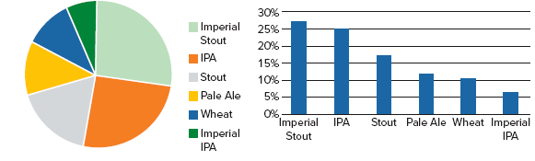
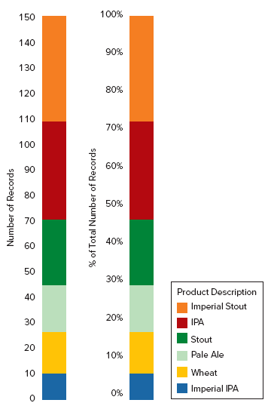
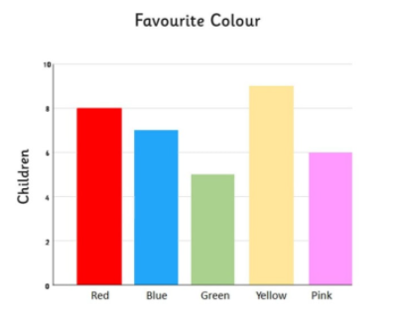
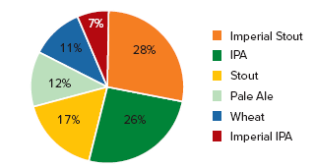
Charts for Qualitative Data
Bar charts
  Chart or graph that presents categorical data with rectangular bars with heights or lengths proportional to the values that they represent. The bars can be plotted vertically or horizontally.
  A vertical bar chart is sometimes called a column chart.
Pie charts
  size of each slice is proportional to the data it represents
Stacked bar chart.

Slide 6
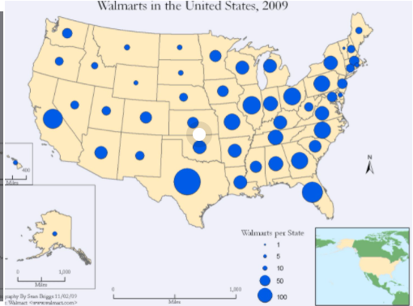
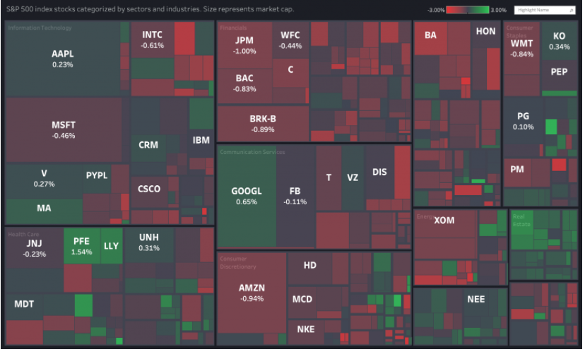
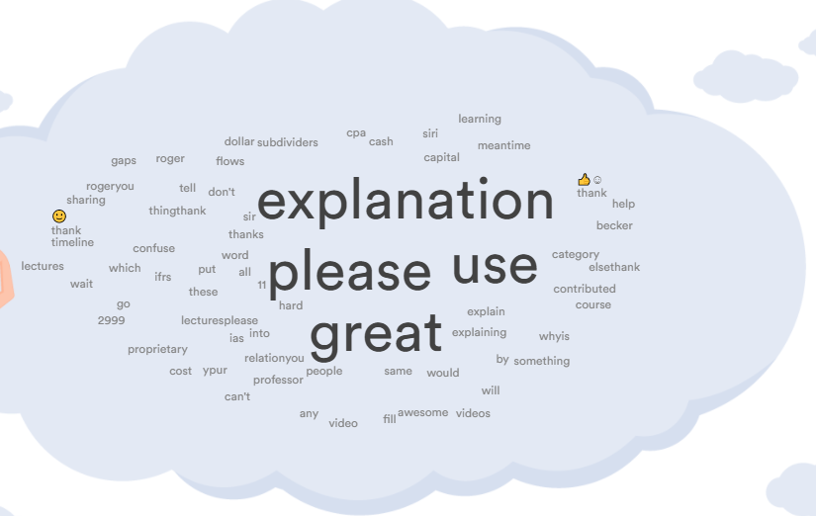
Other Charts: Proportion in Qualitative Data
Tree maps and heat maps
  Treemapping is a method for displaying hierarchical data using nested figures, usually rectangles
Symbol maps
  proportional symbol map shows a marker (often a circle) positioned on a map. The marker is sized according to a quantitative value
Word clouds (sentiment analysis)
  visual representation of words

Slide 7
Quantitative Data
All of the methods mentioned for qualitative data can work for depicting quantitative data, but the following charts can depict more complex data:
Line charts.
  Show similar information to what a bar chart shows, but line charts are good for showing data changes or trend lines over time.
  Useful for continuous data, (bar charts are often used for discrete data).
  Line charts are not recommended for qualitative data, which by nature of being categorical, can never be continuous.
Student or CPA Candidate?
www.farhatlectures.com

Slide 8
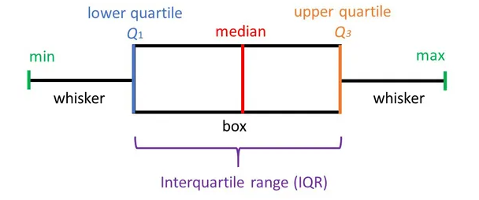
Box and whisker plots.
  Useful for when quartiles, median, and outliers are required for analysis and insights.
Upper Extreme: 32
Lower Extreme: 5
Median (middle): 17
Upper quartile (median): 20
Lower Quartile: 10
Week 1 | 10
Week 2 | 17
Week 3 | 5
Week 4 | 32
Week 5 | 16
Week 6 | 18
Week 7 | 20
5, 10, 16, 17, 18, 20, 32
Student or CPA Candidate?
www.farhatlectures.com

Slide 9
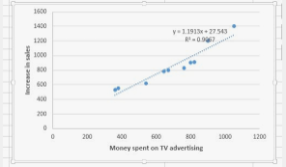
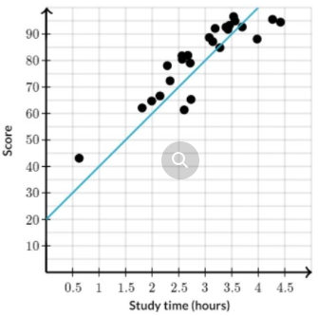
Scatter plots.
  Identify the correlation between two variables or for identifying a trend line or line of best fit.
Student or CPA Candidate?
www.farhatlectures.com

Slide 10
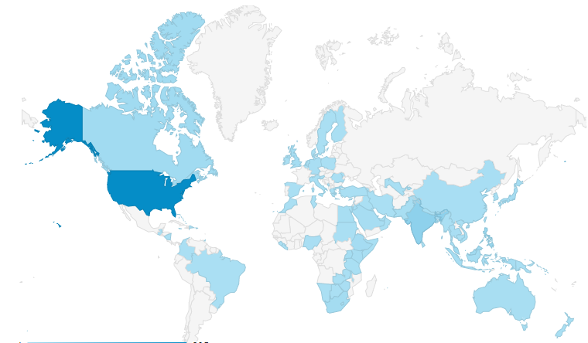
Filled geographic maps
  As opposed to symbol maps, a filled geographic map is used to illustrate data ranges for quantitative data across different geographic areas such as states or countries.
Student or CPA Candidate?
www.farhatlectures.com

Slide 11
Data Scale and Increments
How much data do you need to share in the visual to avoid being misleading at the same time avoid being distracting?
  2 Years Vs 4 Years Vs last 4 Quarters
  (don’t Hide data that they don’t align with your expectations).
How to deal with outliers?
  should they be displayed (draw attention ), or
  leave them out (noise)
Scale:
  charts should begin with a baseline of 0
  if 0 is meaningless to your dataset, you could find a different baseline that makes sense.
  Do not overexaggerate the height or the baseline so that your trendline or bar chart is over- or underemphasized;
4. Provide context or reference points to make the scale meaningful?
  stock price of $100 (High? Low?)
  Meaningless without context of the company’s stock price over time,
  the company’s industry and its competitors’ stock prices, or
  some other piece of context
Student or CPA Candidate?
www.farhatlectures.com

