Slide 1
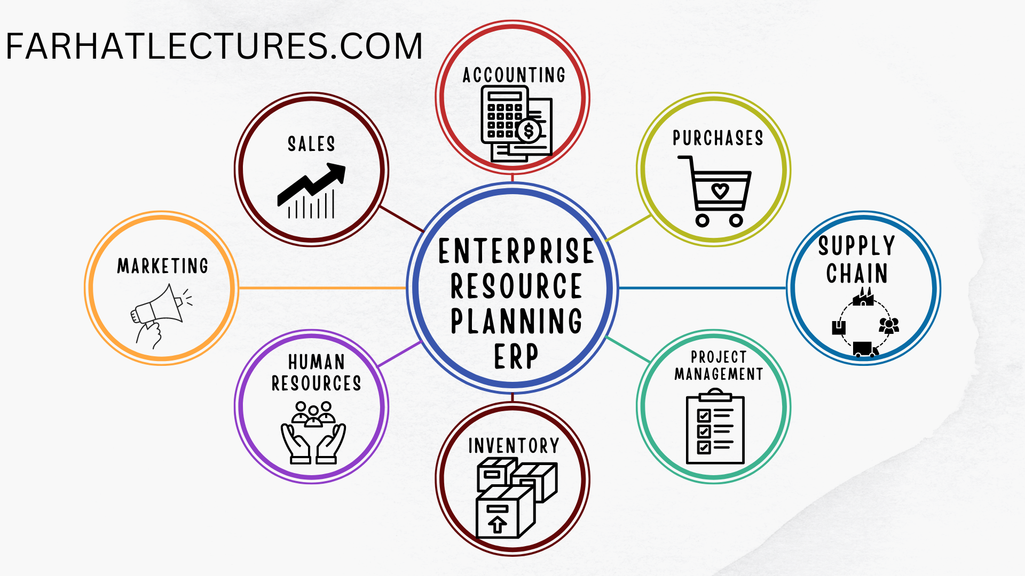
Enterprise Resource Planning (ERP)
It is a type of software that organizations use to manage and automate various business processes, such as:
For more, visit:
www.farhatlectures.com

Slide 2
Components of ERP Systems
ERP (Enterprise Resource Planning) systems typically (not inclusive) include the following” integrated” components:
  Financial management: managing financial transactions, budgeting, and accounting.
  Supply chain management: tracking and managing the movement of goods and materials.
  Manufacturing and production management: managing the production process and supply chain.
  Sales and customer relationship management: managing customer interactions and sales.
  Human resources management: managing employee information and benefits.
  Inventory management: tracking inventory levels and managing stock.
  Project management: managing and tracking projects.
  Data analytics: providing insights and decision-making support through data analysis.
  Business intelligence: providing real-time information and reporting on key performance indicators.
  E-commerce and e-business: managing online sales and customer interactions.
  Many organizations pick and choose ERP modules from several vendors
For more, visit:
www.farhatlectures.com

Slide 3
Goals/benefits of ERP Systems
Improving efficiency and productivity
Enhancing Decision-Making Capabilities
Improving data accuracy and consistency
Reducing Operational Costs
Improving Visibility and Control
Facilitating growth and scalability
Improving customer service
Enhancing compliance
For more, visit:
www.farhatlectures.com

Slide 4
Improving Efficiency and Productivity (1 of 8)
Improving efficiency and productivity by automating and streamlining business processes
The ERP system could be integrated with the inventory management system to automatically trigger the purchase of raw materials when inventory levels reach a certain threshold
  This eliminates the need for manual purchase orders and helps to ensure that production is not interrupted due to lack of materials.
ERP system could be integrated with the company's accounting and financial management systems, allowing for the automatic generation of invoices and purchase orders, and the automatic recording of financial transactions such as payments and bills. Gross profit!
  This eliminates the need for manual data entry and reduces the risk of errors, thereby improving overall productivity.
For more, visit:
www.farhatlectures.com

Slide 5
Enhancing Decision-Making Capabilities (2 of 8)
Enhancing decision-making capabilities by providing real-time access to accurate and relevant data from across the organization.
An example of an ERP system enhancing decision-making capabilities by providing real-time access to accurate and relevant data from across the organization is a healthcare provider using an ERP system to manage patient records.
  The ERP system could be integrated with the provider's electronic health records (EHR) system, allowing for real-time access to patient information such as medical history, medications, and test results. This allows doctors and nurses to make more informed decisions about patient care and to provide more accurate diagnoses and treatment plans.
Additionally, the ERP system could be integrated with the provider's billing and insurance systems, allowing for real-time access to patient insurance information and billing status.
  This allows the provider to quickly identify and resolve any billing issues, such as denied claims, and to ensure that patients are billed correctly.
The ERP system also has reporting and analytics capabilities that can be used to extract data from across the organization, this allows for better tracking of patient outcomes and usage of resources, helping the healthcare provider to identify areas for improvement and to measure the effectiveness of new treatments and procedures.
For more, visit:
www.farhatlectures.com

Slide 6
Improving Data Accuracy and Consistency (3 of 8)
By centralizing data and eliminating the need for manual data entry and reconciliation.
The ERP system could be integrated with the company's point-of-sale (POS) systems, allowing for real-time updates of inventory levels and sales data as transactions occur.
  This eliminates the need for manual data entry and ensures that inventory levels are always accurate.
Additionally, the ERP system could be integrated with the company's financial management systems, allowing for the automatic recording of financial transactions such as sales and purchases.
  This eliminates the need for manual data entry and reduces the risk of errors.
The ERP system also has a centralized database where all the transactions are recorded, this allows for easy access to the data for reporting and analysis, and also enables the data to be consistent across the organization, reducing the chances of inconsistencies in data.
For more, visit:
www.farhatlectures.com

Slide 7
Reducing Operational Costs (4 of 8)
Reducing operational costs by automating manual tasks and eliminating errors. upfront investment
An example of an ERP system reducing operational costs by automating manual tasks and eliminating errors is a logistics company using an ERP system to manage their transportation and delivery processes.
The ERP system could be integrated with the company's transportation management system (TMS), allowing for the automatic scheduling and routing of deliveries based on customer orders and inventory levels.
  This eliminates the need for manual scheduling and reduces the risk of errors, such as missed deliveries or incorrect routes.
The ERP system can also be integrated with other systems like GPS tracking, which allows the company to monitor and optimize the delivery routes in real-time, reducing the fuel consumption and other operational costs.
For more, visit:
www.farhatlectures.com

Slide 8
Improving Visibility and Control (5 of 8)
Improving visibility and control over business operations by providing a comprehensive view of an organization's performance.
An example of an ERP system improving visibility and control over business operations by providing a comprehensive view of an organization's performance is a construction company using an ERP system to manage their project management and financials.
The ERP system could be integrated with the company's project management system, allowing for real-time access to project status, such as task completion, resource allocation, and budget tracking. This allows the company to identify and address any issues or delays quickly and to ensure that projects are completed on time and within budget.
Additionally, the ERP system could be integrated with the company's financial management systems, allowing for real-time access to financial data such as revenue, expenses, and cash flow. This allows the company to track their financial performance and to identify any areas that may need improvement.
The ERP system also has a dashboard that provides a comprehensive view of all the business operations, this allows the management to track the performance of all projects, financials, and resources, in real-time, making it easy to identify any issues, opportunities or trends.
For more, visit:
www.farhatlectures.com

Slide 9
Facilitating Growth and Scalability (6 of 8)
Facilitating growth and scalability by providing the flexibility to adapt to changing business needs.
An example of an ERP system facilitating growth and scalability by providing the flexibility to adapt to changing business needs is a retail company using an ERP system to manage their sales, inventory and supply chain.
The ERP system could be integrated with the company's e-commerce platform, allowing the company to expand their sales channels and reach new customers. As the business grows, the ERP system can be configured to handle the increased volume of transactions and inventory management, without the need for significant additional investments.
Additionally, the ERP system could be integrated with the company's warehouse management system, allowing the company to manage their inventory and distribution more efficiently as they expand into new markets and open new stores.
The ERP system also has a modular architecture that allows the company to add new functionalities and modules as the business needs change. This ensures that the ERP system can adapt to the company's changing business needs as they grow and expand
For more, visit:
www.farhatlectures.com

Slide 10
Improving Customer Service (7 of 8)
Improving customer service by providing faster and more accurate responses to customer inquiries and orders.
An example of an ERP system improving customer service by providing faster and more accurate responses to customer inquiries and orders is a manufacturing company using an ERP system to manage their production, inventory and sales processes.
The ERP system could be integrated with the company's customer relationship management (CRM) system, allowing for real-time access to customer information such as orders, invoices, and contact details. This allows the company to respond more quickly and accurately to customer inquiries and to process orders more efficiently.
Additionally, the ERP system could be integrated with the company's inventory management system, allowing for real-time access to inventory levels and product availability. This allows the company to provide more accurate delivery times and to handle backorder situations more effectively.
The ERP system also has a self-service portal that allows customers to check their order status, track the delivery, and access the invoices.
  This improves the customers' experience by providing them with real-time information and reducing the need for them to contact the company for updates. More satisfaction ==> More sales ➔ trust
For more, visit:
www.farhatlectures.com

Slide 11
Enhancing compliance (8 of 8)
An example of an ERP system enhancing compliance with regulatory and industry standards is a pharmaceutical company using an ERP system to manage their manufacturing and supply chain processes.
The ERP system could be integrated with the company's quality management system, allowing for the automatic tracking and recording of all manufacturing processes, test results, and quality control measures.
  This ensures that the company is meeting regulatory and industry standards for product quality and safety.
Additionally, the ERP system could be integrated with the company's supply chain management system, allowing for the automatic tracking and recording of all supplier information, such as certifications, and compliance with industry standards.
The ERP system also has built-in audit trails that allow the company to track changes made to the data, this allows the company to comply with the regulations that require maintaining records of the changes made to the data.
For more, visit:
www.farhatlectures.com

Slide 12
Online Transaction Processing and Analytical Processing OLTP & OLAP
ERP systems typically include both OLTP and OLAP functionality.
OLTP is used in ERP systems to handle the day-to-day transactional-based requests, such as financial transactions, inventory management, and customer relationship management.
  These requests involve inserting, updating, or retrieving small amounts of data from a database.
OLAP, on the other hand, is used in ERP systems to provide real-time information and reporting on key performance indicators, such as financial statements, sales reports, and inventory levels.
  OLAP systems are optimized for complex queries and data analysis, and store data in a denormalized format to make it easy to extract insights and perform data analysis.
More About ERP
For more, visit:
www.farhatlectures.com

