Slide 1
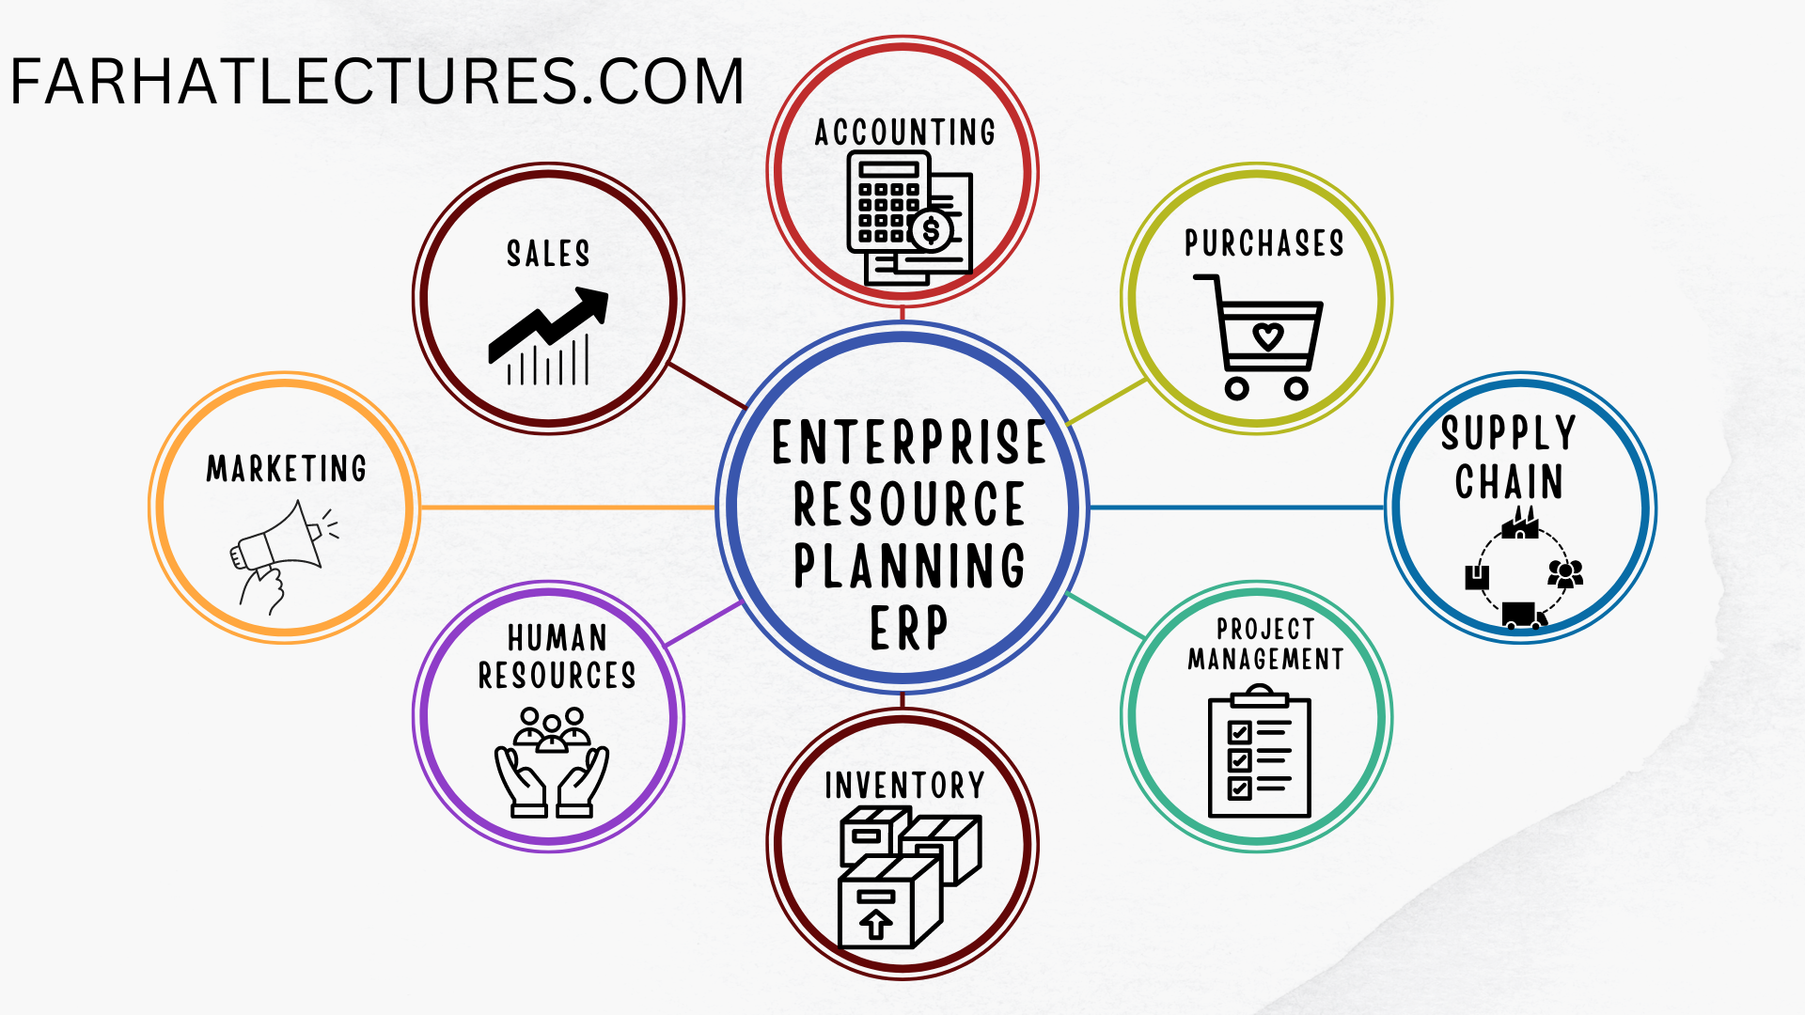
Enterprise Resource Planning (ERP)
It is a type of software that organizations use to manage and automate various business processes, such as:
For more, visit:
www.farhatlectures.com

Slide 2
2 Types of ERP Architecture
An ERP (Enterprise Resource Planning) system architecture refers to the overall design and structure of an ERP software system, including the hardware, software, and network components that make up the system.
Client-Server
Service Oriented
For more, visit:
www.farhatlectures.com

Slide 3
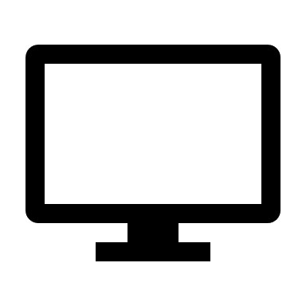

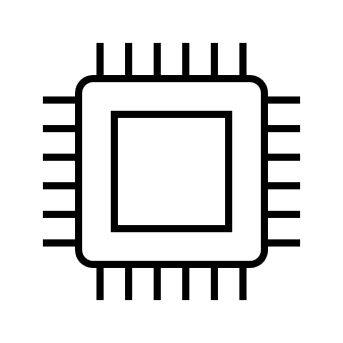
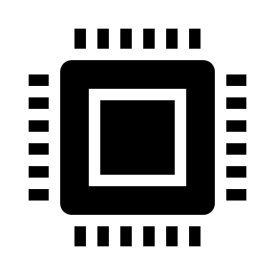
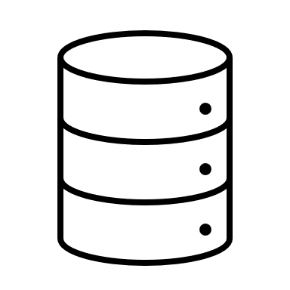
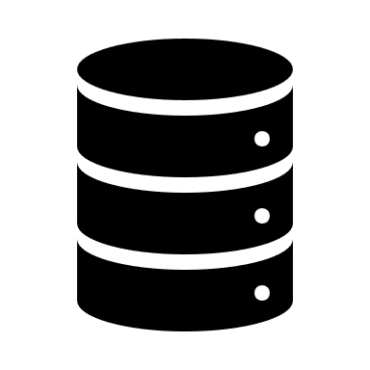
Client Server Part 1
The architecture of an ERP system typically includes several layers, such as
  The user interface
  Business logic, and
  Data storage layers.
For more, visit:
www.farhatlectures.com

Slide 4
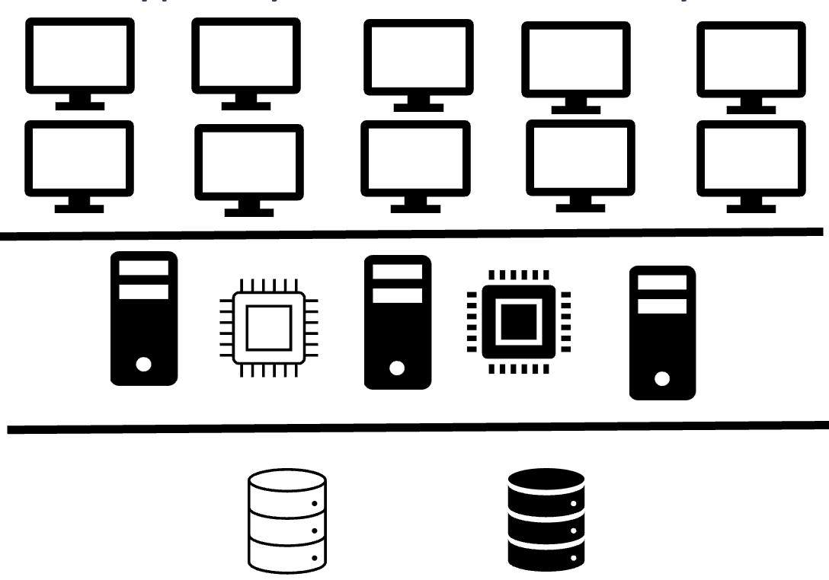
Client Server Part 2
The user interface layer provides the means for users to interact with the system
  Customer input the sales order on the website (application server)
  GUI Graphical User Interface
The business logic layer contains the rules and processes that govern the system's operations
  Create a sale order
  Send it to warehouse for shipping
  Send it to packaging
  Ship
  Bill
  Receive payment
The data storage layer is responsible for storing and managing the system's data.
We can scale the business using these layers
We can also use a cloud for the application and data base
For more, visit:
www.farhatlectures.com

Slide 5
Service-Oriented (web services)
Service-oriented architecture (SOA) is a design approach that organizes an ERP system into a collection of independent, modular services that can be easily combined to create new functionality.
  This approach allows for greater flexibility and scalability in the system, as well as easier maintenance and updates.
Different services are responsible for specific functions, such as data storage, business logic, and user interface.
  For example, a service responsible for managing inventory could be integrated with a service responsible for managing customer orders to create a new service that manages inventory and customer orders together.
Additionally, SOA also allows for better integration with other systems and technologies, such as cloud services, mobile devices, and Internet Over Things (IoT).
  By breaking the system down into a collection of services, it can be more easily integrated with other systems and technologies, which can improve the overall functionality and performance of the system.
For more, visit:
www.farhatlectures.com

