Slide 1
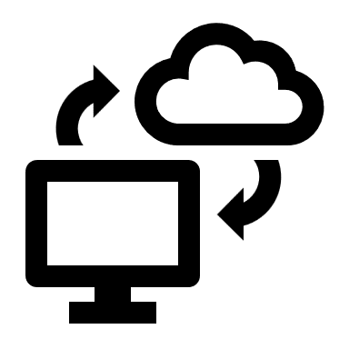
Cloud-Based System
Type of computing in which resources, such as software, storage, and processing power, are provided over the internet through a network of remote servers.
Could be called: the cloud, cloud computing, cloud storage, and cloud services
This allows users to access and use these resources without having to have them installed on their own devices. Cloud-based systems are often used for:
  Software as a service (SaaS),
  Platform as a service (PaaS) applications
  Infrastructure as a service (IaaS)
For more, visit:
www.farhatlectures.com

Slide 2
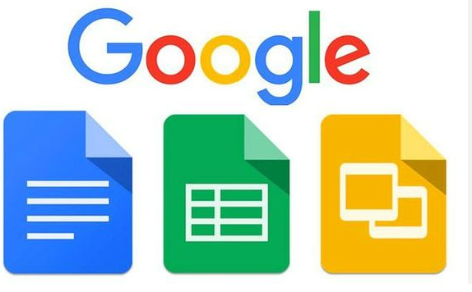
Software as a Service (SaaS)
This type of cloud-based system provides access to software applications over the internet. Examples of SaaS include email, customer relationship management (CRM), and human resources (HR) software.
Usually subscription based
Not having to install them on a user's device.
No need not buy (investment is expensive) software. Renting.
Access to updates and latest technology. Good for start-up or well established businesses. No matter the size.
Examples:
  Productivity software such as Google Workspace and Microsoft 365
  Customer Relationship Management (CRM) software such as Salesforce and Hubspot
  Human Resources (HR) software such as Zenefits and ADP
  Project management software such as Asana and Trello
  Email marketing software such as Mailchimp and Constant Contact
  Accounting software such as QuickBooks and Xero
For more, visit:
www.farhatlectures.com

Slide 3
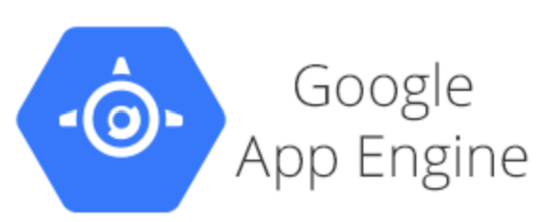
Platform as a service (PaaS) applications
This type of cloud-based system provides a platform for developers to build, test, and deploy their own applications. PaaS solutions typically include development tools, databases, and other resources that are needed to create and run applications.
A PaaS offering usually comprises of a set of tools and frameworks that developers can utilize to create and run their applications. The PaaS provider takes care of the underlying infrastructure, such as servers, storage, and networking, allowing developers to focus on creating the application.
Examples of PaaS include:
  Heroku
  AWS Elastic Beanstalk
  Google App Engine
  Azure App Service
Allows for faster development and deployment of applications, as developers can focus on writing code rather than dealing with infrastructure and deployment tasks.
Many PaaS providers also offer scalability and high-availability features, meaning that the platform can automatically scale up or down depending on the load, and it can ensure that the application is always available.
Cost effective
For more, visit:
www.farhatlectures.com

Slide 4
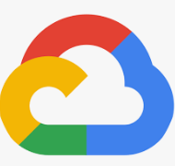

Infrastructure as a Service (IaaS)
This type of cloud-based system provides access to infrastructure resources, such as virtualized computing resources, storage, and networking over the internet.
IaaS is essentially a virtualized version of traditional on-premise infrastructure, but it is owned, operated and maintained by a third-party provider. The provider is responsible for the underlying hardware, while the customer is responsible for the operating system, middleware, and applications that run on top of it.
Examples of IaaS include:
  Amazon Web Services (AWS)
  Microsoft Azure
  Google Cloud Platform (GCP)
  DigitalOcean
For more, visit:
www.farhatlectures.com

Slide 5
More about IaaS
IaaS can provide organizations with the flexibility to scale their infrastructure up or down as needed, depending on the number of users or the amount of data being processed.
  This can make IaaS more cost-effective than traditional on-premise solutions, as organizations only pay for the resources they use.
IaaS providers often offer a wide range of options and configurations, including different types of virtual machines, storage options, and networking capabilities.
  This allows organizations to tailor their infrastructure to their specific needs and requirements. IaaS providers also offer various management and automation tools, which can help to reduce the operational overhead and improve the efficiency of IT teams.
It's important to note that IaaS does not include the software and applications that run on top of it, for that you have SaaS and PaaS, but it provides the foundational layer, like servers, storage and networking, which are needed to run those software and applications.
More about The cloud
For more, visit:
www.farhatlectures.com

