Slide 1
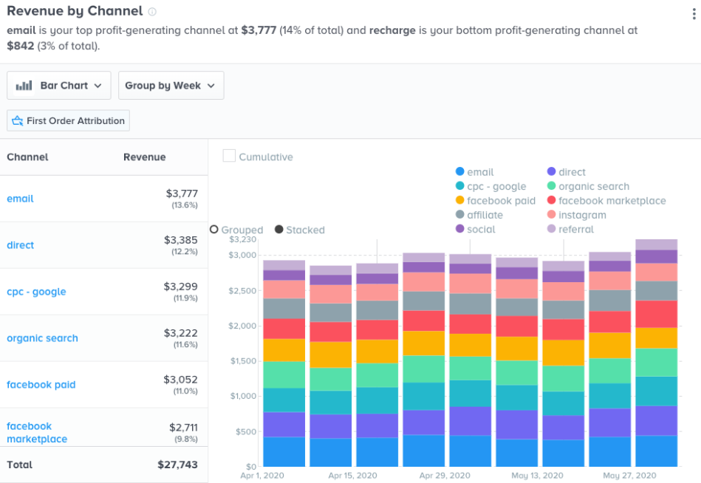
Big Data
Big data is a term that describes any voluminous amount of data can be mined for potential information.
Structured data (Traditionally)
  highly organized into predefined groupings (columns and rows)
    relational databases or well formatted excel files.
    The data can easily be sorted and searched by computer programs.
      Quarterly sales data by product
Unstructured data
  Little or no predefined organizational structure.
  Lack of organization which makes such data more difficult for computer programs to search, sort, and analyze.
    For example, social medial, audios, videos, and images are data types that are difficult for computer programs to analyze.
Semi-structured data (hybrid)
  highly organized as structured data but still have some identifying information that can be used for organization by computer programs.
  Example: Comma-delimited files, CSV, files data can be converted and stored in relational databases for analysis.
  XML and XBRL
  The information collected is converted from low-density data into high-density data (data that has value).
Student or CPA Candidate?
www.farhatlectures.com

Slide 2
Business Intelligence (BI)
Data are processed with analytic and algorithmic tools to reveal meaningful information.
  Data visualization (using Tableau or Power BI) and presented for business decision making
  Look for pattern, trend, business insights
Student or CPA Candidate?
www.farhatlectures.com

Slide 3
The 4 Vs of Big Data
Volume
Variety
Velocity
Veracity
Student or CPA Candidate?
www.farhatlectures.com

Slide 4
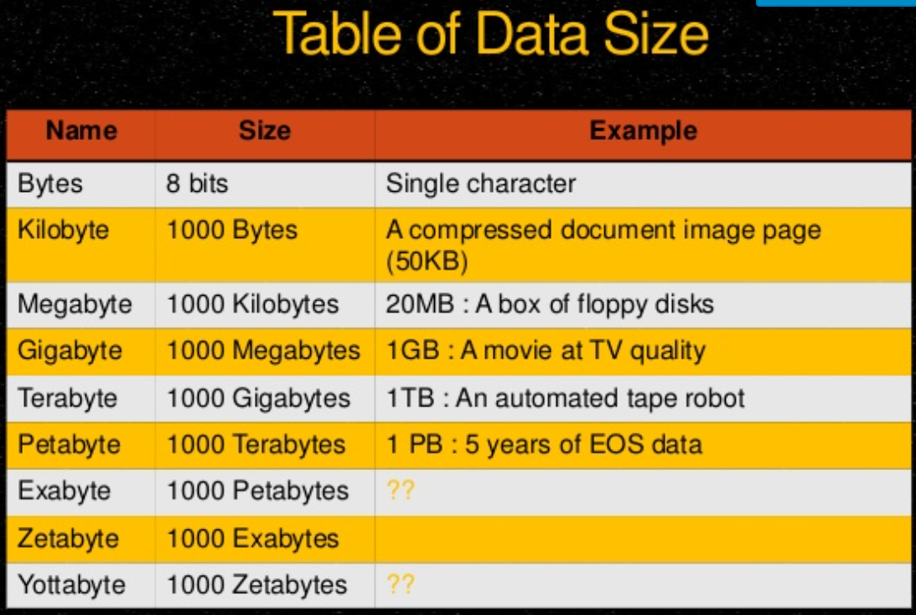
Volume
Extreme Amount of data captured over time and in real time.
  Stores on farm servers
Internet of Thing (IoT) top source of that volume
  Wearable devices
    Human and animal
  Digital machines
  E-Commerce transactions
    Buying/selling
  The more data we have the better
  Decision we can make in
  acquiring and retaining clients
A Million Gigabytes 3.5 of NFLX videos
A Billion Gigabytes
A Trillion Gigabytes (web Traffic 3 x 2020)

Slide 5
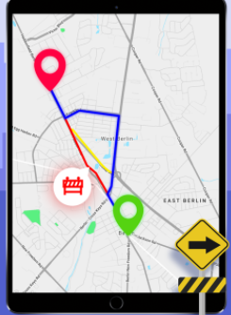
Velocity (speed)
How fast are we collecting and processing data.
  GPS and advertising services (instantaneously)
    Autonomous car
Requires multiple servers with strong computing power.
Cloud computing could an answer for some business
The faster the busines process the data the sooner we can offer customized product for the customers
Student or CPA Candidate?
www.farhatlectures.com

Slide 6
Variety and Veracity
Wide Variety of file types
Structured
  Maintained by Structure Query Language (SQL)
Unstructured (facilitated by advancement in technology)
  Sensors, wearable devices, text, audio, images, video, easy pass, travel log,
  Satellite images to study business traffic (investment or advertainments)
  Purchase data from third parties
Veracity:
  Can I rely on this data?
  Is it trustworthy
  Is their any discrepancy?
Student or CPA Candidate?
www.farhatlectures.com

Slide 7
Big Data
Benefits
Challenges
Increases efficiency (traffic)
Help create customized experience for clients
Monitor your product throughout the supply chain
Privacy (Hippa)
Subject to theft on large scale
Encryption and protecting (cost)
Student or CPA Candidate?
www.farhatlectures.com

