Slide 1
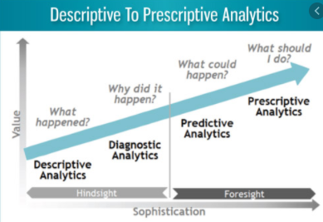
4 Types of Data Analytics
1) Descriptive analytics.
  What is happened in the past or what is happening now (past)
2) Diagnostics Analytics
  Why did it happen (present)
3) Predictive Analytics
  What is likely to happen (future)
4) Prescriptive Analytics
  What should we do (future)
Student or CPA Candidate?
www.farhatlectures.com

Slide 2
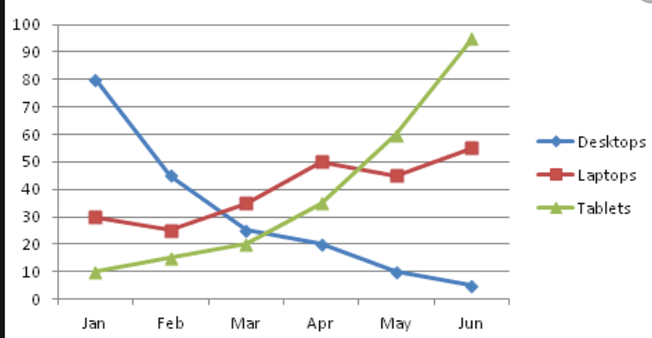
Descriptive analytics
Most basic and most used method.
It concentrates on reporting actual results
  Change in profit margin from prior month
  Mean, mode average of data
  Monthly sales report
Concerned with understanding what is happening by examining past data.
Student or CPA Candidate?
www.farhatlectures.com

Slide 3
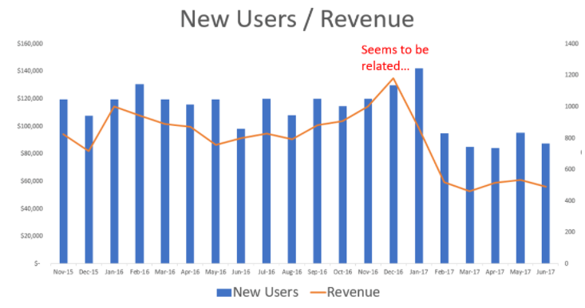
Diagnostics Analytics
Why did it happen?
Detect correlations and pattern of interest
  used to understand why something happened.
  provides insight into the reason certain results occur
  Why did the profit margin changed
  Explain the reason for change in revenue
Student or CPA Candidate?
www.farhatlectures.com

Slide 4
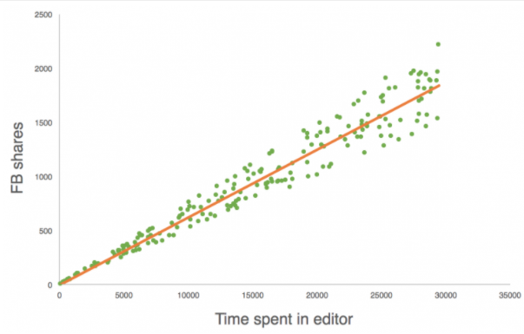
Predictive Analytics
What is likely to happen?
Descriptive + Diagnostics
Predictive analytics (also called data mining) attempts to determine what is likely to occur.
Identifies common attributes or patterns that may be used to identify similar activity
Predict COGS
Predict Raw material need
Relies on advanced statistical methods, such as regression, cluster analysis, and pattern matching.
Involves applying assumptions to data and predicting future results

Slide 5
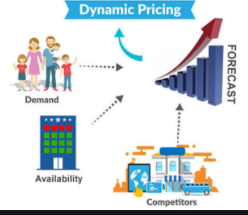
Prescriptive Analytics
How should we act?
Based on diagnostics
Recommends actions on previously observed actions
concentrates on what an organization needs to do in order for the predicted future results to actually occur
Prescriptive analytics applies
  advanced statistical methods
  machine learning and
  neural network analyses
  Artificial Intelligence
For example, hotels set room prices using complex prescriptive models that consider hundreds of variables including days, weekend, holidays, competition, amenities, customer rating, taxes, activities in the area, number of site visitation, number of click to check prices etc.
Used by top executive or advanced analysts.
Student or CPA Candidate?
www.farhatlectures.com

