Slide 1
Three Basic Manufacturing Cost Categories.
Cost Object: anything for which a separate measurement of costs is desired.
  product lines, geographic territories, customers
1) Direct Material (DM):
  Direct materials are raw materials that become an integral part of the product and that can be conveniently traced directly to it.
  Example: Dough (purchased not made!), Sauce, Cheese
  Direct Cost
2) Direct Labor (DL):
  Touch Labor. Can be easily traced to individual units of product.
  Example: Cook/Chef
  Direct Cost
3) Manufacturing Overhead (MOH):
  All others (than DL and DM) manufacturing costs cannot be readily traced to finished products
    Indirect Labor
    Indirect Material: Salt and Mint
    Depreciation of manufacturing equipment
    Utility costs
    Property taxes
    Insurance premiums incurred to operate a manufacturing facility
Indirect Cost
Terminology
  DM + DL are Prime Cost
  DL + MOH = Conversation Cost
Student or CPA Candidate?
www.farhatlectures.com

Slide 2




Slide 3
Nonmanufacturing Cost
Selling Cost:
  Costs necessary to secure the order and deliver the product. Selling costs can be either direct or indirect costs.
Administrative Cost
  All executive, organizational, and clerical costs. Administrative costs can be either direct or indirect costs.
Student or CPA Candidate?
www.farhatlectures.com

Slide 4
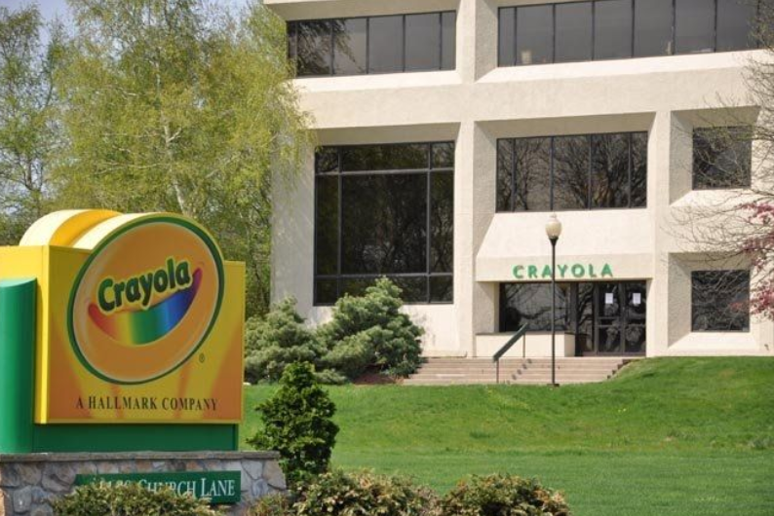
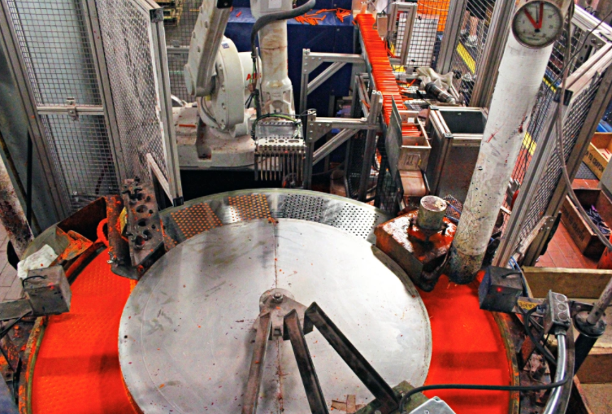

Slide 5
Which of the following is NOT true for direct and indirect cost?
Whether a particular cost is classified as direct or indirect does not depend on the cost object.
Depending on the cost object a particular cost can be direct or indirect.
The salary of a factory of factory manager would be classified under an indirect cost of producing one unit of product.
Direct cost can be easily traced to the particular cost object
Student or CPA Candidate?
www.farhatlectures.com

