Slide 1
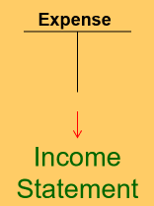
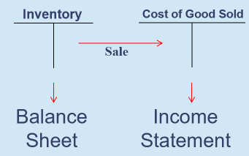
Product Costs
Product Costs
Period Costs
Costs that are involved in acquiring or making a product.
Inventoriable cost
  Asset
“Attach” to a unit of product as long as it remains in inventory awaiting sale.
  Convert to Cost of Good Sold when sold
Selling costs and administrative costs.
Expense as incurred.
No future benefits or cannot be associated with a particular future benefit
Student or CPA Candidate?
www.farhatlectures.com

Slide 2
For manufacturing companies, product costs include three categories
Raw materials:
includes any materials that go into the final product.
  When direct materials are used in production, their costs are transferred from Raw Materials to Work in Process
  Direct labor and manufacturing overhead costs are added to Work in Process to convert direct materials into finished goods.
Work in process:
Units of product that are only partially complete and will require further work before they are ready for sale to the customer.
  Once completed, their costs are transferred from Work in Process to Finished Goods.
Finished goods costs:
Completed units of product that have not yet been sold to customers (waiting in the store or warehouse).
  When a manufacturer sells its finished goods to customers, the costs are transferred from Finished Goods to Cost of Goods Sold.
Student or CPA Candidate?
www.farhatlectures.com

Slide 3
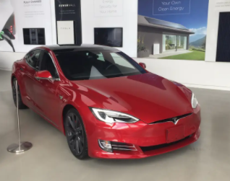
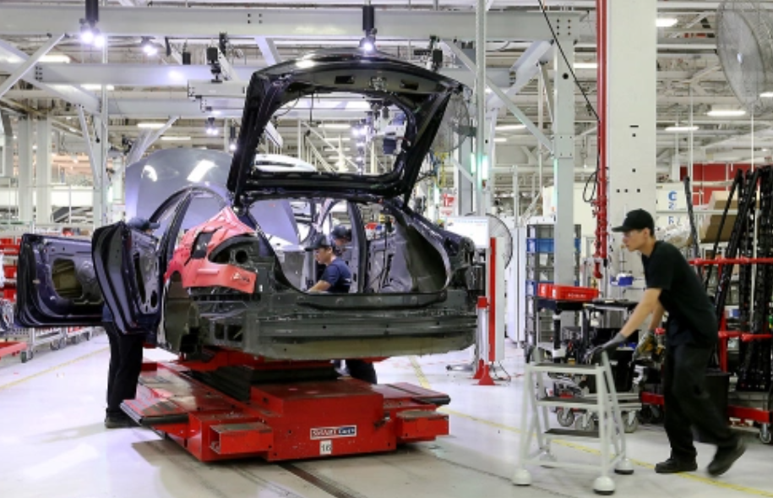
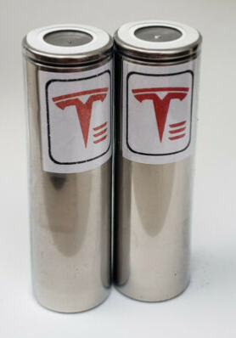
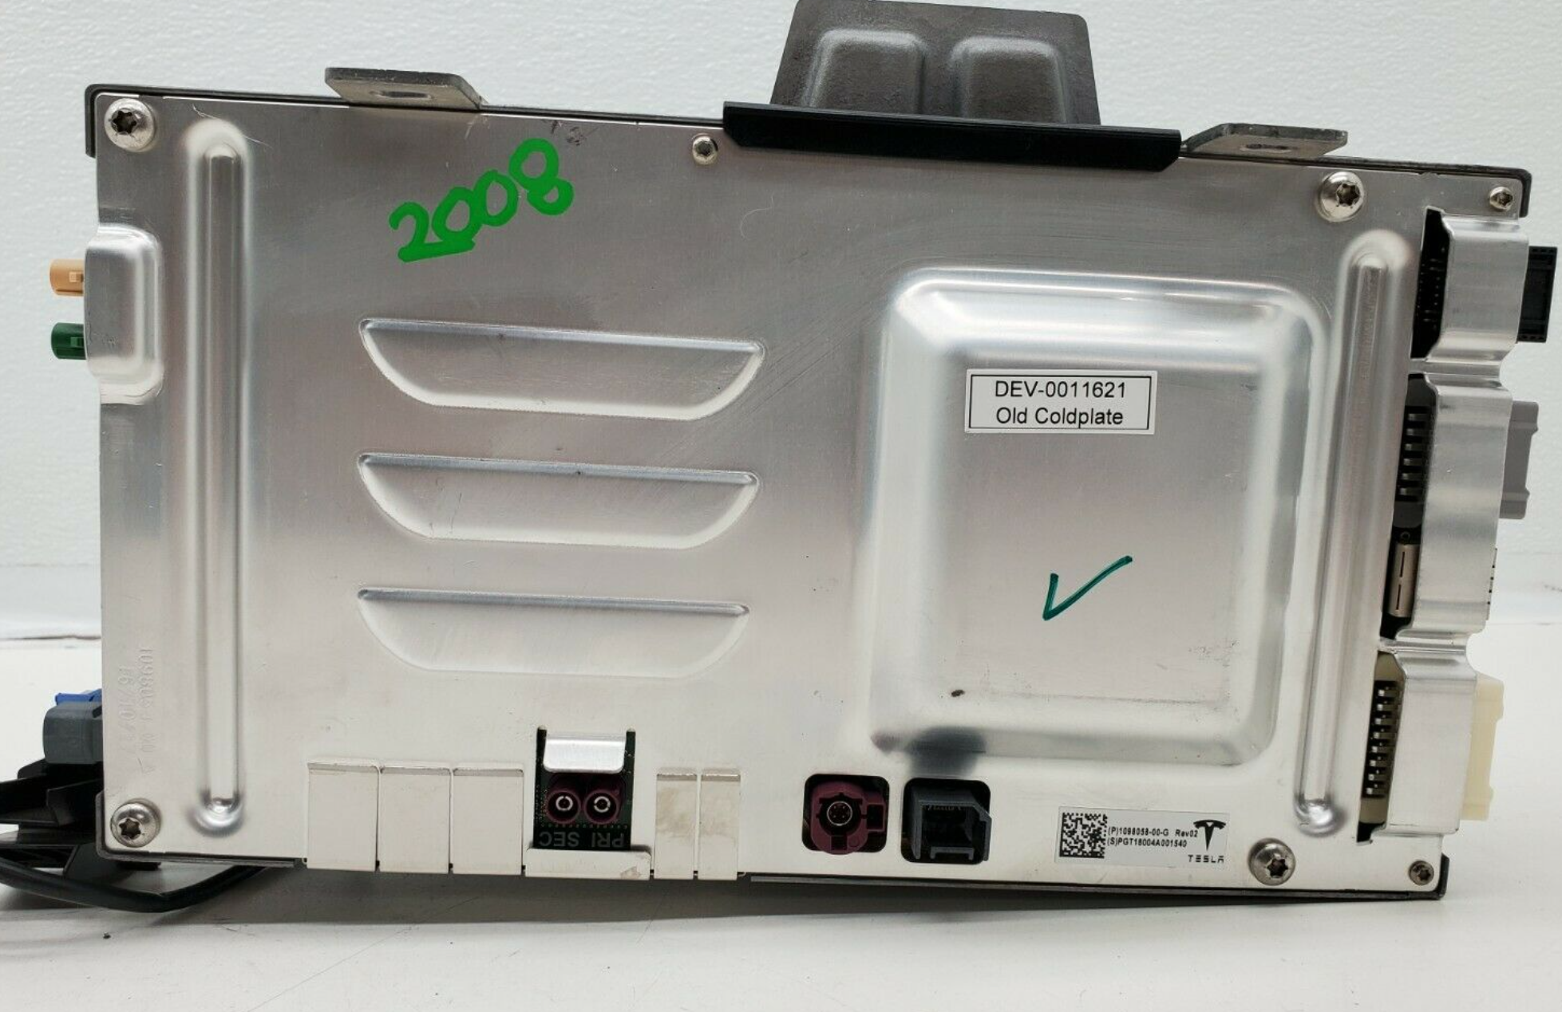
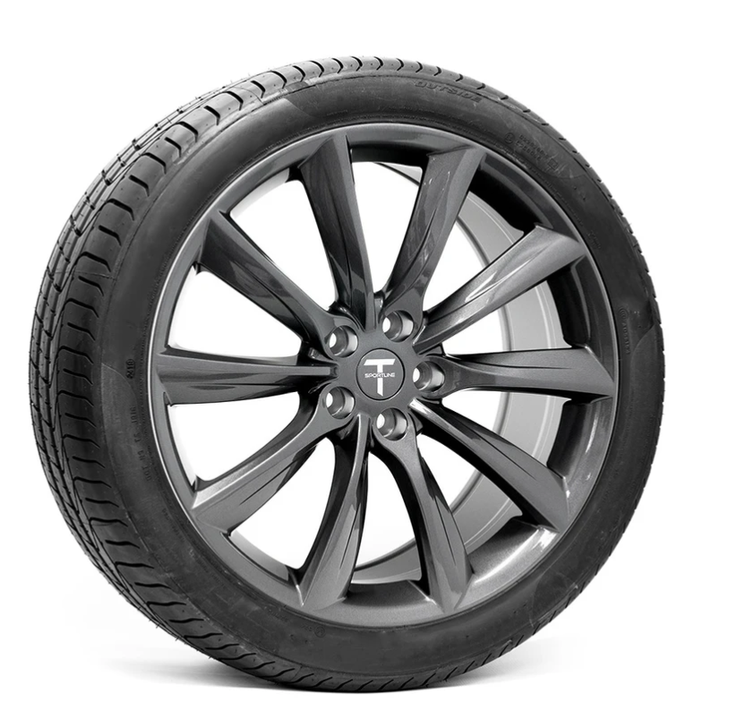

Slide 4
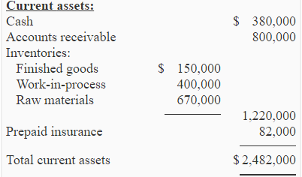
Student or CPA Candidate?
www.farhatlectures.com

Slide 5
Each of the following would be a period cost except
A) Depreciation of factory maintenance equipment.
B) the salary of the company president's secretary
C) the cost of a general accounting office.
D) Insurance on a company showroom where customers can view new products.
Student or CPA Candidate?
www.farhatlectures.com

