Slide 1
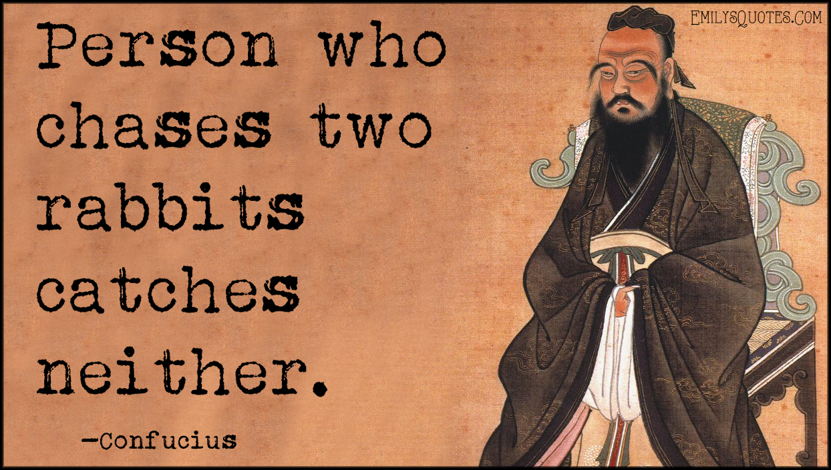
Michael Porter:
Two Competitive Strategies
1-1

Slide 2
Michael Porter:
Two Competitive Strategies
Cost Leadership:
outperform competitors by producing at the lowest cost, consistent with quality demanded by the consumer.
Does not mean low quality.
Save every penny. Amazon. Security Checks!
South West Airlines (hedge fuel) Happy employees, 737 (standardization, low maintenance cost)
Differentiation:
creating value for the customer through product innovation, product features, customer service, etc. Perception!
The customer is willing to pay more for these added values. Iphone Vs Flip Phone
For more lectures Visit:
www.farhatlectures.com
1-2

