Slide 1
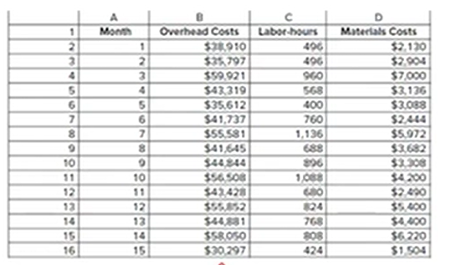
Mixed cost: FC and VC
Assume:
Linear relationship
Straight line
Find the slop=VC
Rise/run
Y2-Y1/X2-X1
Change in cost/change in activity

Slide 2
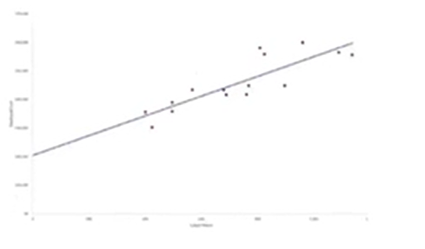
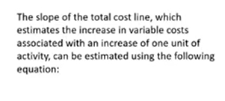
Fixed cost= Total cost at highest activity level – (Variable cost × Highest activity level)
Or
Fixed cost= Total cost at lowest activity level – (Variable cost × lowest activity level)

Slide 3
