Slide 1
How to report Investment?
Initially, all investment are recorded at cost.
What about subsequent changes?
  Fair Value
  Cost Method
  Equity ( part 2 of 2)
  Consolidation
It depends on the degree of the control
Student or CPA Candidate?
www.farhatlectures.com

Slide 2
Part 2
Reporting a change to the equity method.
Reporting investee income from sources other than continuing operations.
Reporting investee losses.
Reporting the sale of an equity investment.
Student or CPA Candidate?
www.farhatlectures.com

Slide 3
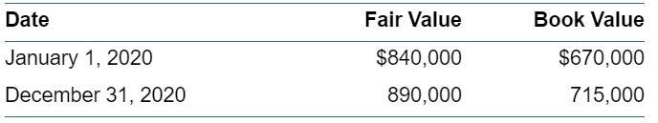
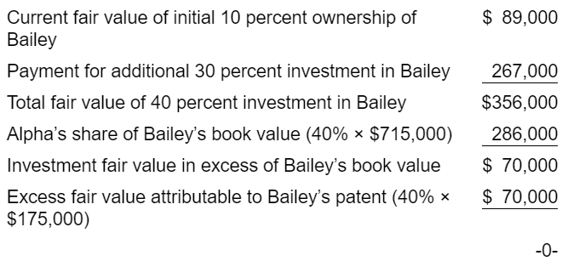
Reporting a change to the equity method
Less than 20% (at first) to 20-50%
FASB requires a prospective approach
  Requiring that the cost of any new share acquired simply be added to the current investment carrying amount.
January 1, 2020, Alpha Company exchanges $84,000 for a 10 percent ownership in Bailey Company. NO significant influence
  the fair-value method
January 1, 2021, Alpha purchases an additional 30 percent of Bailey’s outstanding voting stock for $267,000.
Significant influence
On January 1, 2021, Bailey’s carrying amounts for its assets and liabilities equaled their fair values except for a patent, which was undervalued by $175,000 and had a 10-year remaining useful life.
Student or CPA Candidate?
www.farhatlectures.com

Slide 4


Let’s assume that Bailey reports net income of $130,000 and declares and pays a $50,000 dividend at the end of 2021.
Student or CPA Candidate?
www.farhatlectures.com

Slide 5
Reporting Investee’s Other Comprehensive Income (OCI) and Irregular Items
OCI is earnings that bypass net income such as:
  Accumulated derivative net gains and losses
  Foreign currency translation adjustments
  Certain pension adjustments.
Equity method accounting requires that the investor record its share of investee OCI, which then is included in its balance sheet as Accumulated Other Comprehensive Income (AOCI)
Student or CPA Candidate?
www.farhatlectures.com

Slide 6
Big company purchased 30 percent investment in the voting stock of Small Company. Significant Influence
No excess amortization resulted from this investment.
In 2020, Small reports net income of $500,000.
Small also reports $80,000 in OCI from pension and other postretirement adjustments gain.
Investment in Small Company 150,000
Equity in Investee Income 150,000
Investment in Small Company 24,000
Other Comprehensive Income of Investee 24,000
Discounted Operation:
Reported as part of regular income
Student or CPA Candidate?
www.farhatlectures.com

Slide 7
Impairments of Equity Method Investments
Investments can suffer permanent losses in fair value that are not evident through equity method accounting.
Reasons for Impairment:
  loss of major customers
  changes in economic conditions
  loss of a significant patent or other legal right
  damage to the company’s reputation
“A loss in value of an investment which is other than a temporary decline shall be recognized.
Evidence of a loss in value might include, but would not necessarily be limited to, absence of an ability to recover the carrying amount of the investment or inability of the investee to sustain an earnings capacity that would justify the carrying amount of the investment.”
Student or CPA Candidate?
www.farhatlectures.com

Slide 8
Investment Reduced to Zero
T Account
Student or CPA Candidate?
www.farhatlectures.com

Slide 9
Sale of an Equity Investment
The investor can choose to sell part or all of its holdings in the investee company.
If a sale occurs, the equity method continues to be applied until the transaction date, thus establishing an appropriate carrying amount for the investment.
The investor then reduces this balance by the percentage of shares sold.
Student or CPA Candidate?
www.farhatlectures.com

Slide 10



Assume that Top Company owns 40 percent of the 100,000 outstanding shares of Bottom Company, an investment accounted for by the equity method.
Any excess investment cost over Top’s share of Bottom’s book value is considered goodwill.
The asset balance to $320,000 as of January 1, 2021.
Bottom Company reports net income of $70,000 during the first six months of 2021 and declares and pays cash dividends of $30,000.
Balance of $336,000 as of July 1, 2021.
Student or CPA Candidate?
www.farhatlectures.com

Slide 11
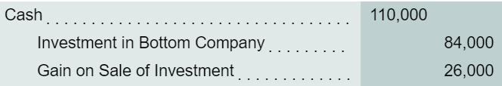
On July 1, 2021, Top elects to sell 10,000 of these shares (one-fourth of its investment) for $110,000 in cash.
Reducing ownership in Bottom from 40 percent to 30 percent.
After the sale is completed, Top continues to apply the equity method to this investment based on 30 percent ownership rather than 40 percent.
If the sale reduced the ownership to 15% then fair value method would be used.
Remaining book value becomes the new cost figure.
No Retrospective adjustment is made.
Change to the equity method is also treated prospectively.
Student or CPA Candidate?
www.farhatlectures.com

