Slide 1
How to report Investment?
Initially, all investment are recorded at cost.
What about subsequent changes?
  Fair Value
  Cost Method
  Equity (Part 1 of 2)
  Consolidation
It depends on the degree of the control
Student or CPA Candidate?
www.farhatlectures.com

Slide 2
Equity Method
20 to 50%:
“Ability to exercise significant influence over reporting and financial policies of an investee even though the investor holds 50% or less of the common stock “
Here's a list of several conditions that indicate the presence of influence :
  Board of directors is elected by the investor
  Investor participate in strategic and policy making of the investee
  Significance (material) intra entity transactions
  Exchange of managerial personnel/management
  Technology interdependence or dependents
  The proportional amount of the investor share in relationship to other investments
These conditions are all evaluated together
20 to 50% is just guideline.
  Ability to have significant influence is what matters
Student or CPA Candidate?
www.farhatlectures.com

Slide 3
Other issues/Limitations
An agreement exists between investor an investor by which the investor surrenders significant rights as a shareholder ➔ ignore 20 to 50%
Concentration of ownership operates the investee without regard for the views of the investors ➔ ignore 20 to 50%
The investor attempts but fails to obtain representation on the investees board of directors ➔ no significant influence
Consolidation is required if can if control over the investee exist regardless of the percentage ➔ regardless of 20 to 50%
Control can be achieved through contractual another arrangement called variable interests
  for example the company may create a separate legal entity in which it holds less than 50% of the voting interests but controls that entity through governance document provisions or
  other contracts that specify decision making power in the distribution of profit and losses entities controlled ➔ variable interest entities
  Sponsoring firm may be required to include them in the consolidated financial report despite the fact that ownership is less than 50% .
Investors can always choose to use the fair value option reporting for significant influence investments
Also, In some cases the majority shareholder may not have control over the company because the minority shareholders restrict the power of the majority
  that restriction could manifest itself in compensation hiring termination and other critical operating and capital spending decision
  ATT (60%) & Bell South (40%) owned Cingular . ATT used the equity method
Student or CPA Candidate?
www.farhatlectures.com

Slide 4
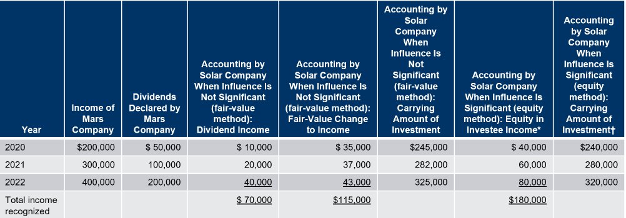
Solar Company owns a 20 percent interest in Mars Company purchased on January 1, 2020, for $210,000.
Mars reports net income of $200,000, $300,000, and $400,000, respectively, in the next three years while declaring dividends of $50,000, $100,000, and $200,000.
The fair values of Solar’s investment in Mars, as determined by market prices, were $245,000, $282,000, and $325,000 at the end of 2020, 2021, and 2022, respectively.
Student or CPA Candidate?
www.farhatlectures.com

Slide 5
Investment in Mars Company | 40,000
Equity in Investee Income |  | 40,000
To accrue earnings of a 20 percent owned investee ($200,000 ×20%)
Dividend Receivable | 10,000
Investment in Mars Company |  | 10,000
To record a dividend declaration by Mars Company ($50,000 × 20%)
Cash | 10,000
Dividend Receivable |  | 10,000
To record collection of the cash dividend.

Slide 6
Excess of Investment Cost Over Book Value Acquired
Paying for investment = Book Value is rare.
Book value assets – Liability
Difference is for many reasons:
  Profitability
  New Product
  Expected Dividend payment
  Projections
  Perceive worth of the company (not book value)
Asset and liability accounts on the balance sheet tend to measure historical costs rather than current value.
  Inventory costing methods (L I F O and F I F O).
  Acceptable depreciation methods (straight-line, units of production).
Allocate the cost of an equity method investment and compute amortization expense to match revenues recognized from the investment to the excess of investor cost over investee book value. Any extra goodwill
Student or CPA Candidate?
www.farhatlectures.com

Slide 7
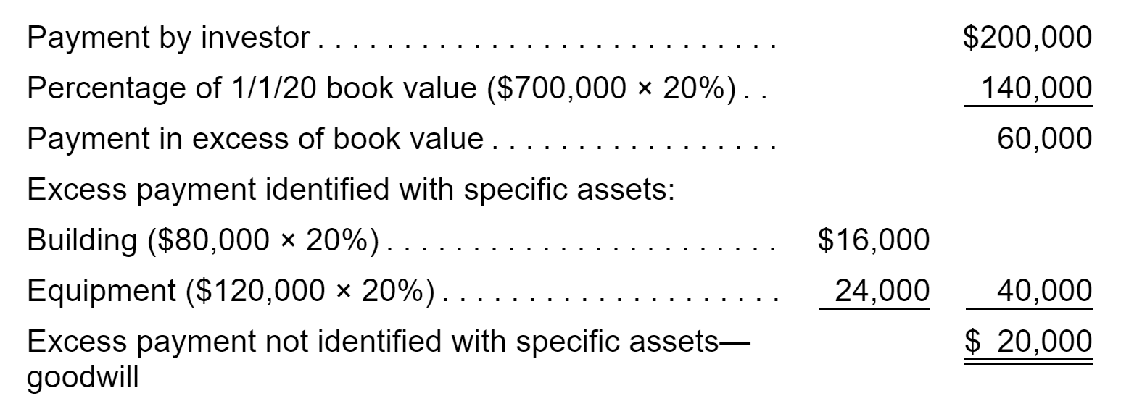
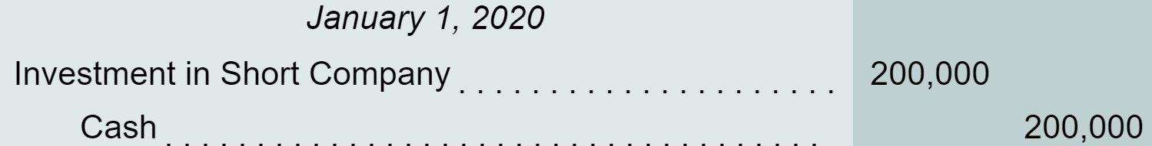
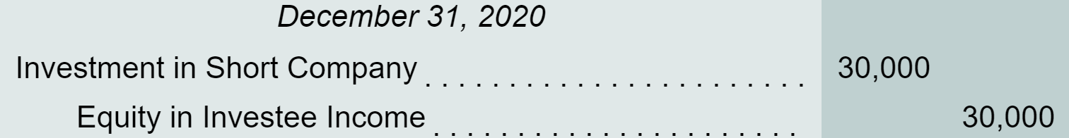
Tall Company purchases 20 percent of Short Company for $200,000. Tall can exercise significant influence over the investee; thus, the equity method is appropriately applied.
The acquisition is made on January 1, 2020, when Short holds net assets with a book value of $700,000.
Tall believes that the investee’s building (10-year remaining life) is undervalued within the financial records by $80,000 and equipment with a 5-year remaining life is undervalued by $120,000.
Any goodwill established by this purchase is considered to have an indefinite life.
During 2020, Short reports a net income of $150,000 and at year-end declares a cash dividend of $60,000.

Slide 8
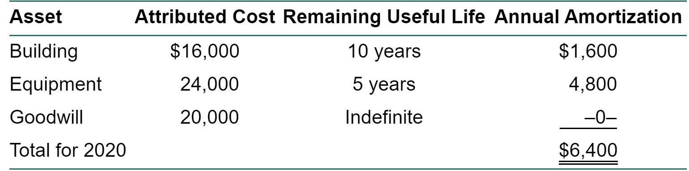
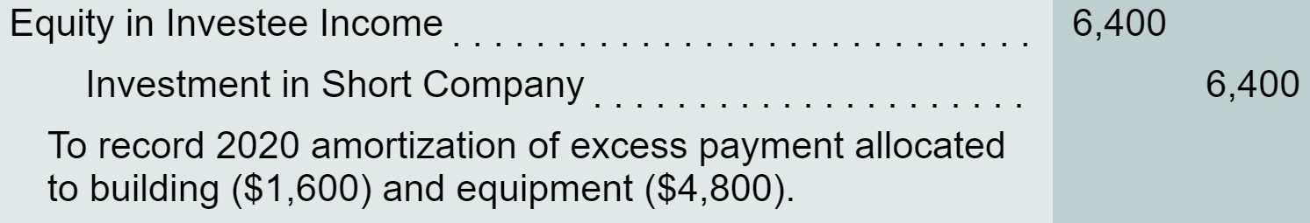
Tall believes that the investee’s building (10-year remaining life) is undervalued within the financial records by $80,000 and equipment with a 5-year remaining life is undervalued by $120,000.
Student or CPA Candidate?
www.farhatlectures.com

Slide 9
More to go. Part 2
Reporting a change to the equity method.
Reporting investee income from sources other than continuing operations.
Reporting investee losses.
Reporting the sale of an equity investment.
Student or CPA Candidate?
www.farhatlectures.com

