Slide 1

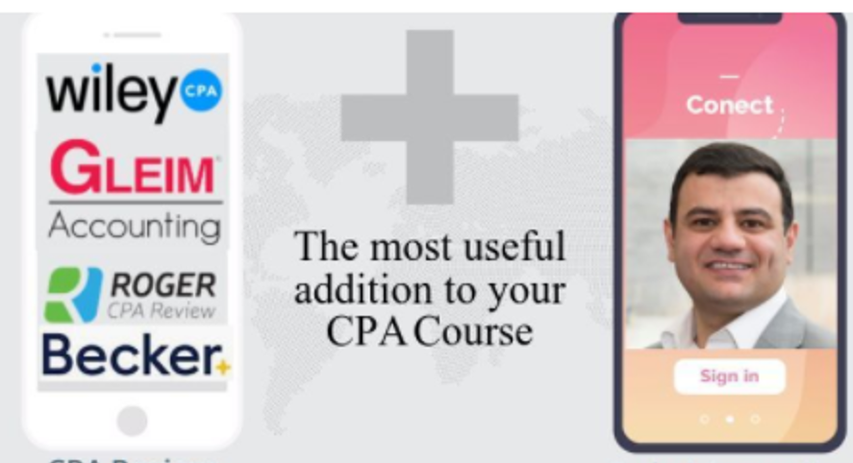


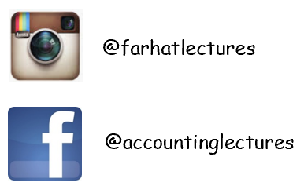

pan
Courses Covered:
  Financial Accounting
  Managerial Accounting
  Intermediate accounting
  Income Tax
  Governmental and Not For Profit
  Auditing and Attestation
  Cost Accounting
  Advanced Accounting
  CPA exam: FAR, BEC, AUD, REG
  Introduction to Finance
  International Accounting
  Plus many more
Student or CPA Candidate?
www.farhatlectures.com

Slide 2
Equity method: InterCompany Gross Profit of Inventory
Entity cannot recognize profits through activities with itself.
Sold inventory to 40% owned company
Delay 40 percent of the gross profit recognition until the inventory is sold to an independent party or is consumed.
  the investor recognizes the remaining gross profit.
Accounting for both the profit deferral and subsequent recognition takes place through adjustments to the “Equity in Investee Income” and “Investment” accounts.
Student or CPA Candidate?
www.farhatlectures.com

Slide 3
Big Company owns a 40 percent share of small Company.
In 2021, Big sells inventory to small at a price of $50,000.(downstream sale)
  This figure includes a gross profit of 30 percent, or $15,000.
By the end of 2021, small has sold $40,000 of these goods to outside parties while retaining $10,000 in inventory for sale during the subsequent year.
The investor delays gross profit recognition (for 10K).
Big’s profit associated with these remaining items is $3,000 ($10,000 × 30%).
only 40 percent of the investee’s stock is held, just$1,200 ($3,000 × 40%) of this profit is deferred.
Equity in Investee Inocme 1,200
  Investment in Small Company 1,200
Reverse when the 10,000 of inventory sold.
Student or CPA Candidate?
www.farhatlectures.com

Slide 4
Upstream sale is the same. NOT when consolidation occurs!
Big Company once again owns 40 percent of small Company.
During the current year, small sells merchandise costing $40,000 to Big for $60,000. 33% gross profit (20/60)
Big still retains $15,000 (year end) of these goods.
small reports net income of $120,000 for the year
Investment in small company 48,000
  Equity In investment Income 48,000
15,000 remaining x 33% = 5,000 Profit
5,000 x 40% =
2,000
Equity in Investee Income 2,000
  Investment in small company 2,000
48,000 – 2,000
Student or CPA Candidate?
www.farhatlectures.com

Slide 5
pan
Courses Covered:
  Financial Accounting
  Managerial Accounting
  Intermediate accounting
  Income Tax
  Governmental and Not For Profit
  Auditing and Attestation
  Cost Accounting
  Advanced Accounting
  CPA exam: FAR, BEC, AUD, REG
  Introduction to Finance
  International Accounting
  Plus many more
Student or CPA Candidate?
www.farhatlectures.com

