Slide 1
Intangible Assets (Intermediate Accounting)
What is the big idea?
  Resources that lack physical existence (cannot see or touch)
  Not a financial instrument
  Long-term asset.
Types (6)
Cost
Amortization
Cost Subsequent to acquisition
Impairments
Student or CPA Candidate?
www.farhatlectures.com

Slide 2





Type of Intangible assets (except goodwill)
Marketing-related
  Trademarks or trade names, internet domain, non-compete agreement
  Trademark and trades names legal protection for indefinite 10-year period.
Customer lists
  Customer list, production backlogs, contractual customer relationship
  Limited life
Artistic-related.
  Plays, literary works, musical works.
  Copyright granted for the life of the author plus 70 years
Contract-related.
  Franchise, broadcast right, construction permit, supply contract
  Limited or unlimited life
Technology-related.
  Patent, trade secrets
  20 years of protection. Amortize over legal or useful life whichever is shorter

Slide 3
How to Value?
Purchased Intangibles
  Cost
  Includes all costs necessary to get the intangible asset ready for its intended use
  Purchase price
  Legal fees
  Other incidental expenses
Internally Created Intangibles
  Generally expensed till you reach technological feasibility
    Only capitalize direct costs incurred in developing intangible, such as legal costs

Slide 4
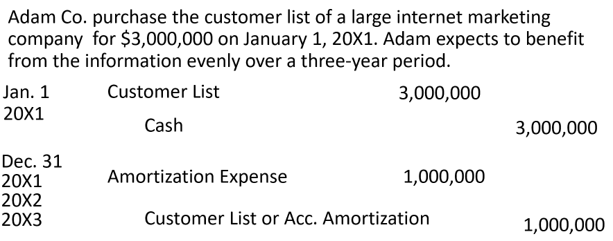
Amortization
Limited-Life Intangibles
  Amortize to expense over useful life
    periods over which the asset will contribute to cash flows
  Amortization should be cost less residual value (usually zero)
  Companies should evaluate the limited-life intangibles for impairment
Indefinite-Life Intangibles
  Useful life (cash flow) is “unknown”. No amortization
  Must test for impairment at least annually or as needed (circumstances changes)

Slide 5
Cost subsequent to Acquisition
Work MCQs and additional questions/lectures
Impairments
Legal cost to defend your patent.
  If successful ➔ capitalize
  If not succuss full ➔ expense
    Check for impairment
Adam Co. incurs $150,000 in legal costs on January 1, 20X1 to s defend a patent. Adam was successful. The patent’s useful life is 15 years, amortized on a straight-line basis
Jan. 1
Patents
150,000
Cash
150,000
Dec. 31
Amortization Expense
10,000
Patents (or Accumulated Amortization)
10,000

