Slide 1
The Balanced Scorecard (BSC)
Way to Measure the performance of a company.
Traditionally: Financial Indicators, Higher Profit, Higher Bonuses, EPS, ROI, ROA etc. Good numbers = Good managers. ESOP.
Shortcomings: Myopia (short sighted) and focus top managers.
Caused a new generation of cost accountant to find a tool to monitor (tell me) when I accomplish my strategic objective.
Traditional measures: Lag Indicators (end results).
I need Leading indicators or critical success factors:
2. Customer satisfaction
3. Internal Process
4. Learning and Growth
For more lectures, visit:
www.farhatlectures.com

Slide 2
The Balanced Scorecard (BSC)
This BSC recognize that for the company to be successful, to need to focus on four components:
  Financial perspective (financial measures). Did not change.
  Customer perspective (customers satisfaction/relationship). What customers expect from us? How does the customer sees it? Yelp!
  Internal process perspective (e.g., productivity and speed). How well are we doing things that add value to the customer
  Learning and growth (e.g., training and number of new patents or products). To be sustainable. Innovation technology and Knowledge. Invest in your employees.
  Evolve over the years as business changes.
For more lectures, visit:
www.farhatlectures.com

Slide 3
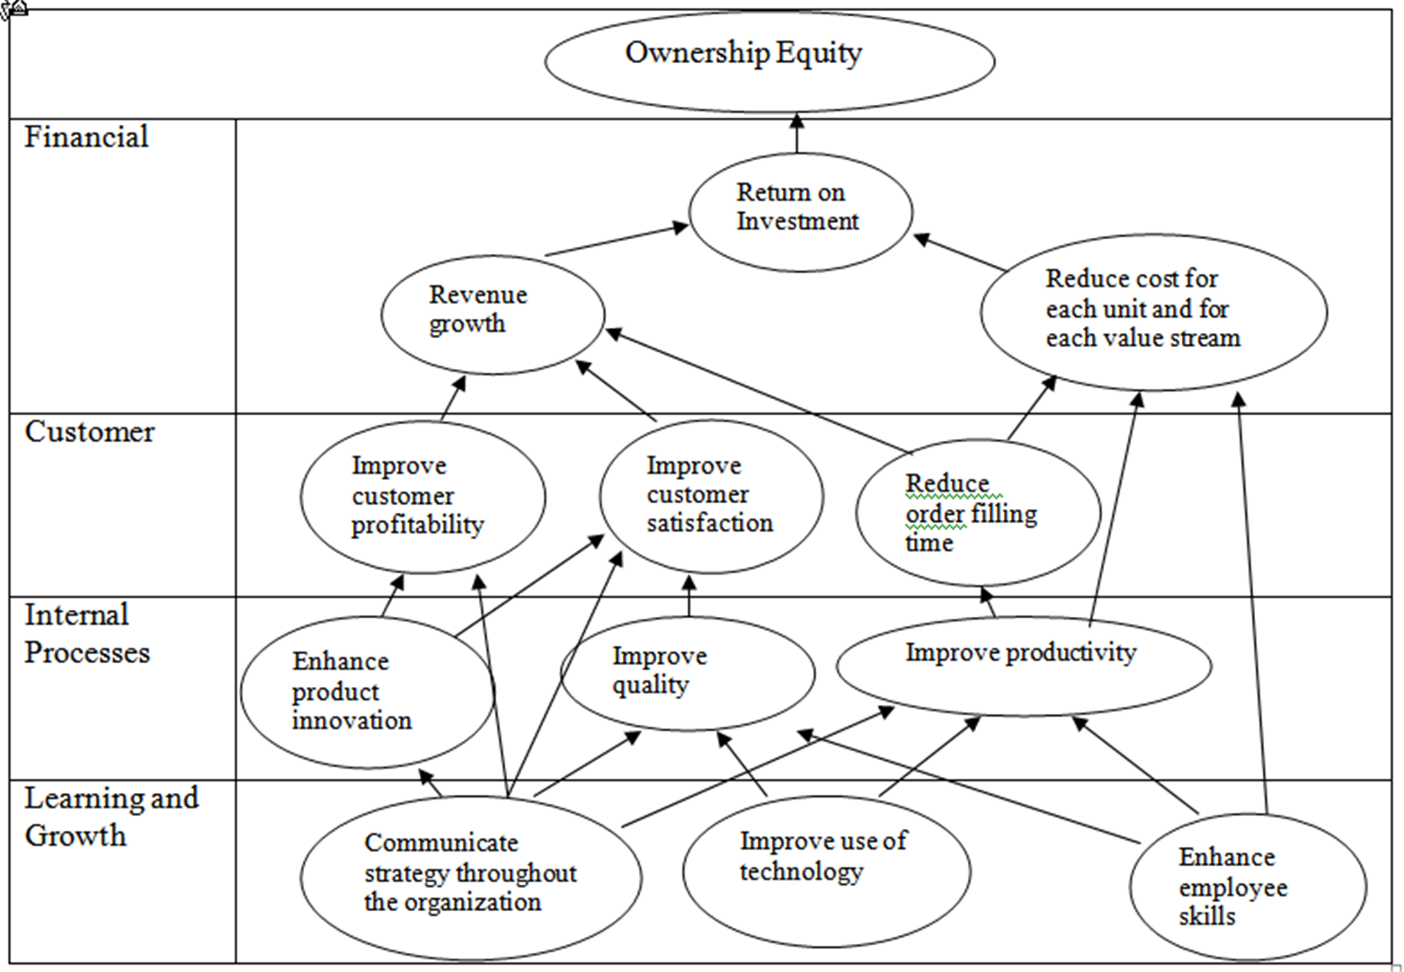
An Example Strategy Map
For more lectures, visit:
www.farhatlectures.com
2-3

Slide 4

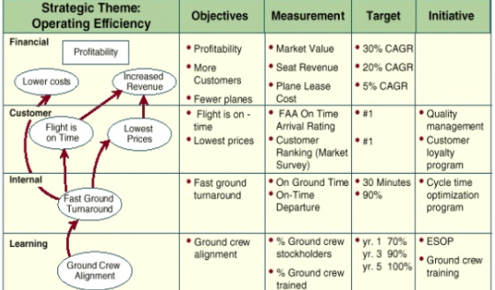
SouthWest Airline
For more lectures, visit:
www.farhatlectures.com

