Slide 1
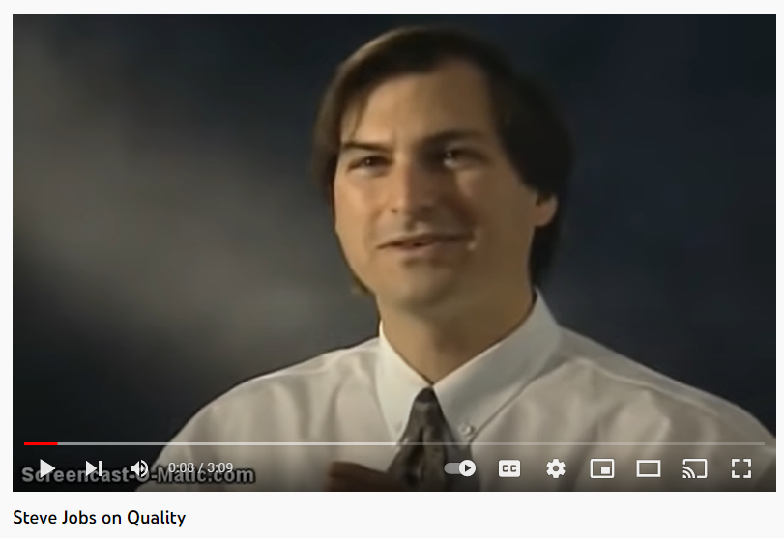
The Four Costs of Quality
I. Cost of good Quality:
  1. Prevention Cost
  2. Appraisal Cost
II. Cost of poor Quality:
  3. Internal Failure Costs
  4. External Failure Costs
https://www.youtube.com/watch?v=kib6uXQsxBA&t=36s
Student or CPA Candidate?
www.farhatlectures.com
Strong believer of Quality

Slide 2
Prevention Cost (1 of 4)
Activities of cost to reduce (eliminate) the number of defects/poor quality/nonconformance up front
Voluntary: Company chooses to carry those activities
“An ounce of Prevention is Worth a Pound of Cure” By Benajmin Franklin
  Better off preventing by spending money up front
Examples:
  Design Prevention (take your time)
    Market research
    Design input
    Prototype before production
  Vet your suppliers
    Asses their capability and reputation
  Hiring Policy (background checks)
  Training and education
  Preventive system maintenance
  Raw material inspection
Student or CPA Candidate?
www.farhatlectures.com

Slide 3
Appraisal Cost (2 of 4)
Incurred to identify defective products before the products are shipped to customers to assure, they meet our specific requirements
Make sure our product is good!
  Looking for issues/problems
  Voluntary activities
  Examples:
    Product sampling (2 of 100)
    Any quality control testing
    Testing and inspecting of incoming materials
    Final product testing
    Depreciation of testing equipment
    Calibration of equipment
    Bank reconciliation or any type of reconciliation
Student or CPA Candidate?
www.farhatlectures.com

Slide 4
Internal Failure Costs (3 of 4)
Cost incurred as a result of identifying defects before they are shipped
Customer is not aware of the issue
  Involuntary
Examples:
    Scrap (bad product)
    Spoilage (ruined before shipment)
    Rework (repainting the car)
    Re-inspection
    Expediting or rushing
      behind schedule
        paid for overtime for employees or
        premium for material needed or
        rushing an order
Student or CPA Candidate?
www.farhatlectures.com

Slide 5
External Failure Costs (4 of 4)
Cost incurred as a result of defective products being shipped to customers
Most expensive: lost reputation and goodwill
    Unhappy or angry customer asking for remediation.
    Involuntary
Examples:
  Product return/return
  Cost of field servicing and handling complaints
  Warranty repairs
  Lost sales (not on record!)
Work MCQs and other resources
Student or CPA Candidate?
www.farhatlectures.com

