Slide 1
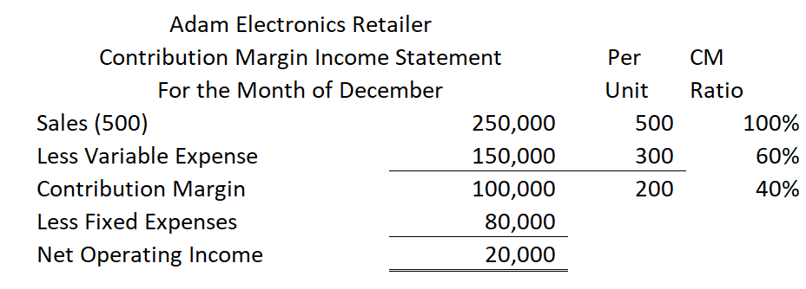
Cost-Volume-Profit (application)
Prior Session: Contribution Margin and Contribution Margin Ratio (%)
Contribution margin income statement
  (Sales – Variable Cost) – Fixed Cost = Profit
Student or CPA Candidate?
www.farhatlectures.com

Slide 2
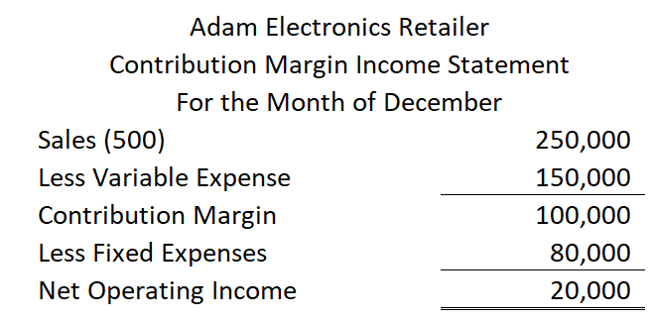
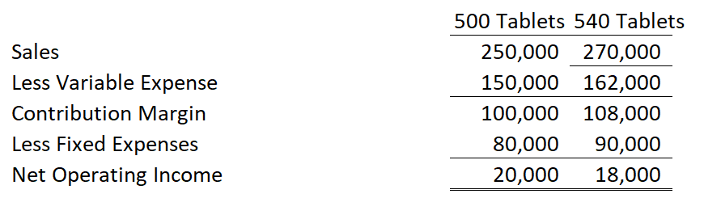
What is the profit impact if Adam can increase unit sales from 500 to 540 by increasing the monthly advertising budget by $10,000?
Increase in CM (40 Units X 200) = 8,000
Increase in fixed cost = 10,000
Overall decrease in operating income of 2,000
Student or CPA Candidate?
www.farhatlectures.com

Slide 3
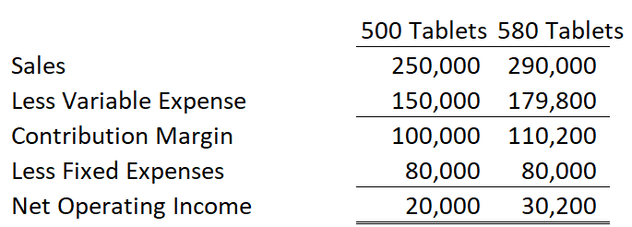
What is the profit impact if Adam can use higher quality raw materials, thus increasing variable costs per unit by $10, to generate an increase in unit sales from 500 to 580?
Increase in sales = 40,000 (80 x 500)
Increase in VC = 29,800 (310 x 80) + (500 x 10)
Net increase of 10,200
Student or CPA Candidate?
www.farhatlectures.com

Slide 4
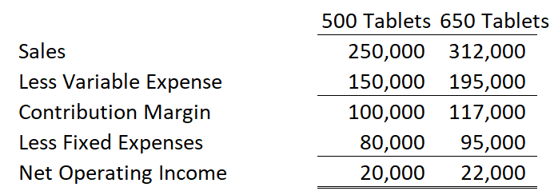
What is the profit impact if Adam:
cuts its selling price $20 per unit
increases its advertising budget by $15,000 per month, and
increases sales from 500 to 650 units per month?
650 x $480 = 312,000 increase by 62,000
650 x 300 = 195,000 increase = 45,000
Fixed cost increase by 15,000
Net increase of 2,000
Student or CPA Candidate?
www.farhatlectures.com

Slide 5
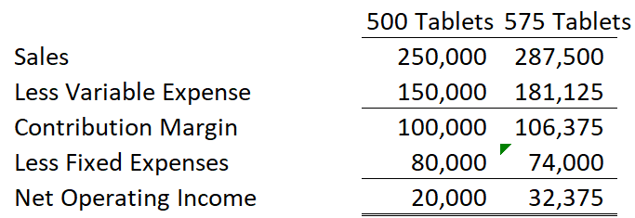
What is the profit impact if Adam:
pays a $15 sales commission per tablet sold instead of paying salespersons flat salaries that currently total $6,000 per month, and
increases unit sales from 500 to 575 tablets?
Sales increase to 287,500 (575 x 500)
Variable expense increase to 181,125 (575 x 315)
Contribution margin = 106,375
Deduct 74,000 of fixed expense
Equal = 32,375
Student or CPA Candidate?
www.farhatlectures.com

Slide 6
If Adam has an opportunity to sell 150 tablets to a wholesaler without disturbing sales to other customers or fixed expenses, what price would it quote to the wholesaler if it wants to increase monthly profits by $3,000?
150 tablets x 320 = 48,000
150 tablet x 300 = 45,000
Net profit of 3,000.
3,000/150 = 20 per tablet
VC = 300/unit
I need to sell each tablet for 320.
MCQs
Student or CPA Candidate?
www.farhatlectures.com

