Slide 1
Introduction to Cost-Volume -Profit Analysis (CPV)
What is Cost-Volume-profit Analysis? Tool!
Cost?
  Variable cost (VC) and Fixed Cost (FC)
Volume?
  Quantity (Q) of units sold
Profit?`
  Sales (selling price x Q) – Variable Cost (VC x Q) – fixed cost = Profit
Contribution margin Income statement
Contribution Margin (CM)
Profit = (CM X Q) – Fixed cost
Student or CPA Candidate?
www.farhatlectures.com

Slide 2

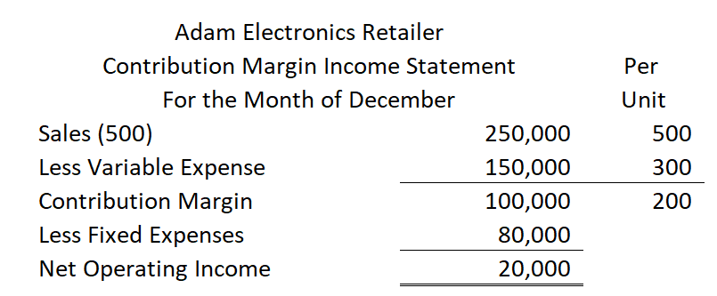
Contribution margin is needed for Adam id cover his fixed expenses. Otherwise, no profit!
Contribution margin per unit = 200. This is important to understand.
Need to fill the fixed cost bucket before the CM pours into the profit bucket
How many units do you need to sell to fill the fixed cost bucket?
80,000/200 Cm/Unit = 400 Tablets
Student or CPA Candidate?
www.farhatlectures.com

Slide 3
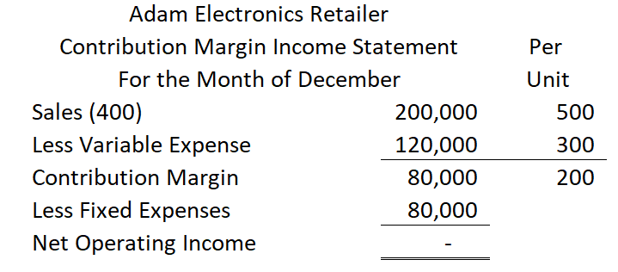
Break-even: Profit = 0
CM = Fixed Cost
What happens if we sell one tablet about 400?
Profit = (CM X Q) – Fixed cost
For each additional tablet, we make a profit of $200.
Profit = (440 X 200) – 80,000 = 8,000.
What is my profit if Adam sells 440 tablets?
40 X 200 = 8,000. No need for contribution income statement
Student or CPA Candidate?
www.farhatlectures.com

Slide 4
Assumptions (SIMPLIFYING)
Selling price does not change with volume
Costs are strictly variable and fixed.
In multi-product companies the sales mix is constant
Student or CPA Candidate?
www.farhatlectures.com

