Slide 1

Supplemental Disclosures: Balance Sheet
Four types of information that are supplemental to account titles and amounts presented in the balance sheet:
Contingencies
Summary of accounting policies,
contractual situations, and
fair values provide for elaboration or qualification of items listed in the balance sheet.
For more lectures, visit:
www.farhatlectures.com

Slide 2

Contingency
Is defined as an existing situation involving uncertainty as to possible gain (gain contingency) or loss (loss contingency) that will ultimately be resolved when one or more future events occur or fail to occur
  In short, they are uncertain occurrences that may have a material effect on financial position
    Lawsuit
    Guaranteeing the debt of other
    Environmental
For more lectures, visit:
www.farhatlectures.com

Slide 3
Summary of Accounting Policies
The methods used to value assets and allocate costs vary considerably among balance sheet accounts.
To help users of the financial statements understand and evaluate financial statement components and their relationships, these valuation methods are normally disclosed in a separate Summary of Significant Accounting Policies preceding the financial statement notes.
    For instance, companies can compute inventories under several cost flow assumptions (e.g., LIFO and FIFO),
    depreciate plant and equipment under several accepted methods (e.g., double-declining-balance and straight-line), and
    carry investments at different valuations (e.g., amortized cost, equity, and fair value).
Sophisticated users of financial statements know of these possibilities and examine the statements closely to determine the methods used.
Companies must also disclose information about the nature of their operations, the use of estimates in preparing financial statements, certain significant estimates, and vulnerabilities due to certain concentrations.
For more lectures, visit:
www.farhatlectures.com

Slide 4
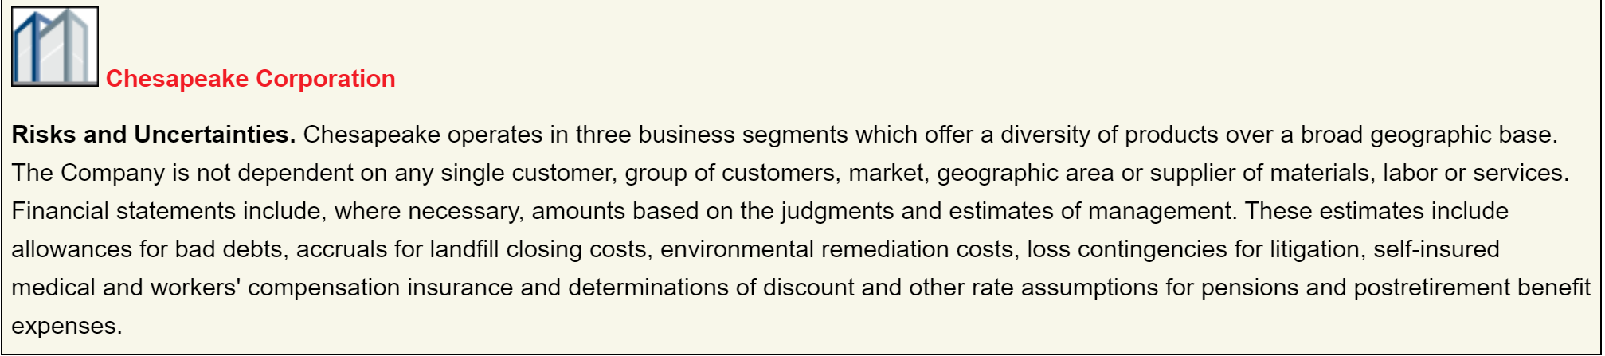

Slide 5

Contractual Situation
Contractual situations of significance should be disclosed.
For example, they must clearly state the essential provisions of
  lease contracts,
  pension obligations, and
  stock compensation plans in the notes.
Analysts want to know not only the amount of the liabilities but also how the different contractual provisions affect the company at present and in the future.
Companies must disclose the following commitments if the amounts are material:
  commitments related to obligations to maintain working capital,
  to limit the payment of dividends,
  to restrict the use of assets, and
  to require the maintenance of certain financial ratios.
Management must exercise considerable judgment to determine whether omission of such information is misleading.
The rule in this situation is, “When in doubt, disclose.” It is better to disclose a little too much information than not enough.
For more lectures, visit:
www.farhatlectures.com

Slide 6

Fair Value Disclosure
Financial instruments are defined as cash, an ownership interest, or a contractual right to receive or obligation to deliver cash or another financial instrument.
Companies are to follow a fair value hierarchy that provides insight into how to determine fair values.
Level 1:
  measures (the most reliable) are based on observable inputs, such as market price for identical assets or liabilities.
Level 2:
  measures (less reliable) are based on marketbased inputs other than those included in Level 1, such as those based on market prices for similar assets or liabilities.
Level 3:
  measures (least reliable) are based on unobservable inputs, such as a company’s own data or assumptions. In addition, companies must provide significant additional disclosure related to Level 3 measurements.
For more lectures, visit:
www.farhatlectures.com

Slide 7

Methods or Techniques for Disclosures
Effective communication of the information required to be disclosed in financial statements is an important consideration.
Accountants have developed certain methods that have proven useful in disclosing pertinent information. (Auditors, Analysts, Users)
The methods are:
parenthetical explanations,
notes,
cross reference and contra items, and
supporting schedules.
For more lectures, visit:
www.farhatlectures.com

Slide 8

Parenthetical Explanations
For more lectures, visit:
www.farhatlectures.com

Slide 9
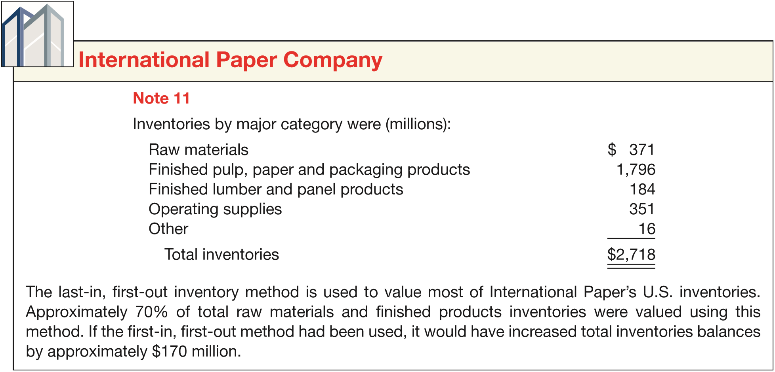
Notes
For more lectures, visit:
www.farhatlectures.com

Slide 10
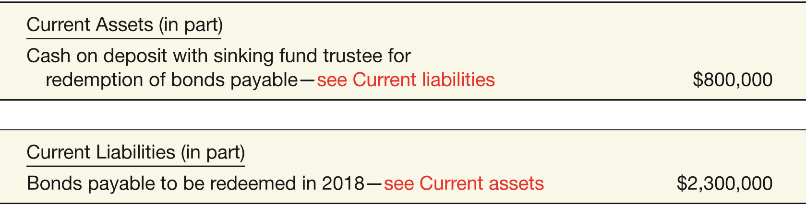
Cross-Reference and Contra Items
For more lectures, visit:
www.farhatlectures.com

Slide 11
Contra Items
  A contra account on a balance sheet reduces either an asset, liability, or owners’ equity account. Examples include
  Accumulated Depreciation—Equipment and Discount on Bonds Payable.
  An adjunct account increases either an asset, liability, or owners’ equity account. An example is
  Premium on Bonds Payable.
For more lectures, visit:
www.farhatlectures.com

Slide 12
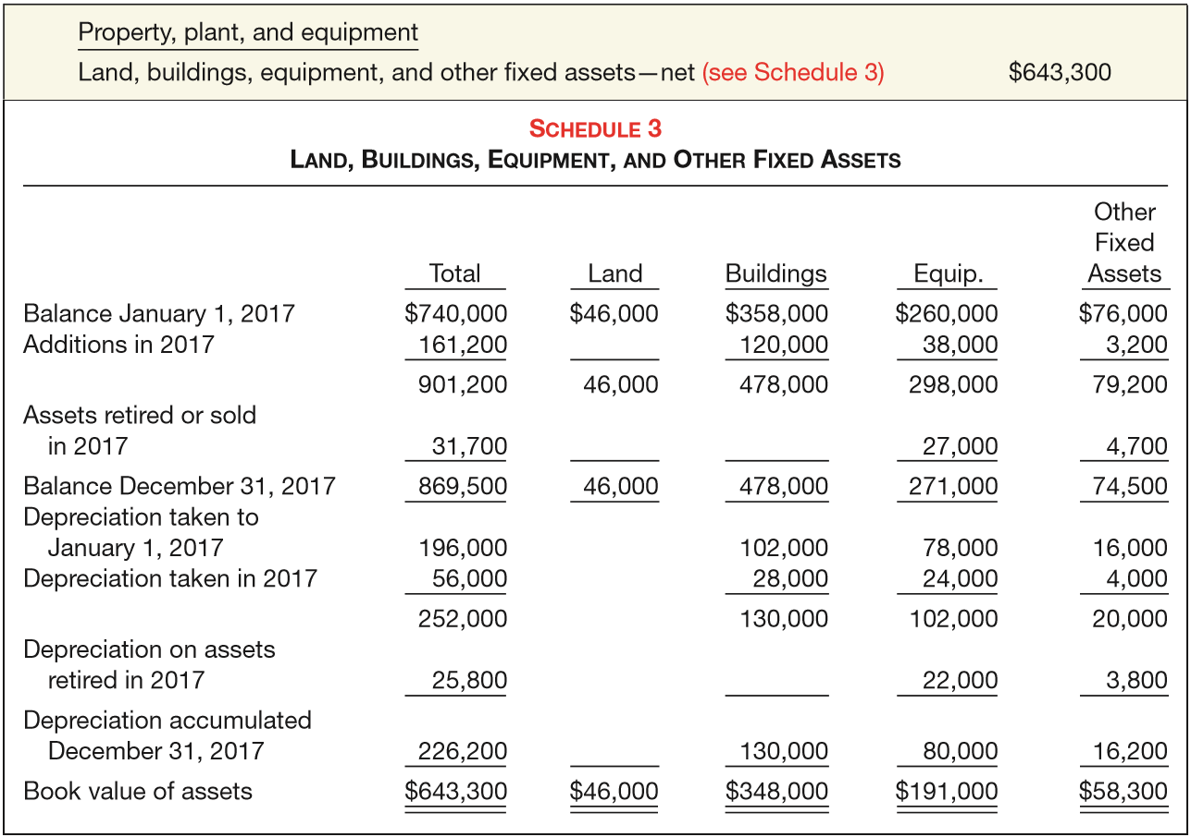
Supporting Schedule
For more lectures, visit:
www.farhatlectures.com

