Slide 1

Proprietary Funds: Enterprise Funds (1 of 2)
These funds are used to account for government activities that operate like businesses, charging fees for goods or services provided to the public.
  Examples include public utilities (water, sewer, or electricity), public transportation systems, or municipal parking facilities.
Accrual (LT assets and LT debt)
For more, visit
www.farhatlectures.com

Slide 2
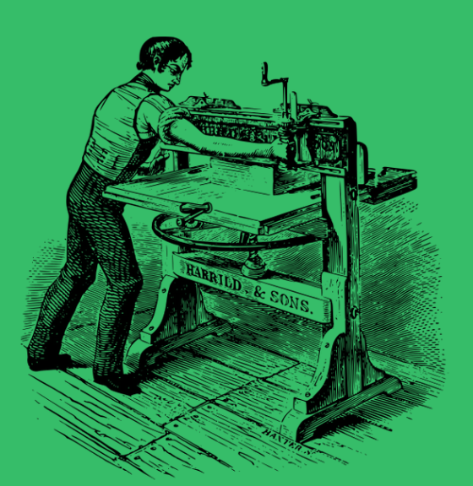
Proprietary Funds: Internal Service Funds (2 of 2)
These funds account for goods or services provided by one department or agency to other departments or agencies within the government on a cost-reimbursement basis.
  Examples include centralized services such as vehicle maintenance, information technology support, or printing services.
Accrual (LT assets and LT debt)
For more, visit
www.farhatlectures.com

