Slide 1

MCQ from Farhatlectures.com
Adam Inc has developed and patented a computer chip that allows telecommunication in sports events to become more efficient. Adam Inc agrees to sell the patent to the 49ers for five annual payments of 50,000 each. The payments are to begin at the end of the third year starting from today. Given a 6% interest rate, what is the present value of the payments?
a. 186,760
b. 190,278
c. 187,434
d. 162,715
Lectures + MCQs @ farhatlectures.com ➔ Free Trial

Slide 2
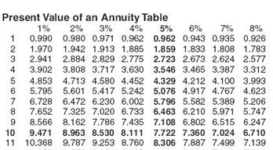
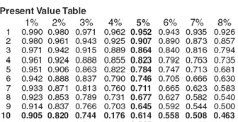
Lectures + MCQs @ farhatlectures.com ➔ Free Trial

Slide 3
MCQ from Farhatlectures
What amount should George invest now at 12% to provide 5 payments of $5,000 at the end of each year, starting 3 years from now?
11,350
12,829
10,450
14,306
Lectures + MCQs @ farhatlectures.com ➔ Free Trial

Slide 4
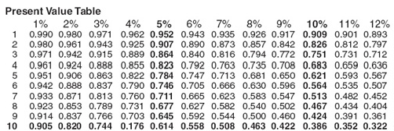
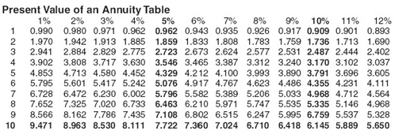
Lectures + MCQs @ farhatlectures.com ➔ Free Trial

