Slide 1

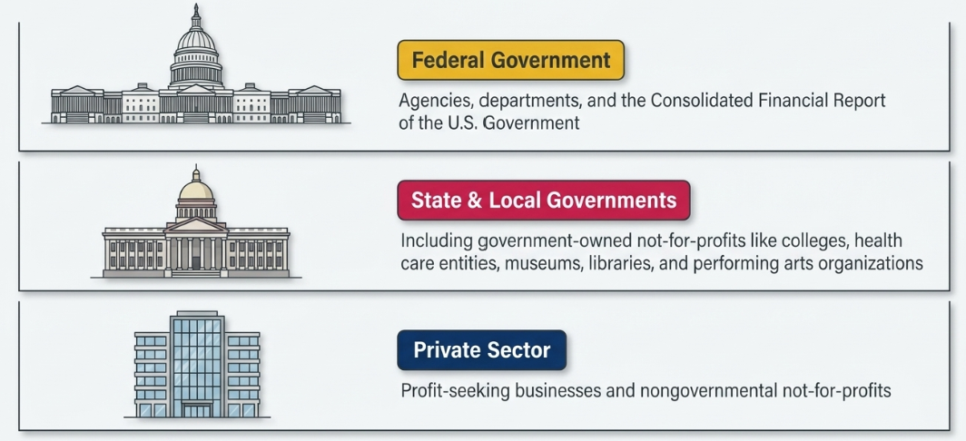
Governmental Accounting Standard Board-GASB
📹 Videos AICPA MCQs & Sims 🤖 Farhat AI Assistant🎙 Podcast Lessons 📊 CPA, CMA, EA Exam 💼Accounting & Finance Courses 🙌 Support by Farhat Team
🌐 farhatlectures.com | ⭐ Start Your Free Trial

Slide 2
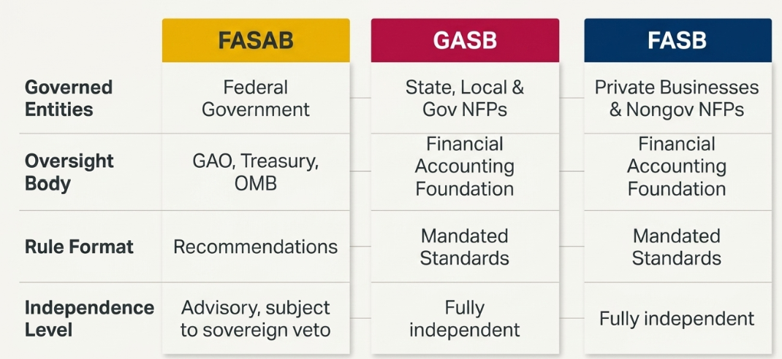
The Three Stannard Setting
Federal Accounting Standards Advisory Board (FASAB)
📹 Videos AICPA MCQs & Sims 🤖 Farhat AI Assistant🎙 Podcast Lessons 📊 CPA, CMA, EA Exam 💼Accounting & Finance Courses 🙌 Support by Farhat Team
🌐 farhatlectures.com | ⭐ Start Your Free Trial

Slide 3
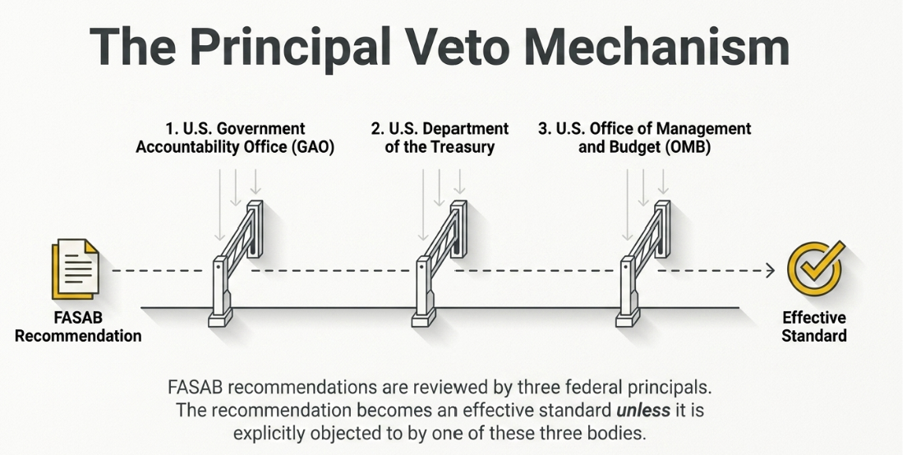
📹 Videos AICPA MCQs & Sims 🤖 Farhat AI Assistant🎙 Podcast Lessons 📊 CPA, CMA, EA Exam 💼Accounting & Finance Courses 🙌 Support by Farhat Team
🌐 farhatlectures.com | ⭐ Start Your Free Trial

Slide 4
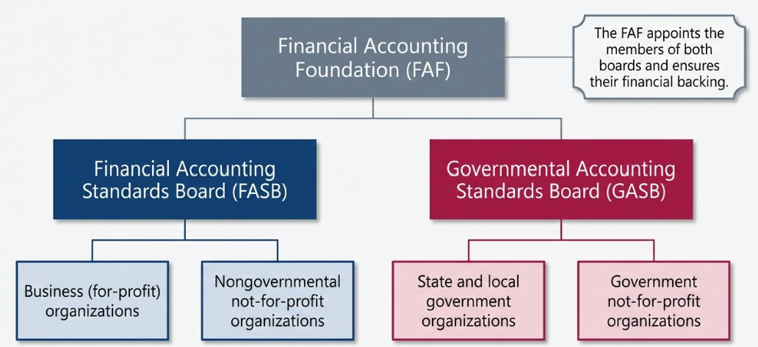
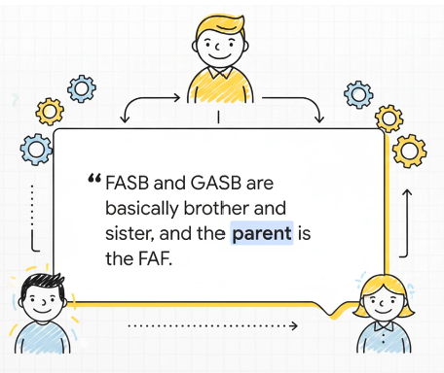
📹 Videos AICPA MCQs & Sims 🤖 Farhat AI Assistant🎙 Podcast Lessons 📊 CPA, CMA, EA Exam 💼Accounting & Finance Courses 🙌 Support by Farhat Team
🌐 farhatlectures.com | ⭐ Start Your Free Trial
Notes:
Business for-profit organizations include Apple Inc. and Walmart Inc. These companies operate to earn profits for their owners or shareholders and generally follow FASB accounting standards.
Nongovernmental not-for-profit organizations include the American Red Cross and Harvard University. These organizations are not owned or controlled by a government and do not distribute profits to owners. They generally follow FASB accounting standards for not-for-profit organizations. Desales University
State and local government organizations include the City of Philadelphia and the Commonwealth of Pennsylvania. These governmental entities provide public services and obtain much of their funding from taxes and other public revenues. They follow GASB accounting standards.
Government not-for-profit organizations include the University of California system, WCU and NYC Health + Hospitals. These organizations provide services without a profit objective, but they are created, controlled, or financially supported by a state or local government. They generally follow GASB accounting standards.

Slide 5
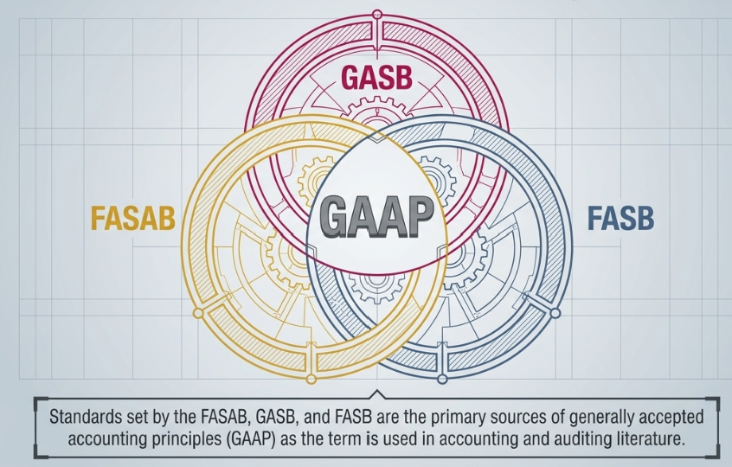
Where does GAAP Fit?
📹 Videos AICPA MCQs & Sims 🤖 Farhat AI Assistant🎙 Podcast Lessons 📊 CPA, CMA, EA Exam 💼Accounting & Finance Courses 🙌 Support by Farhat Team
🌐 farhatlectures.com | ⭐ Start Your Free Trial

Slide 6
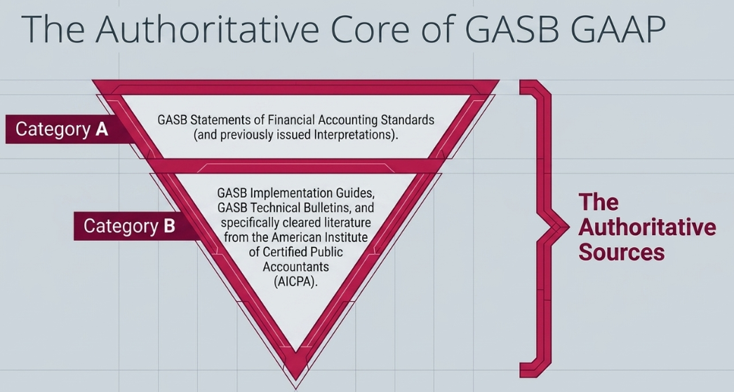
📹 Videos AICPA MCQs & Sims 🤖 Farhat AI Assistant🎙 Podcast Lessons 📊 CPA, CMA, EA Exam 💼Accounting & Finance Courses 🙌 Support by Farhat Team
🌐 farhatlectures.com | ⭐ Start Your Free Trial

Slide 7
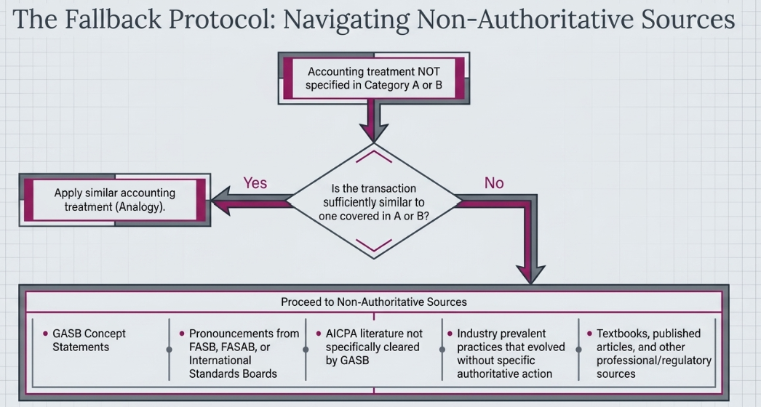
📹 Videos AICPA MCQs & Sims 🤖 Farhat AI Assistant🎙 Podcast Lessons 📊 CPA, CMA, EA Exam 💼Accounting & Finance Courses 🙌 Support by Farhat Team
🌐 farhatlectures.com | ⭐ Start Your Free Trial

